Slide 1
Respiratory Protection
User Training – Pest Control
Presented by:
Notes:
1
Revised 2/2022
The information in this presentation is provided voluntarily by PestSure Safety and loss prevention as a service and is made available in good faith. This presentation is designed to assist trainers conducting respirator training for pest control technicians. Since workers are the target audience, this presentation emphasizes hazard identification, avoidance, and control – not standards. No attempt has been made to treat the topic exhaustively. It is essential that trainers tailor their presentations to the needs and understanding of their audience.
TRAINER: OBTAIN THESE HANDOUTS FOR USE IN THIS CLASS:
Appendix A to § 1910.134: Fit Testing Procedures
Appendix B-1 to § 1910.134: User Seal Check Procedures
Appendix B-2 to § 1910.134: Respirator Cleaning Procedures
Appendix C to § 1910.134: OSHA Respirator Medical Evaluation Questionnaire
Appendix D to § 1910.134: Information for Employees Using Respirators When Not Required Under the Standard

Slide 2
Objectives
1910.134
At the end of this course, students should be aware of :
Potential respiratory hazards in your workplace
Respirator type/use and limitations
Identifying medical signs and symptoms that limit use
Hands on Practice:
Putting on your respirator and properly adjusting it
Conducting your user seal check
How we use, maintain, store and care for our respirators

Slide 3
Part 1
1910.134(c)
Our Respiratory Safety Program Administrator is:

Slide 4
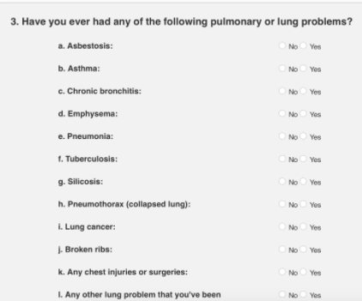
Part 2
1910.134(e)
Medical Evaluation

Slide 5
Why Have Medical Evaluations?
1910.134(e)
A respirator places a physiological burden on the user.
This burden varies with:
Type of respirator worn.
Job and workplace conditions.
Medical status of the employee.
You will have a medical evaluation prior to fit testing.

Slide 6
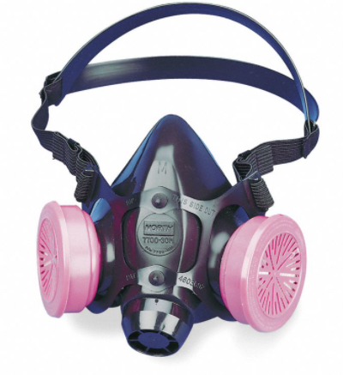
Physiological Effects
Pulmonary
Cardiovascular
Body temperature
Senses
Psychological
Irritation and allergy

Slide 7
Medical Evaluation
1910.134(e)
Establishes the medical condition of the wearer.
Provided before initial respirator use.
Prior to fit testing and training.
Performed by a physician or other licensed health care professional (PLHCP).

Slide 8
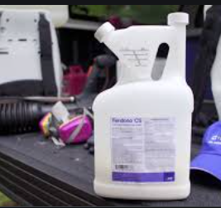
Part 3
1910.134(d)
Selection

Slide 9
Hazard Determination
1910.134(d)
Identify the contaminants and evaluate the hazards.
Determine the physical properties of the contaminants.
Identify areas of potential oxygen (O₂) deficiency.
Estimate or measure employee’s exposure to the hazards.

Slide 10
Hazards Requiring Respirator Use
Oxygen-deficient atmosphere
Does not contain enough oxygen to sustain breathing. (<19.5 percent by volume at sea level).
Examples:
Confined spaces
Silos
Boilers
Tanks
Sewers
Immediately dangerous to life or health (IDLH) or unknown atmosphere.

Slide 11
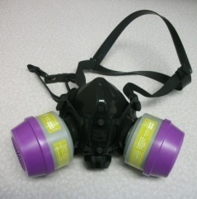
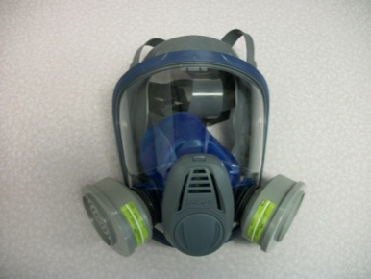
Hazards Requiring Respirator Use
Chemical hazards
Overexposure to workplace contaminants such as: dust, spray, fumes, vapors, smoke, harmful gases.
Biological hazards
Exposure to organisms such as bacteria, viruses, fungi and other living organisms. (These organisms do not have exposure limits.)
NCDOL Photo Library
NCDOL Photo Library

Slide 12
Hierarchy of Controls
1910.134(d)
Engineering controls
Example:
Ventilation
Administrative/work practice controls
Examples:
Rotating employees to reduce exposure time.
Limiting the time someone can work in an area.
Changing the way the work process is conducted.
Personal protective equipment (PPE)
Used when unable to eliminate or reduce the hazard sufficiently.

Slide 13
What is a Respirator?
A device that protects workers by purifying air or by providing an air supply (O2 deficiency or IDLH conditions).
Two main types of respirator:
Air-purifying respirators remove contaminants from breathing air through a filter, cartridge or canister.
Supplied-air respirators provide clean air from an uncontaminated source such as bottle or compressor.

Slide 14
Selection
1910.134(d)(1)
Select the appropriate respirator based on the hazard, workplace and user factors.
Select only NIOSH-certified respirators.
Provide sufficient number of respirator models and sizes to correctly fit user.
NCDOL Photo Library
NCDOL Photo Library
Notes:
.

Slide 15
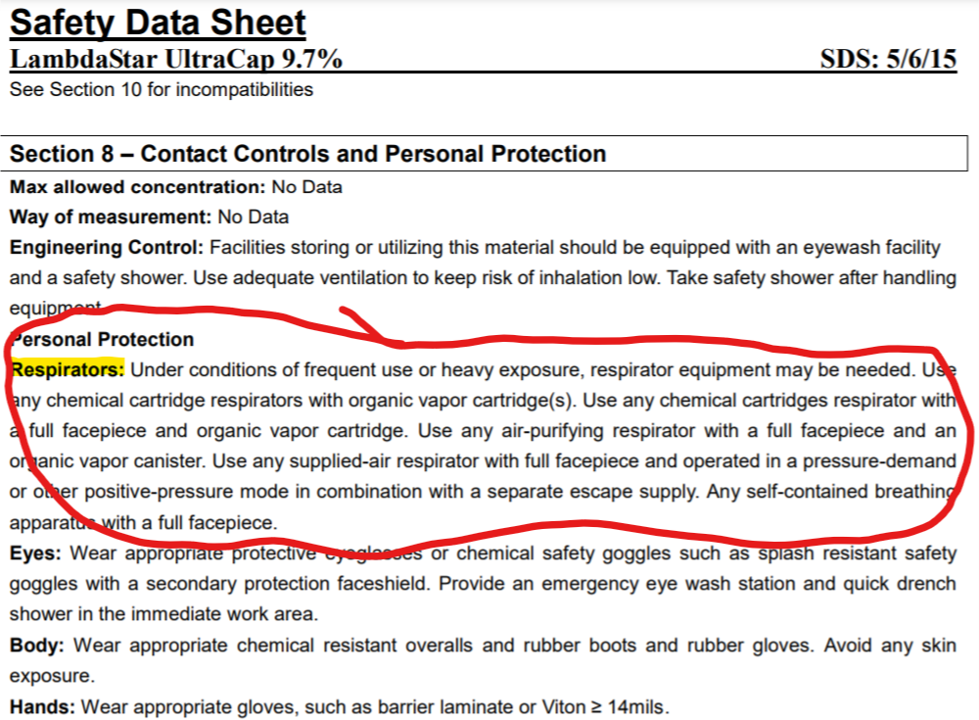
The SDS: information in Section 8

Slide 16
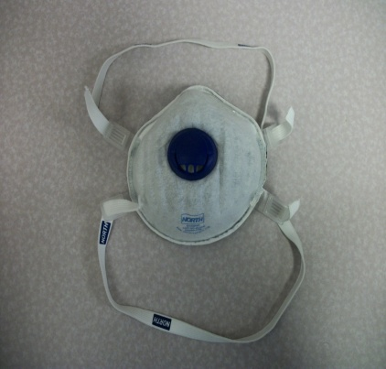
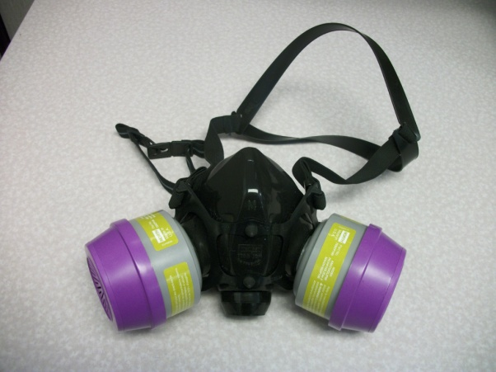
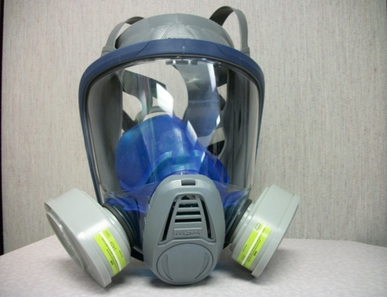
Air-Purifying Respirators (APR)
1910.134
NCDOL Photo Library
NCDOL Photo Library
NCDOL Photo Library
Filtering
Facepiece
Half Mask Respirator
(with Combination Cartridges)
Full Facepiece Respirator
(with Organic Vapor Cartridges)

Slide 17
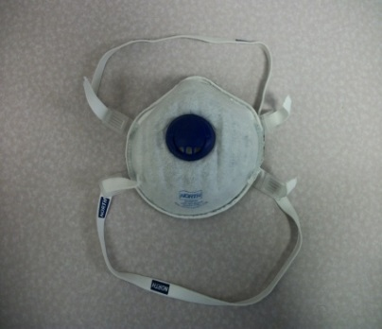
Filtering Facepiece (Dust Mask)
1910.134
Negative pressure particulate respirator
with entire or majority of face piece
composed of a filtering medium..
Captures particles in the air, such as
dusts, aerosols, mists, and fumes.
Filters will be labeled with a letter N, R or P
and a number representing the efficiency: 95, 99 or 100.
Does not protect against gases or vapors.
Replace filters when the user finds it difficult to breathe.
NCDOL Photo Library

Slide 18
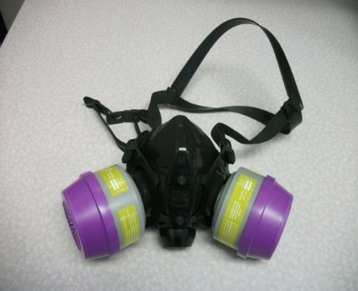
Respirators with Combination Cartridges
1910.134
Full Facepiece and Half Mask
Used in atmospheres that contain both
particulates and gases or vapors.
Have both particulate filters and gas/vapor
cartridges or canisters.
Not for use in oxygen-deficient atmospheres or atmospheres which have high concentrations of contaminants (such as IDLH).
Breathing may become difficult because of the additional effort required to draw air through the purifying medium.
NCDOL Photo Library

Slide 19
Respirators with Organic Vapor Cartridges
1910.134
Full Facepiece and Half Mask
Does not protect against airborne particles.
Provides protection only as long as the filter’s absorbing capacity is not depleted.
Uses chemical filters (called cartridges or canisters) to remove specific dangerous gases or vapors.
Service life of the filter depends upon
many factors and can be estimated in
various ways.
NCDOL Photo Library

Slide 20
Cartridge/Canister Service Life
1910.134(j)
Conditions affecting service life:
Exertion level
Cartridge variability
Temperature
Humidity
Multiple contaminants

Slide 21
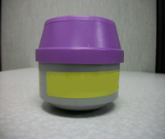
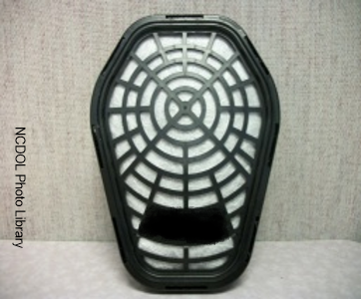
Filters/Cartridges/Canister Labels
1910.134(j)
Only NIOSH approved.
Labeled and color coded.
Label shall not be removed and remains legible.
NCDOL Photo Library

Slide 22
Part 4 Training and Information

Slide 23
Training and Information
1910.134(k)(1)
Why the respirator is necessary and how improper fit, usage, or maintenance can compromise the protective effect of the respirator.
Limitations and capabilities of the respirator.
How to effectively use the respirator in emergencies.

Slide 24
Training and Information
1910.134(k)(1)
How to inspect, don, doff, use, perform seal checks.
Maintenance and storage procedures.
How to recognize medical signs and symptoms that may limit or prevent the effective use of respirator.
https://youtu.be/LII-z2WJ4Dc

Slide 25
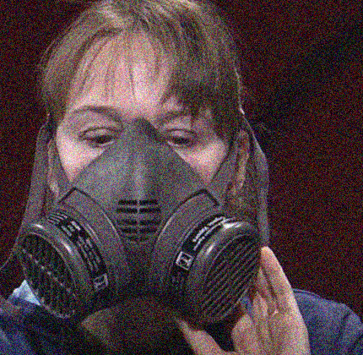
Part 5 Fit Testing
1910.134(f)

Slide 26
When is Fit Testing Required?
1910.134(f)
Before initial use
Annually, thereafter
When facial features change, such as with weight gain or loss, use of dentures
Note: Employees wearing tight-fitting face-pieces
must not be fit tested if they have facial hair *

Slide 27
Qualitative Fit Test (QLFT)
1910.134(f)
A pass/fail fit test to assess the adequacy of respirator fit that relies on the individual’s response to the test agent.
Must not be used if a person has no sense of taste or smell.
Used for respirators requiring a fit factor of 100 or less.

Slide 28
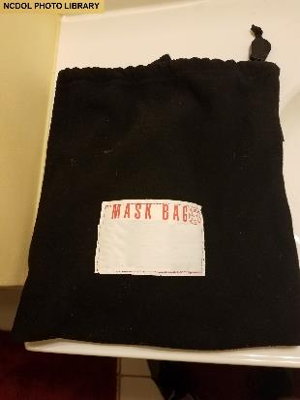
Part 6 Maintenance and Care
1910.134(h)

Slide 29
Cleaning and Disinfecting
1910.134(h)(1)
Respirators must be clean, sanitary, and in good working order.
Respirators must be cleaned and disinfected using the procedures on the next 2 slides or procedures recommended by the respirator manufacturer.

Slide 30
Respirator Cleaning

Slide 31
Respirator Cleaning - continued
https://youtu.be/ScvkveNQqMc

Slide 32
Cleaning and Disinfecting
1910.134(h)(1)
Respirators cleaned and disinfected at the following intervals:
If exclusive use by employee – as often as necessary to be maintained in a sanitary condition.
If shared by employees – prior to each use by different employee.
If for emergency use – after each use.
If used for training and fit testing – between each employee and at the end of each training/fit testing session.

Slide 33
Storage
1910.134(h)(2)
Respirators must be protected from:
Dust
Sunlight
Heat
Cold
Moisture
Chemicals
Stored in a sealed container or bag
Notes:
.

Slide 34
Inspection
1910.134(h)(3)
Check for:
Holes in the filters
Loss of elasticity or tears in the head straps and hoses
Broken or loose connectors and fittings
Cracked or scratched face pieces
Detergent residue
Dirt in the valves
General cleanliness

Slide 35
Repairs
1910.134(h)(4)
Respirators that fail an inspection or are otherwise found to be defective are removed from service and discarded or repaired/adjusted.
Repairs made only by appropriately trained persons.
Use only respirator manufacturer’s NIOSH-approved parts.
Notes:
.

Slide 36
Part 7
1910.134(g)
Use
Notes:
.

Slide 37
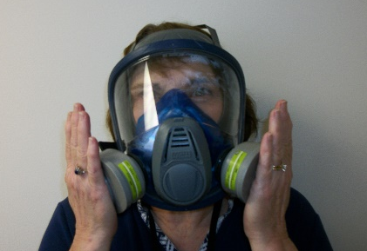
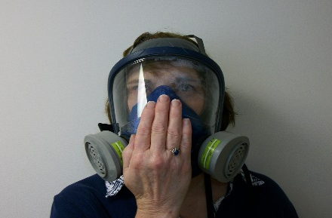
Use of Respirators
1910.134(g)
Always put respirator on in clean air environment.
Always seal-check the respirator to make sure proper fit has been achieved for tight-fitting respirators.
Two types of user seal checks (demonstrate):
NCDOL photo library
NCDOL photo library
Negative Pressure
Positive Pressure

Slide 38
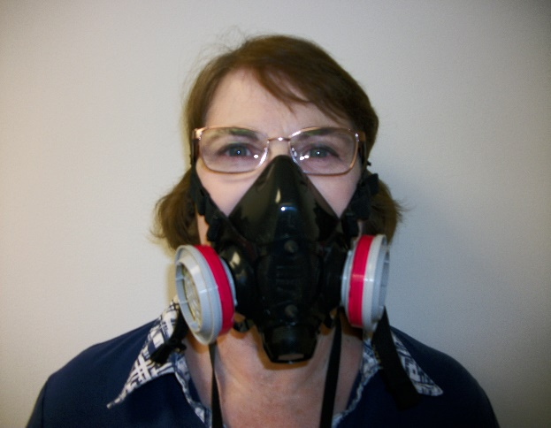
Use
1910.134(g)(1)
Respirators are only effective when the seal around your nose and mouth is tight.
If you cannot achieve proper fit, do not enter the contaminated area.
Facial hair cannot inhibit the seal when wearing a tight-fitting respirator.
Glasses cannot be worn with
a full-face respirator.
Spectacle kit required
NCDOL photo library

Slide 39
Use
1910.134(g)(2)
Leave the contaminated atmosphere if any of the following occurs:
Smell or taste something out of the ordinary
Eyes or throat become irritated
Observe a change in breathing
Face piece is leaking or other parts break

Slide 40
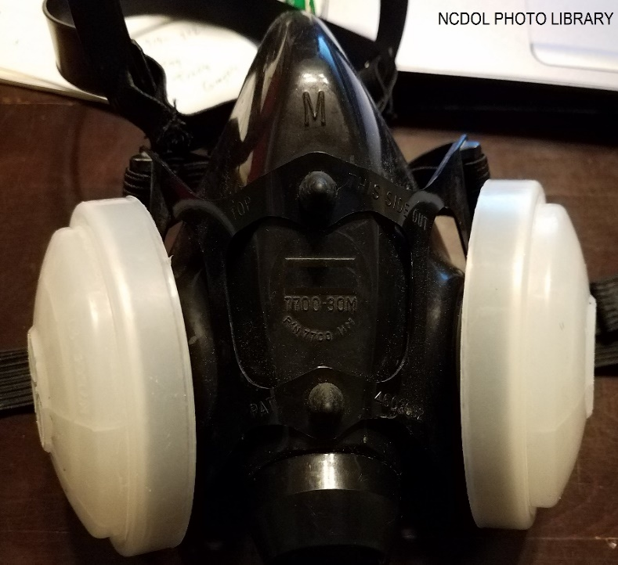
Part 10
1910.134(c)
Voluntary Use
Notes:
1910.134(o) and 1910.134 Appendix D

Slide 41
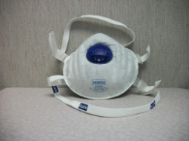
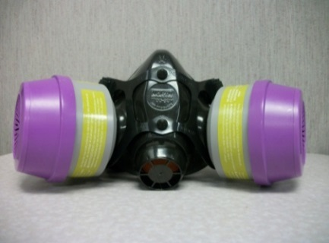
Voluntary Use
1910.134(c)(2)
For all respirators, the employer must:
Determine that voluntary use is appropriate.
Ensure that use of the selected respirator will not create a hazard.
Provide employees with information in Appendix D.
For all respirators except filtering face pieces, the employer will address:
Medical evaluations, and
Training on maintenance, storage and care.
NCDOL Photo Library
NCDOL Photo Library

Slide 42
Handouts Trainer – obtain from program administrator for use in this class
1910.134
Appendix A to § 1910.134: Fit Testing Procedures
Appendix B-1 to § 1910.134: User Seal Check Procedures
Appendix B-2 to § 1910.134: Respirator Cleaning Procedures
Appendix C to § 1910.134: OSHA Respirator Medical Evaluation Questionnaire
Appendix D to § 1910.134: Information for Employees Using Respirators When Not Required Under the Standard

Slide 43
Objectives
1910.134
At the end of this course, students should be aware of :
Potential respiratory hazards in your workplace
Respirator type/use and limitations
Identifying medical signs and symptoms that limit use
Hands on Practice
Putting on your respirator and properly adjusting it
Conducting your user seal check
How we use, maintain, store and care for our respirators

Slide 44
Please ask any questions.
Discussion?
Notes:
44

