Slide 1
Respiratory Protection
29 CFR 1910.134
Presented by:
Notes:
1
Revised 12/2021
The information in this presentation is provided voluntarily by the N.C. Department of Labor, Education Training and Technical Assistance Bureau as a public service and is made available in good faith. This presentation is designed to assist trainers conducting OSHA outreach training for workers. Since workers are the target audience, this presentation emphasizes hazard identification, avoidance, and control – not standards. No attempt has been made to treat the topic exhaustively. It is essential that trainers tailor their presentations to the needs and understanding of their audience.
The information and advice provided on this Site and on Linked Sites is provided solely on the basis that users will be responsible for making their own assessment of the matters discussed herein and are advised to verify all relevant representations, statements, and information.
This presentation is not a substitute for any of the provisions of the Occupational Safety and Health Act of North Carolina or for any standards issued by the N.C. Department of Labor. Mention of trade names, commercial products, or organizations does not imply endorsement by the N.C. Department of Labor.

Slide 2
Objectives
1910.134
At the end of this course, students should be aware of the requirements for:
  Written respiratory protection program
  Selection and types of respirators
  Medical evaluations and fit testing
  Use, maintenance and care of respirators
  Training employees
  Program evaluation
  Recordkeeping

Slide 3
Ten Parts of an Effective Respirator Program

Slide 4

Part 1
1910.134(c)
Someone in Charge

Slide 5
Someone in Charge
1910.134(c)
Written program must be implemented by a trained program administrator.
  Must be qualified.
  Know the hazards in the workplace and if engineering controls can be applied.
  Identify types of respirators to be used
  if engineering controls will not work.
Update as necessary.

Slide 6
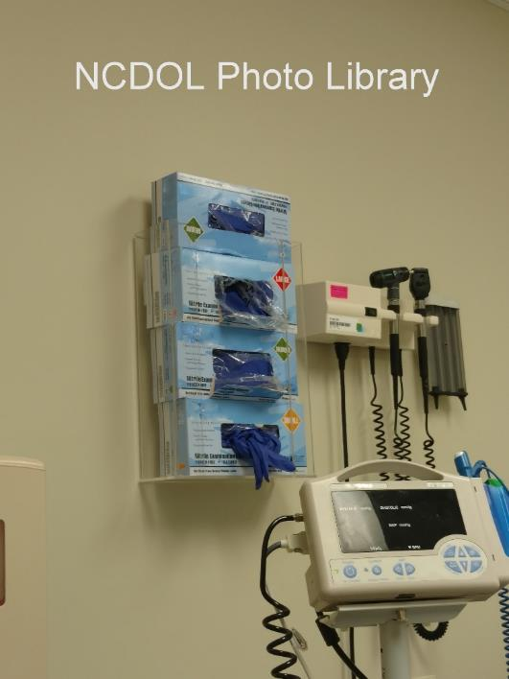
Part 2
1910.134(e)
Medical Evaluation

Slide 7
Why Have Medical Evaluations?
1910.134(e)
A respirator places a physiological burden on the employee.
This burden varies with:
  Type of respirator worn.
  Job and workplace conditions.
  Medical status of the employee.

Slide 8
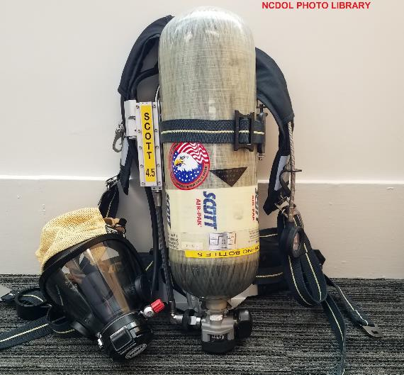
Physiological Effects
Pulmonary
Cardiovascular
Body temperature
Senses
Psychological
Irritation and allergy

Slide 9
Medical Evaluation
1910.134(e)
Establishes the medical condition of the wearer.
Provided before initial respirator use.
Prior to fit testing and training.
Performed by a physician or other licensed health care professional (PLHCP).
  OSHA Respirator Medical Evaluation Questionnaire; Appendix C or
  Initial medical examination.

Slide 10
Follow-Up Medical Examinations
1910.134(e)(3)
Required if:
  Positive response to questions 1 - 8 in Section 2, Part A of Appendix C.
  Initial medical examination indicates need for follow-up physical.
Must include any medical tests, consultations or diagnostic procedures PLHCP deems necessary.

Slide 11
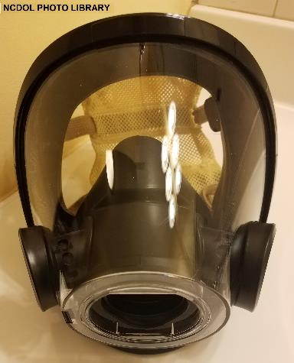
Part 3
1910.134(d)
Selection

Slide 12
Hazard Determination
1910.134(d)
Identify the contaminants and evaluate the hazards.
Determine the physical properties of the contaminants.
Identify areas of potential oxygen (O₂) deficiency.
Estimate or measure employee’s exposure to the hazards.
  Assume IDLH, when not known*

Slide 13
Hazards Requiring Respirator Use
Oxygen-deficient atmosphere
  Does not contain enough oxygen to sustain breathing. (<19.5 percent by volume at sea level).
    Examples:
      Confined spaces
      Silos
      Boilers
      Tanks
      Sewers
Immediately dangerous to life or health (IDLH) or unknown atmosphere.

Slide 14
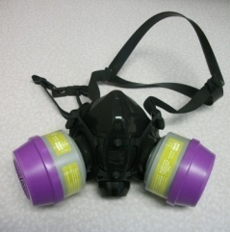
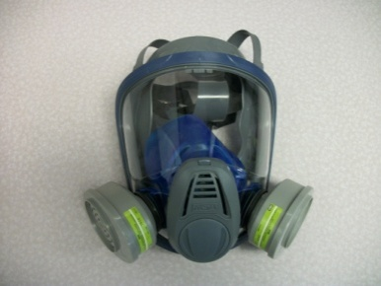
Hazards Requiring Respirator Use
Chemical hazards
  Overexposure to workplace contaminants such as: dust, spray, fumes, vapors, smoke, harmful gases.
Biological hazards
  Exposure to organisms such as bacteria, viruses, fungi and other living organisms. (These organisms do not have exposure limits.)
NCDOL Photo Library
NCDOL Photo Library

Slide 15
Hierarchy of Controls
1910.134(d)
Engineering controls
  Example:
    Ventilation
Administrative/work practice controls
  Examples:
    Rotating employees to reduce exposure time.
    Limiting the time someone can work in an area.
    Changing the way the work process is conducted.
Personal protective equipment (PPE)
  Used when unable to eliminate or reduce the hazard sufficiently.

Slide 16
Selection
1910.134(d)(1)
Select the appropriate respirator based on the hazard, workplace and user factors.
Select only NIOSH-certified respirators.
Provide sufficient number of respirator models and sizes to correctly fit user.
NCDOL Photo Library
NCDOL Photo Library
Notes:
.

Slide 17
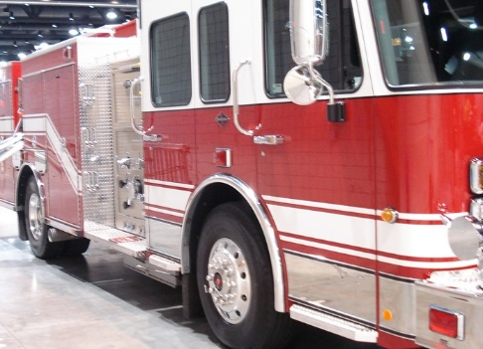
Interior Structural Firefighting
1910.134(g)(4)
At least two employees enter IDLH atmosphere (two-in).
Must remain in visual or voice contact with one another.
At least two employees remain outside IDLH atmosphere (two-out).
Must use pressure demand SCBAs.
Does not preclude emergency rescue of human beings before entire team assembles.
NCDOL Photo Library

Slide 18
What is a Respirator?
A device that protects workers by purifying air or by providing an air supply (O2 deficiency or IDLH conditions).
Two main types of respirator:
  Air-purifying respirators remove contaminants from breathing air through a filter, cartridge or canister.
  Supplied-air respirators provide clean air from an uncontaminated source such as bottle or compressor.

Slide 19
Breathing Air Use
1910.134(i)
Compressors
  If oil lubricated:
    CO alarm, high temperature alarm or both.
    If only high temperature alarm, must monitor for CO at sufficient intervals.
  If non-oil lubricated:
    Employer shall ensure that the CO level is < 10 ppm.
  Breathing air couplings must be incompatible with those for non-respirable air or other gas systems.

Slide 20
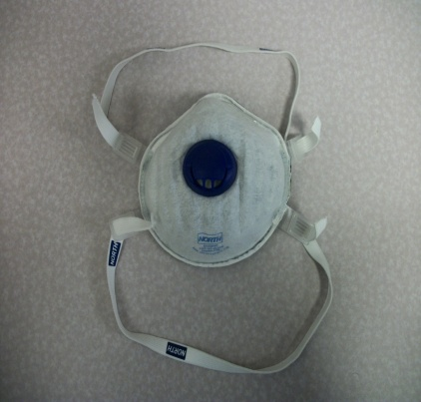
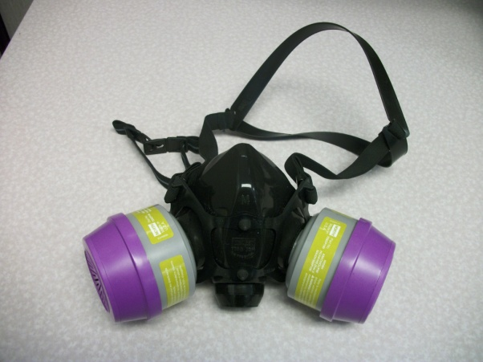
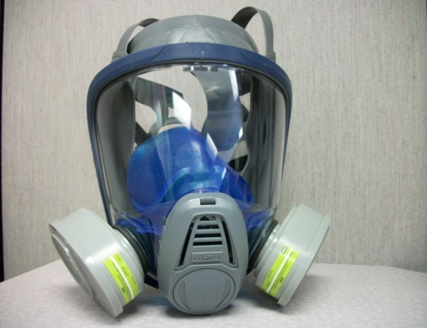
Air-Purifying Respirators (APR)
1910.134
NCDOL Photo Library
NCDOL Photo Library
NCDOL Photo Library
Filtering
Facepiece
Half Mask Respirator
(with Combination Cartridges)
Full Facepiece Respirator
(with Organic Vapor Cartridges)

Slide 21
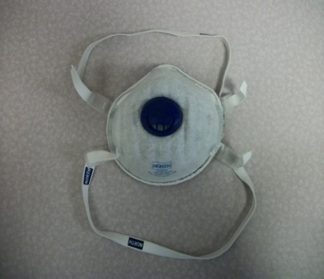
Filtering Facepiece (Dust Mask)
1910.134
Negative pressure particulate respirator
with entire or majority of face piece
composed of a filtering medium..
Captures particles in the air, such as
dusts, aerosols, mists, and fumes.
Filters will be labeled with a letter N, R or P
and a number representing the efficiency: 95, 99 or 100.
Does not protect against gases or vapors.
Replace filters when the user finds it difficult to breathe.
NCDOL Photo Library

Slide 22
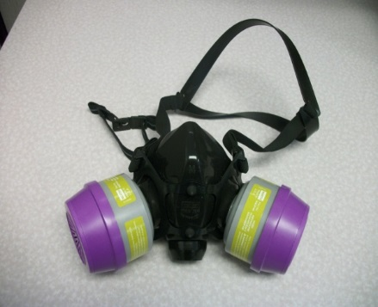
Respirators with Combination Cartridges
1910.134
Full Facepiece and Half Mask
  Used in atmospheres that contain both
  particulates and gases or vapors.
  Have both particulate filters and gas/vapor
  cartridges or canisters.
  Not for use in oxygen-deficient atmospheres or atmospheres which have high concentrations of contaminants (such as IDLH).
  Breathing may become difficult because of the additional effort required to draw air through the purifying medium.
NCDOL Photo Library

Slide 23

Respirators with Organic Vapor Cartridges
1910.134
Full Facepiece and Half Mask
  Does not protect against airborne particles.
  Provides protection only as long as the filter’s absorbing capacity is not depleted.
  Uses chemical filters (called cartridges or canisters) to remove specific dangerous gases or vapors.
  Service life of the filter depends upon
  many factors and can be estimated in
  various ways.
NCDOL Photo Library

Slide 24
Powered-Air Purifying Respirator (PAPR)
1910.134
An air-purifying respirator with a blower to force the ambient air through air-purifying elements to the inlet covering.
Can be a full and half-mask facepiece, helmet or hood.
Use restricted to battery life and the fan and
pack must be carried by the wearer at
all times.
Cannot be used in oxygen deficient or IDLH atmospheres.

Slide 25
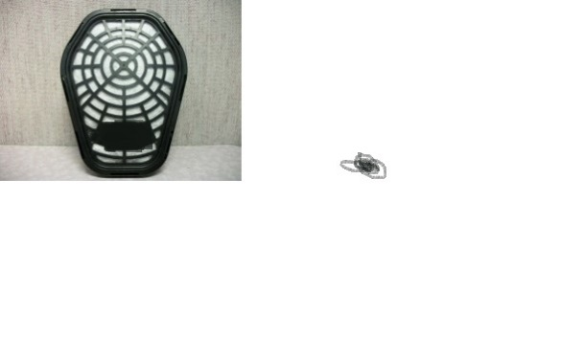
Cartridge/Canister Service Life
1910.134(j)
Conditions affecting service life:
  Exertion level
  Cartridge variability
  Temperature
  Humidity
  Multiple contaminants

Slide 26
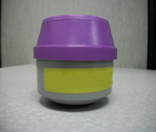
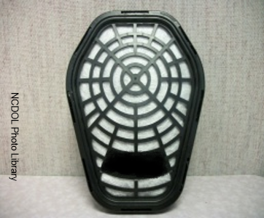
Filters/Cartridges/Canister Labels
1910.134(j)
Only NIOSH approved.
Labeled and color coded.
Label shall not be removed and remains legible.
NCDOL Photo Library

Slide 27
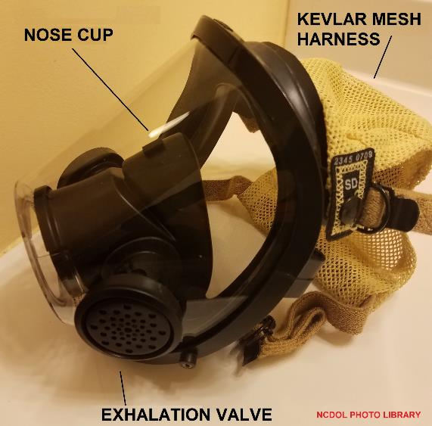
Assigned Protection Factor (APF)
1910.134(b)
Workplace level of respiratory protection that a respirator or class of respirators is expected to provide to employees.

Slide 28
TABLE 1 – ASSIGNED PROTECTION FACTORS⁵
Respirator Type^{1, 2} | Quarter Mask | Half Mask | Full Face | Helmet/Hood | Loose-Fitting
Air Purifying | 5 | ³10 | 50 | ----------------- | ----------------
PAPR | ---------------- | 50 | 1,000 | ⁴25/1,000 | 25
SAR Demand Continuous Flow Pressure Demand/ other (+) pressure | ---------------- ---------------- ---------------- | 10 50 50 | 50 1,000 1,000 | ------------------ ⁴25/1,000 ------------------ | -------------------- 25 --------------------
SCBA Demand Pressure Demand/ other (+) pressure | ---------------- ---------------- | 10 -------------- | 50 10,000 | 50 10,000 | ----------------------------------------
¹May use respirators assigned for higher concentrations in lower concentrations or when required use is independent of concentration.
²These APF’s are only effective when employer has a continuing, effective respirator program per 1910.134.
³This APF category includes filtering facepieces and elastomeric facepieces.
⁴Must have manufacturer test evidence to support an APF of 1,000 or else these respirators receive an APF of 25.
⁵These APFs do not apply to escape-only respirators. Escape respirators must conform to 1910.134(d)(2)(ii) or OSHA’s substance specific standards, if used with those substances.

Slide 29
What is a MUC?
1910.134(b)
Maximum use concentration (MUC)
  Maximum atmospheric concentration of a hazardous substance from which an employee can be expected to be protected when wearing a respirator and is determined by the assigned protection factor of the respirator or class of respirators and the exposure limit of the hazardous substance.
  When no OSHA exposure limit is available for a hazardous substance, an employer must determine an MUC on the basis of relevant available information and informed professional judgment.

Slide 30
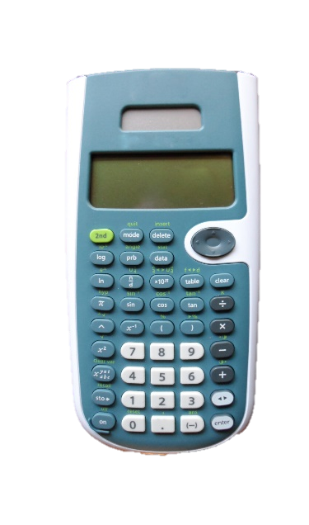
How to Calculate MUC
The MUC can be determined mathematically by multiplying the assigned protection factor specified for a respirator by the required OSHA permissible exposure limit (PEL), short-term exposure limit (STEL), or ceiling limit (CL).
Nova Development
APF x PEL = MUC
APF x STEL = MUC
APF x CL = MUC
NCDOL Photo Library

Slide 31
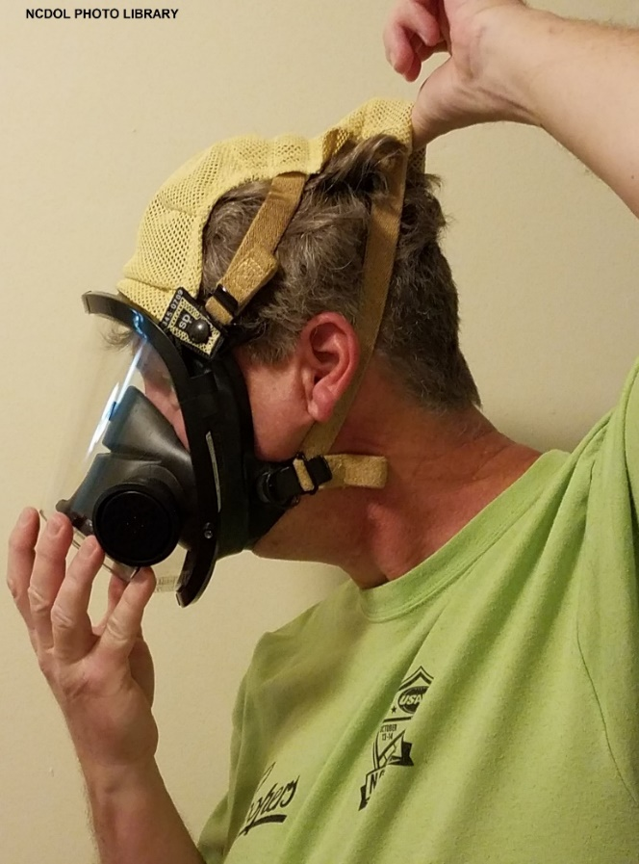
Part 4
Training and Information

Slide 32
Training and Information
1910.134(k)(3)-(5)
Required:
  Prior to requiring the employee to use a respirator
  Annually
  When changes in workplace render previous training obsolete
  Employee use demonstrates
  inadequate training
  Any other situation arises in which
  retraining appears necessary

Slide 33
Training and Information
1910.134(k)(1)
Why the respirator is necessary and how improper fit, usage, or maintenance can compromise the protective effect of the respirator.
Limitations and capabilities of the respirator.
How to effectively use the respirator in emergencies.
General requirements of the standard.

Slide 34

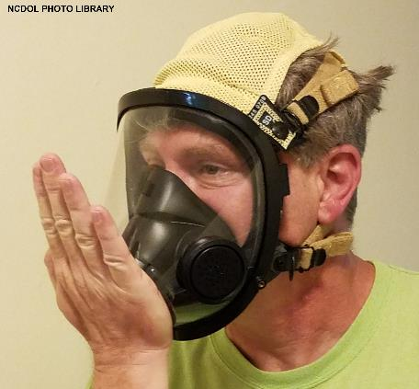
Training and Information
1910.134(k)(1)
How to inspect, don, doff, use, perform seal checks.
Maintenance and storage procedures.
How to recognize medical signs and symptoms that may limit or prevent the effective use of respirator.

Slide 35
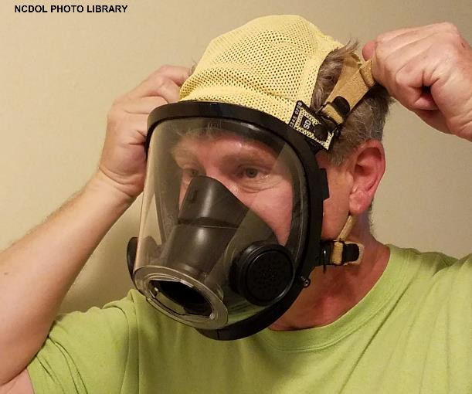
Part 5
Fit Testing
1910.134(f)

Slide 36
When is Fit Testing Required?
1910.134(f)
Before initial use
Annually, thereafter
When facial features change, such as with weight gain or loss, use of dentures
Note: Employees wearing tight-fitting face-pieces
must not be fit tested if they have facial hair *

Slide 37
Qualitative Fit Test (QLFT)
1910.134(f)
A pass/fail fit test to assess the adequacy of respirator fit that relies on the individual’s response to the test agent.
Must not be used if a person has no sense of taste or smell.
Used for respirators requiring a fit factor of 100 or less.

Slide 38
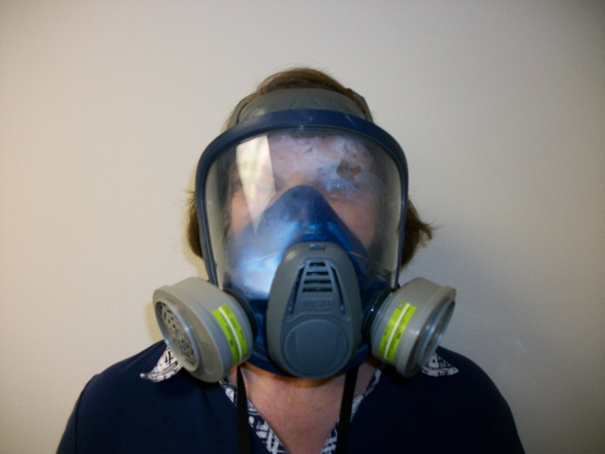
Quantitative Fit Test (QNFT)
1910.134(f)
An assessment of the adequacy of respirator fit by numerically measuring the amount of leakage into the respirator (Fit Factor).
Can be used for any type of respirator.
Must be used for respirators
requiring a fit factor of 500
or greater*.
NCDOL photo library

Slide 39
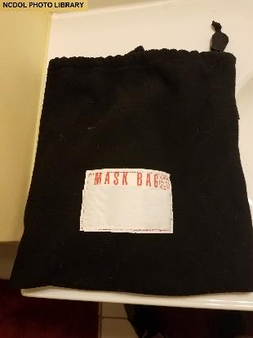
Part 6
Maintenance and Care
1910.134(h)

Slide 40
Cleaning and Disinfecting
1910.134(h)(1)
Respirators must be clean, sanitary, and in good working order.
Respirators must be cleaned and disinfected using the procedures in Appendix B-2 or procedures recommended by the respirator manufacturer.

Slide 41
Cleaning and Disinfecting
1910.134(h)(1)
Respirators cleaned and disinfected at the following intervals:
  If exclusive use by employee – as often as necessary to be maintained in a sanitary condition.
  If shared by employees – prior to each use by different employee.
  If for emergency use – after each use.
  If used for training and fit testing – between each employee and at the end of each training/fit testing session.

Slide 42
Storage
1910.134(h)(2)
Respirators must be protected from:
  Dust
  Sunlight
  Heat
  Cold
  Moisture
  Chemicals
  Stored in a sealed container or bag
Notes:
.

Slide 43
Inspection
1910.134(h)(3)
Check for:
  Holes in the filters
  Loss of elasticity or tears in the head straps and hoses
  Broken or loose connectors and fittings
  Cracked or scratched face pieces
  Detergent residue
  Dirt in the valves
  General cleanliness

Slide 44
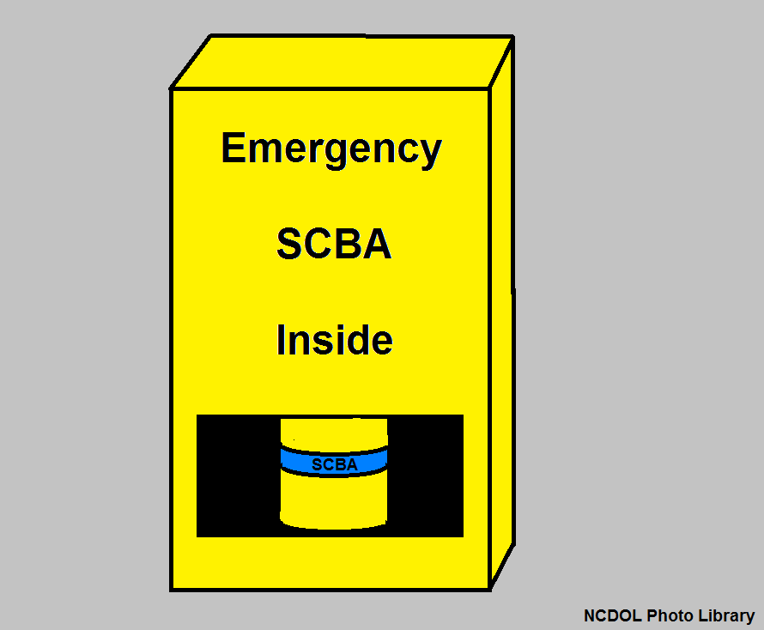
Inspection
1910.134(h)(3)(iv)
Respirators maintained for emergency use must be inspected at least monthly and in accordance with the manufacturer’s recommendations, and shall be checked for proper function before and after each use.
Notes:
.

Slide 45
Repairs
1910.134(h)(4)
Respirators that fail an inspection or are otherwise found to be defective are removed from service and discarded or repaired/adjusted.
  Repairs made only by appropriately trained persons.
  Use only respirator manufacturer’s NIOSH-approved parts.
Notes:
.

Slide 46
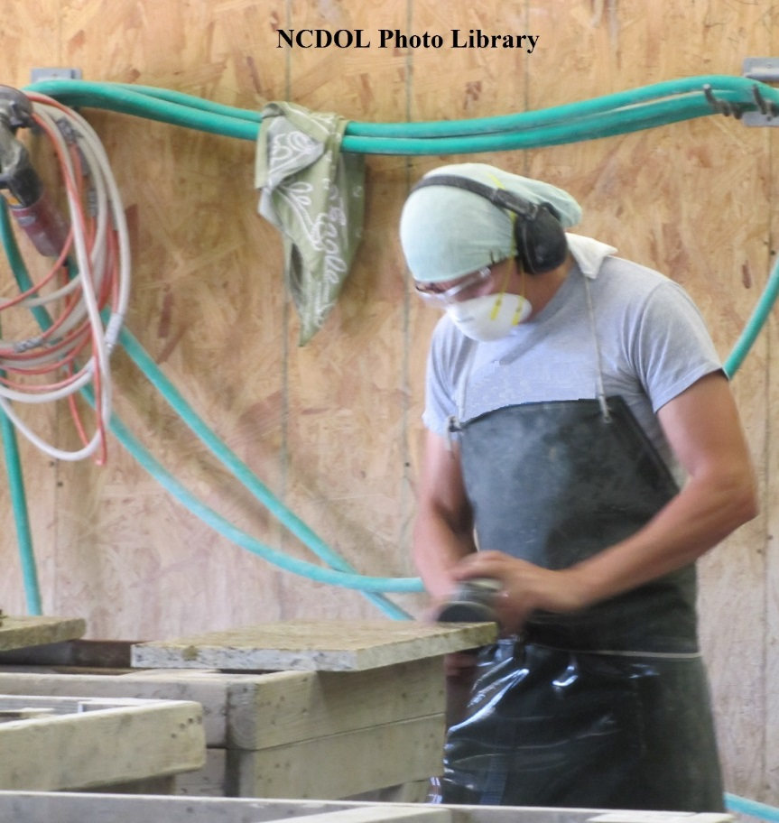
Part 7
1910.134(g)
Use
Notes:
.

Slide 47
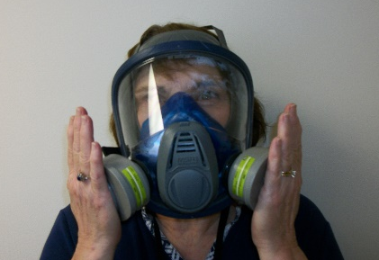
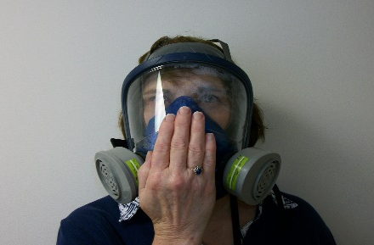
Use of Respirators
1910.134(g)
Always put respirator on in clean air environment.
Always seal-check the respirator to make sure proper fit has been achieved for tight-fitting respirators.
Two types of user seal checks (Appendix B-1):
NCDOL photo library
NCDOL photo library
Negative Pressure
Positive Pressure

Slide 48
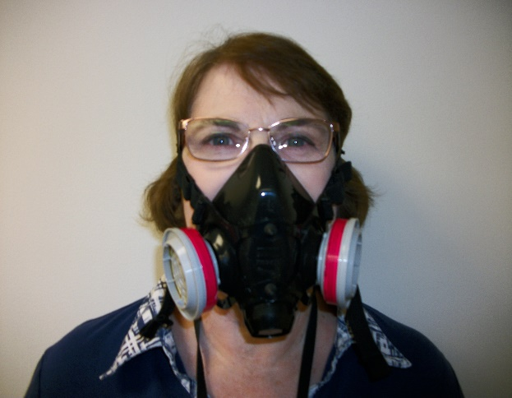
Use
1910.134(g)(1)
Respirators are only effective when the seal around your nose and mouth is tight.
  If you cannot achieve proper fit, do not enter the contaminated area.
Facial hair is not allowed when wearing a tight-fitting respirator.
Glasses cannot be worn with
a full-face respirator.
  Spectacle kit required
NCDOL photo library

Slide 49
Use
1910.134(g)(2)
Leave the contaminated atmosphere if any of the following occurs:
  Smell or taste something out of the ordinary
  Eyes or throat become irritated
  Observe a change in breathing
  Face piece is leaking or other parts break
  Alarms signaling equipment has failure
  or end of breathing air supply

Slide 50
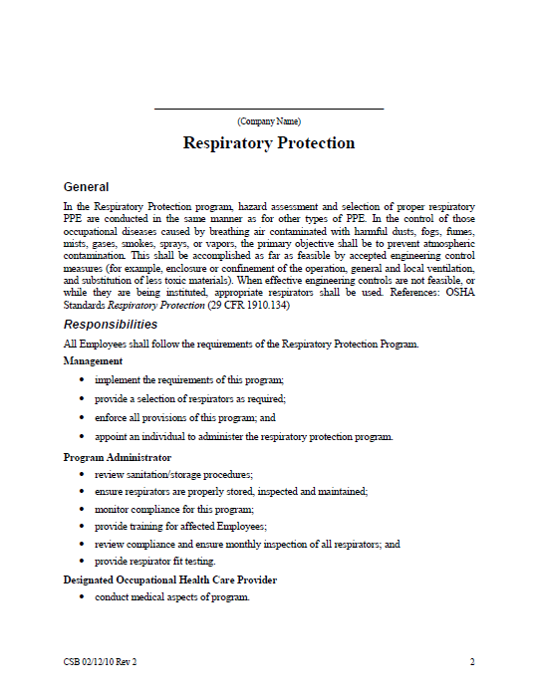
Part 8
1910.134(l)
Program Evaluation
NCDOL Photo Library

Slide 51
Program Evaluation
1910.134(l)
Conduct workplace evaluations
Consult employees concerning:
  Respirator fit
  Appropriate respirator selection
  Proper respirator use
  Proper respirator maintenance

Slide 52
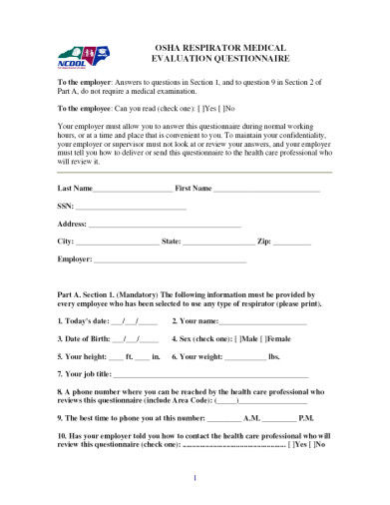
Part 9
1910.134(m)
Recordkeeping

Slide 53
Recordkeeping
1910.134(m)(1)-(4)
Written program
Medical evaluations
Fit test records
Emergency use respirator inspection
NCDOL Photo Library

Slide 54
Written Program
1910.134(c)(1)
Written program must contain procedures for:
  Selecting respirators
  Medical evaluations
  Fit testing
  Respirator use
  Respirator maintenance
  Ensuring adequate breathing air for SARs
  Employee training
  Program evaluation
Program must be worksite-specific

Slide 55
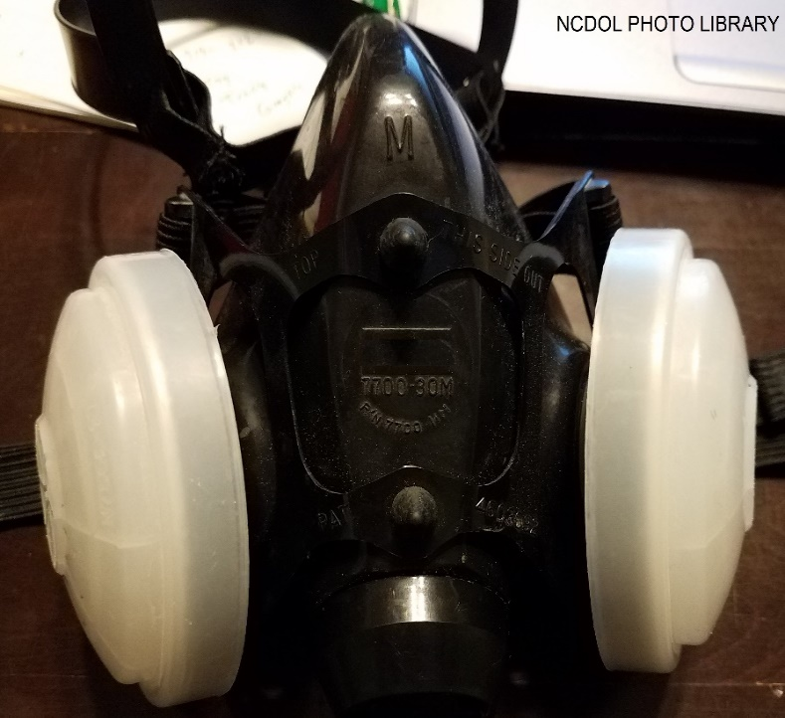
Part 10
1910.134(c)
Voluntary Use
Notes:
1910.134(o) and 1910.134 Appendix D

Slide 56
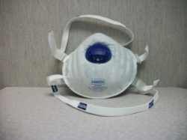
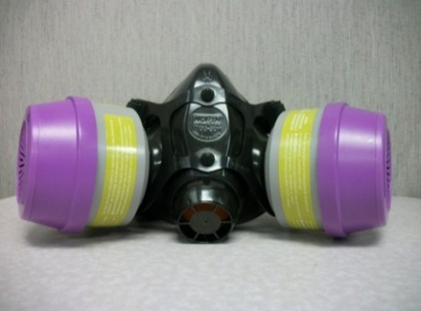
Voluntary Use
1910.134(c)(2)
For all respirators, the employer must:
  Determine that voluntary use is appropriate.
  Ensure that use of the selected respirator will not create a hazard.
  Provide employees with information in Appendix D.
For all respirators except filtering face pieces, the employer must establish and implement a written program to address:
  Medical evaluations, and
  Training on maintenance, storage and care.
NCDOL Photo Library
NCDOL Photo Library

Slide 57
All Mandatory Appendices
1910.134
Appendix A to § 1910.134: Fit Testing Procedures
Appendix B-1 to § 1910.134: User Seal Check Procedures
Appendix B-2 to § 1910.134: Respirator Cleaning Procedures
Appendix C to § 1910.134: OSHA Respirator Medical Evaluation Questionnaire
Appendix D to § 1910.134: Information for Employees Using Respirators When Not Required Under the Standard

Slide 58
Summary
1910.134
Students should now be aware of the
requirements for:
  Written respiratory protection program
  Selection and types of respirators
  Medical evaluations and fit testing
  Use, maintenance and care of respirators
  Training employees
  Program evaluation
  Recordkeeping
Notes:
58

Slide 59
Thank You For Attending!
Final Questions?
Notes:
59

