Slide 1

The School of Hard Knocks
Mark VanderWerp, BCE​

Slide 2
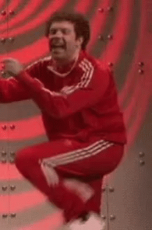
Working session

Slide 3
overview
Injury by the (PestSure) Numbers​
OJT Best Practices
Adding Safety to OJT (Exercise)
OJT Pit Falls
​

Slide 4
Injury by the (pestsure) numbers

Slide 5


Slide 6
Cause of injury

Slide 7
Age at time of injury

Slide 8
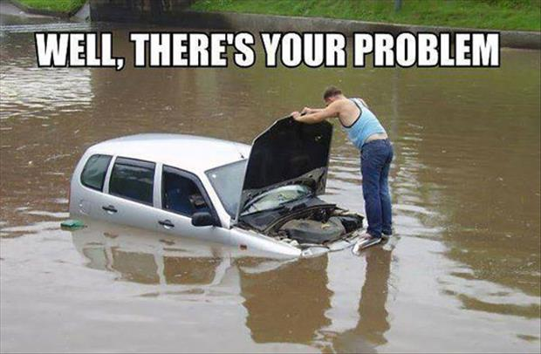
tenure at time of injury
Notes:
This is a pretty good indication that our OJT programs aren’t fully optimized!

Slide 9
OJT Best practices
Notes:
This looks like a job for OJT! I can say looking back at our OJT, safety wasn’t always a key consideration when we were putting it together.

Slide 10


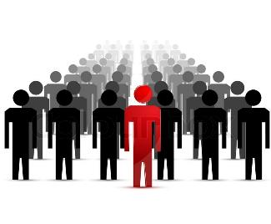

#1: Engage/excite the learner!
What do they know?
Why they need it
Everyone is doing it
Notes:
We’re doing this training because we have to. We’re doing this training because this is something most of our new employees asked for.

Slide 11
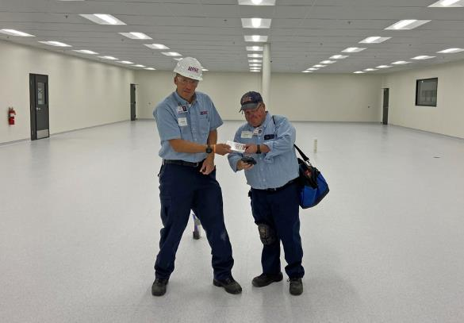
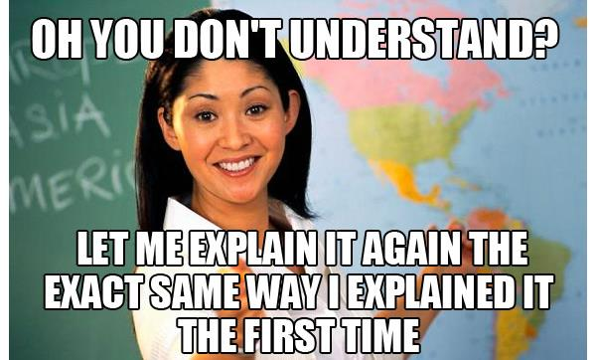
#2: Teach at the learner’s level
Clear language
Showing while explaining
Repetition!

Slide 12
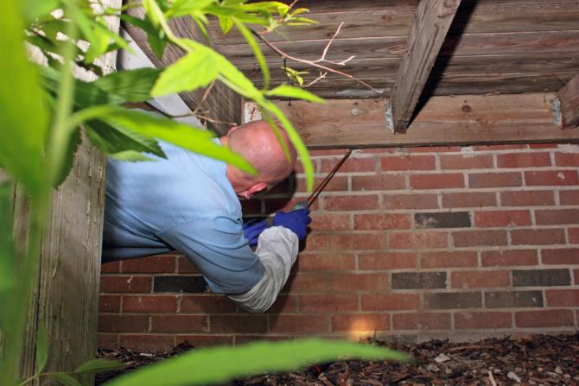
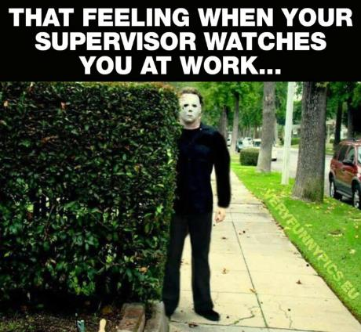
#3: Watch the learner perform
Notes:
We’re doing this training because we have to. We’re doing this training because this is something most of our new employees asked for.

Slide 13
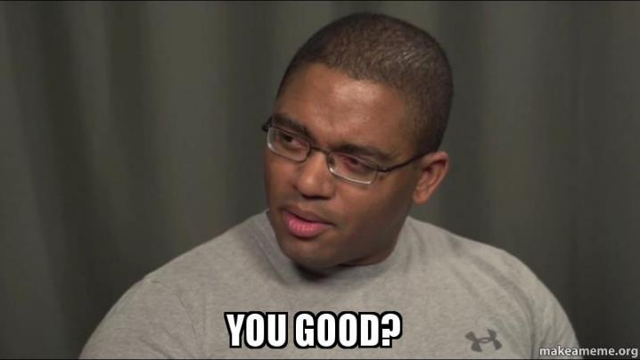
#4: Follow up
Notes:
Following up is ideally done in person but may be done by looking at paperwork, material ordering, truck inspections, etc.

Slide 14
OJT: Let’s focus on safety!

Slide 15
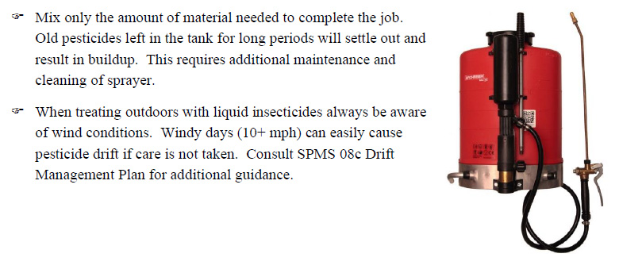

OJT WITHOUT SAFETY Could be On the Job Trauma!
Notes:
Following up is ideally done in person but may be done by looking at paperwork, material ordering, truck inspections, etc.

Slide 16
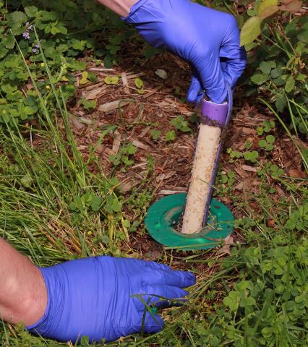
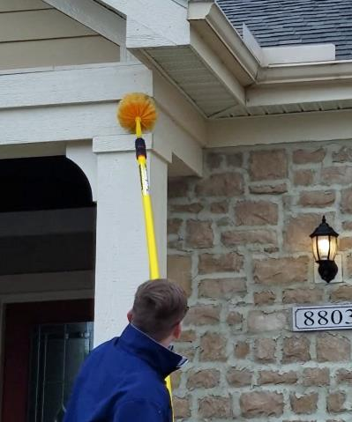
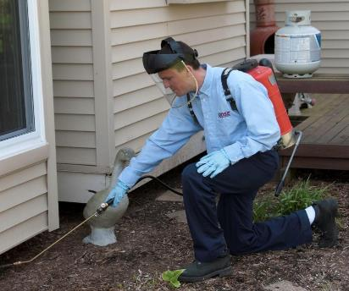
common Exposures
Backpack Applications
Sentricon Install/Service
Webstering & Using Extension Poles

Slide 17

volunteers?
sentricon
backpack
webster
Notes:
This is a pretty good indication that our OJT programs aren’t fully optimized!

Slide 18

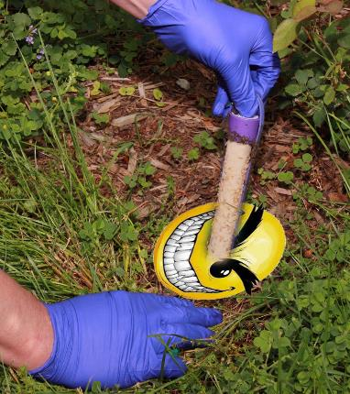
Tales from the osha log…
“Looking for a station in some bushes and got stung by yellowjackets twice.”
“Ground was hard, Auger slipped out of hand hitting thumb and snapped it in two.”
“Bent over to look into station and he hurt his back.”
“Pulling up bait stick out of a Sentricon station. He yanked on it, the bait stick cut his left hand between thumb and index finger.”
“Drilling Sentricon hole and auger got hung on something and caused hand to twist.”
“While kicking mulch off a station, he hyper-extended his right knee.”
“While drilling the hole for the stations, he lost consciousness and passed out. He doesn't drink enough fluids on hot days.”
“Walking around the home locating stations. Stepped in a small hole and twisted knee.”
“Repairing a damaged water line while performing an install. When cutting the water line to replace it his hand slipped hitting the concrete and cut his left wrist.”
“I tripped over a bush while working my way backwards locating stations.”
Sentricon Install/Service

Slide 19
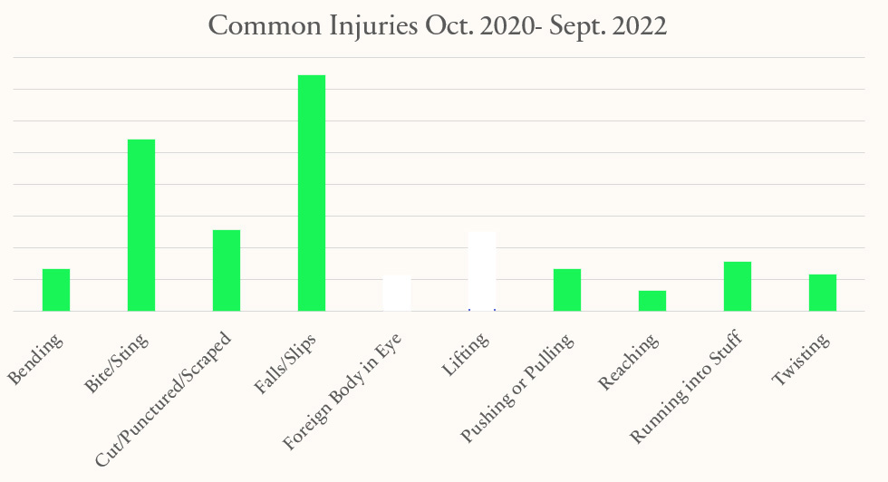
sentricon related injuries

Slide 20

volunteers?
sentricon
backpack
webster
Notes:
This is a pretty good indication that our OJT programs aren’t fully optimized!

Slide 21
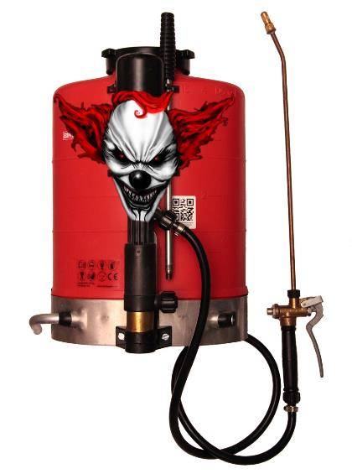
Tales from the osha log…
“While servicing with the backpack, he stepped into a hole, causing pain to his left hip area.”
“Had his backpack on, so he treated the [wasp] nest and ran, twisting his knee in the process.”
“Picked up backpack, it started to fall, grabbed it and cut finger.”
“She was filling up her backpack sprayer and when she went to pick it up felt pain.”
“Tripped over stump and fell with backpack sprayer.”
“Treating around home and stepped on a piece of wood did not notice the nail and stepped on the nail.”
“Walking with the backpack on a steep incline. Rolled his ankle a little bit and heard /felt a pop in his knee.”
“While wearing backpack mister, slipped down wet grass (slope) and fell onto back and cut left shin.”
“Had backpack mister on, treating side yard and noticed dog. The dog lunged at tech and bit his calf.”
“Applying product using backpack sprayer. Put sign in yard and while bending over, product came out of equipment went down lower back and leg area.”
“Performing maintenance on backpack sprayer when the hose came loose, and diluted pesticide got on his face and in his right eye.”
“Tech tripped on a metal stake in the ground, hidden by tall grass. Hit left knee/right leg on sidewalk. Backpack sprayer pushed his forehead to the ground. Scraped leg, bruised knee, scraped forehead.”
Backpack Applications

Slide 22
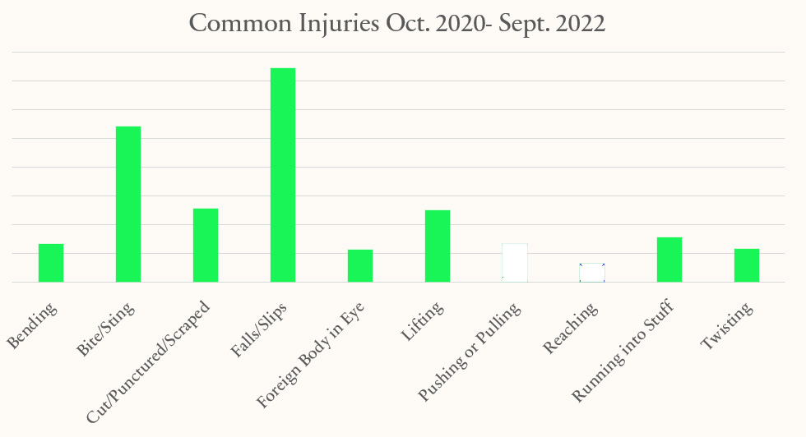
Backpack related injuries

Slide 23
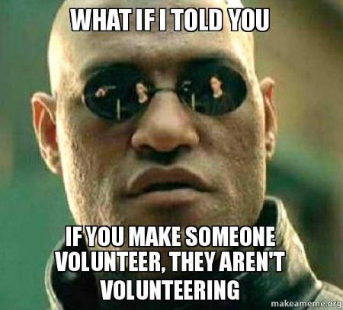
volunteers?
sentricon
backpack
webster
Notes:
This is a pretty good indication that our OJT programs aren’t fully optimized!

Slide 24
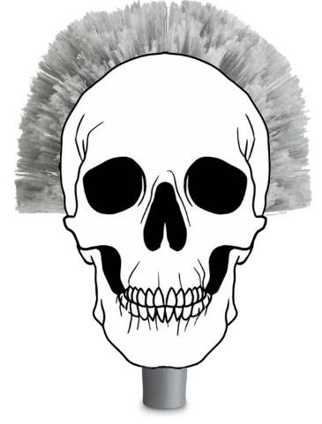

Tales from the osha log…
“Technician was using a webster and stepped backwards off a raised walkway, causing a fall.”
“Servicing with webster, fell through deck.”
“Walking around home webstering home and fell in hole and twisted left ankle.”
“Going up stairs to webster home when one of the steps (which was made of stone) came up and hit right leg.”
“Walking down stairs holding web brush. Fell on wet stairs.”
“Removing spider webs and there was a loose board turned upside down with nail exposed. Stepped on the nail.”
“Webstering when he felt a pop in the back of his right shoulder, and it began to burn.”
“Using the webster around house with Delta Dust and dust went into both eyes.”
“I was webstering and felt a sting on my wrist, so I looked down and a spider was crawling out from under my sleeve.”
“Removing spider webs with a webster pole and developed a blister on his left thumb.”
“Using a webster to remove spider webs and ended up striking his hand against a chair.”
Webstering & Using Extension Poles

Slide 25
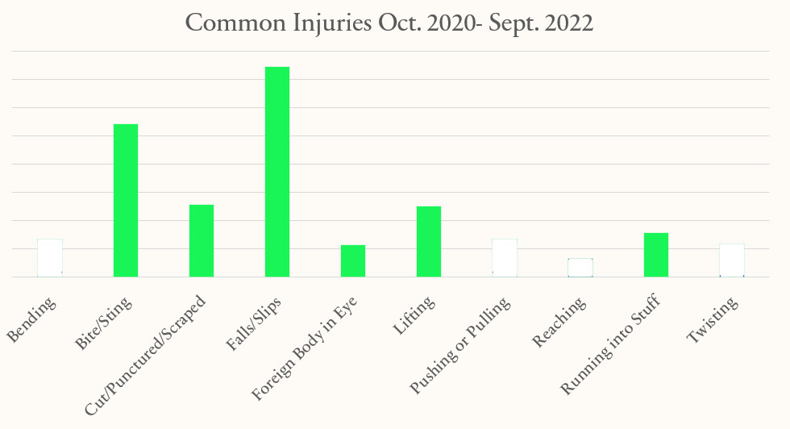
Webster related injuries

Slide 26
OJT Pitfalls

Slide 27
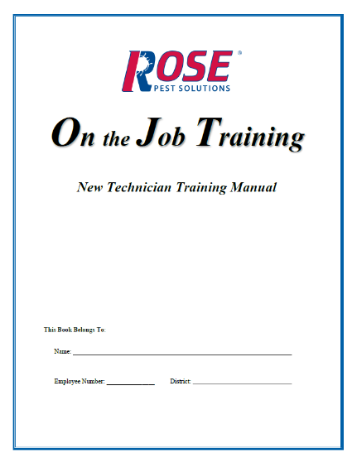
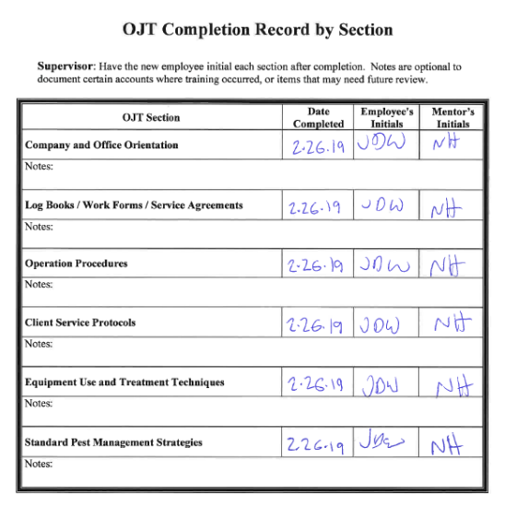
Unstructured & undocumented?

Slide 28
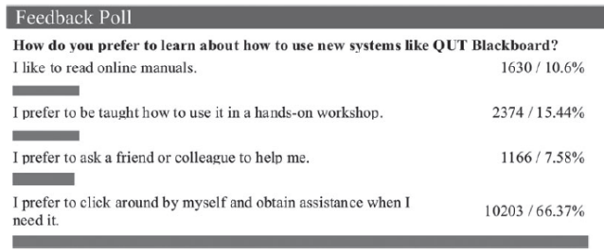

TLDR

Slide 29
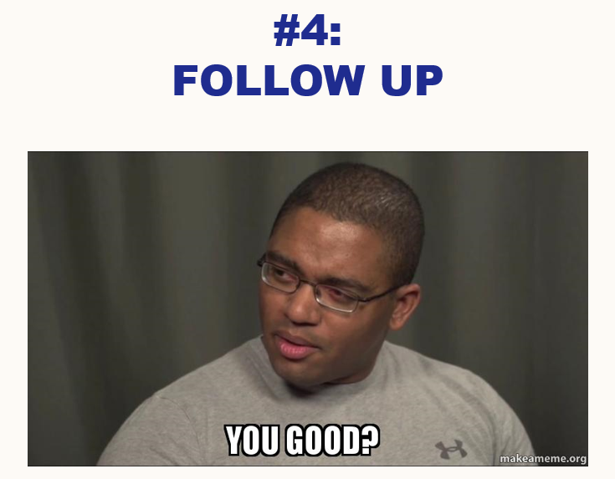
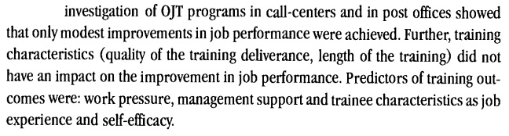
staffing shortages
Van der Klink, 2002
Notes:
Self-efficacy is similar to confidence.

Slide 30
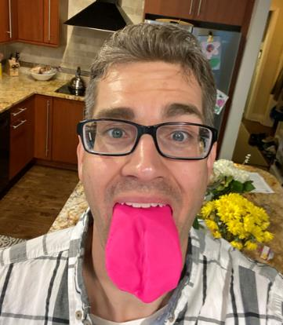
Thank you!
“At the end of the day people won't remember what you said or did, they will remember how you made them feel.”
--Maya Angelou

