Slide 1
Spill Control
S. Alan Harlan, ACE
2 Hours WDO

Slide 2
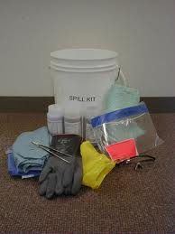
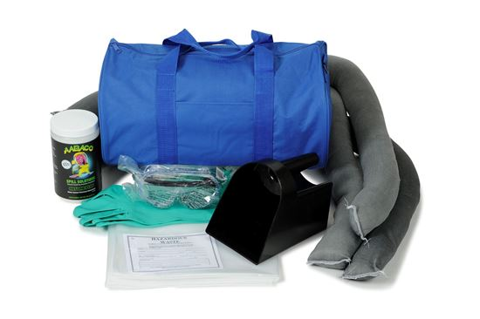
Spill Kit Contents
Unlined nitrile, latex, or rubber gloves
NIOSH respirator and cartridges
Safety glasses or goggles
Plastic bags
Soak Up
Detergent
Snakes
Broom
Dustpan
Paper towels

Slide 3
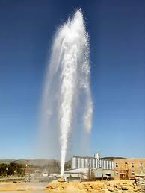
Control
I hope that this is not something that reminds anyone of a spill from a termite pumping unit.

Slide 4
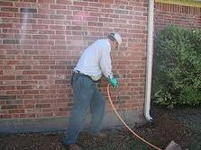

Control
How do you control the spill?
Start with turning off the engine. Reduce the amount that has to be cleaned up.

Slide 5
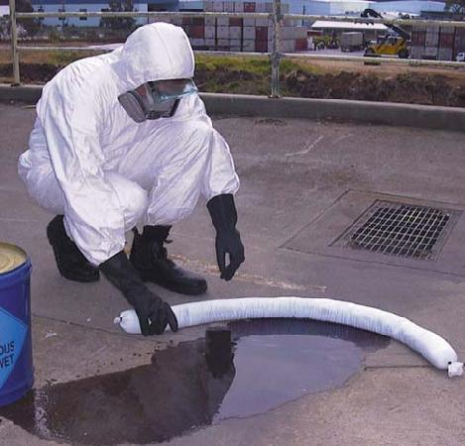
Contain
Limit the distance that the spill has travelled by damming it with an absorbent snake. Sprinkle the loose absorbent over the spill. Remember, 1 lb. of absorbent will soak up 11 gallons. Wait until the absorbent has turned to a clear gelatinous sludge.

Slide 6
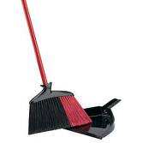
Clean
Now clean up the absorbent material.
How should you dispose of the contained spill at this point?

Slide 7
Dry Materials
Dusts, Granules, Termite Bait, and Rodenticide should be swept thoroughly and placed in a plastic bag. Label the bag with pertinent information:
Product
Date
Location
Technician

Slide 8
Call
Let someone know…
Preferably after the spill has been cleaned-up

Slide 9
What Would You Do?
Are you ready for a spill?
Have you thought about what you might do in the event of a spill?
Let’s divide into small groups and discuss
The following potential situation.
What would you do if you were asked to assist?

Slide 10
Scenario #1
A technician loses control of the service vehicle
and is unconscious and severely injured. You
are contacted by the emergency response team
And advised that there is a small leak
originating from around the pump.

Slide 11
Solution?

Slide 12
Things To Consider
If the driver is unconscious, who at your company is the emergency contact?
Can you walk the HAZMAT/Emergency Response Team through containing a spill over the phone?
Do you KNOW what material has been spilled?
Do you have SDS for each product that’s used at your company?

Slide 13
Things I Learned
Use A Mobile SDS app that enables you to immediately send a current SDS to the appropriate party.
Ensure that everyone at your company KNOWS who to contact in the event of an emergency. Response time is critical.
Know where each spill kit is kept on each vehicle. Behind the driver’s seat is a great spot.
Don’t keep the spill kit in the toolbox or where products are stored. Regularly check spill kit for contents and ensure that the soak up material hasn’t hardened. Monthly when counting inventory is a great time to check. You don’t want to find out that you don’t have enough Soak Up when you need it most or when you are stopped by AG for a truck inspection.
Most importantly- Make sure that everyone is OK.

Slide 14
Was This Preventable?

Slide 15
Scenario #2
A technician attempts to make a u-turn across a four lane highway. The vehicle is struck in the side by an oncoming motorist, dislodging the termite pumping unit and cracking the tank. It causes a spill. You are asked to assist.

Slide 16
Solution?

Slide 17
Things to Consider
Is the driver OK and able to lend aid in the clean up?
Are the passengers in the other vehicle OK?
Keep everyone away from the site of the spill.
If possible, mark the area where the spill is located with “crime scene” tape.
How do you direct the spill cleanup if you are unavailable?

Slide 18
Things I Learned
If you are the one responsible for spill cleanup oversight, it’s important to have several backup people in place to fill in when you’re not available.
EVERYONE should have a spill kit and should be able to competently lend aid in the event of an emergency.
Mock spills/Practice should be periodically conducted to improve competency. Annual fit testing can be conducted concurrently with spill control/Hazmat training.

Slide 19
Was This Preventable?

Slide 20
Scenario #3
A technician has just completed a residential pre-treat and is attempting to leave when his vehicle catches fire and engulfs the termite pumping unit, melting part of the top. The fire is extinguished and a tow truck is on the way. It is not possible to tow without a large quantity of the solution spilling. The technician calls you and wants to know how he should proceed.

Slide 21
Solution?

Slide 22
Things To Consider
Holy $#1^! The truck is on fire!

Slide 23
Things I Learned
Bad stuff happens on Friday afternoon!
Drop everything and drive out to the site
Fire Extinguishers for all vehicles is a good idea
Look for creative solutions.

Slide 24
Was This Preventable?

Slide 25
Scenario #4
You are treating a back patio when you suddenly lose pressure. Thinking that the tank is empty, you head back to the vehicle to refill it. Arriving at the truck, you see liquid shooting in the air around the hose reel. You are parked on the street on a slope. The rear of your truck faces the middle of a cul de sac with a storm drain which leads to a neighborhood lake.

Slide 26
Solution?

Slide 27
Things To Consider
What happens if it rains while I’m cleaning up?
Is bleach an appropriate part of the clean up process?

Slide 28
Things I Learned
Hose clamps don’t last forever.
Hose Clamps cost as little as $.40 and as much as $40- replace periodically.
The best time to learn where a spill kit is located and whether all items are present is not when a spill is occurring.
The best time to train a new employee on the merits of spill control is not when an actual spill is occurring.
Locate storm drains, wells, and easements prior to performing work.
Should new employees have phones issued on day one in the event of an accident?

Slide 29
Was This Preventable?

Slide 30
Takeaways
Proper Preparation Prevents…
Practice
Be Consistent- Inspect Kits regularly for location and contents
Consistently look for ways to prevent spills from happening.
Keep additional PPE in the spill kit

Slide 31
Spill Control
S. Alan Harlan, ACE
2 Hours WDO

