Slide 1



Safety and Loss Prevention Meeting

Slide 2
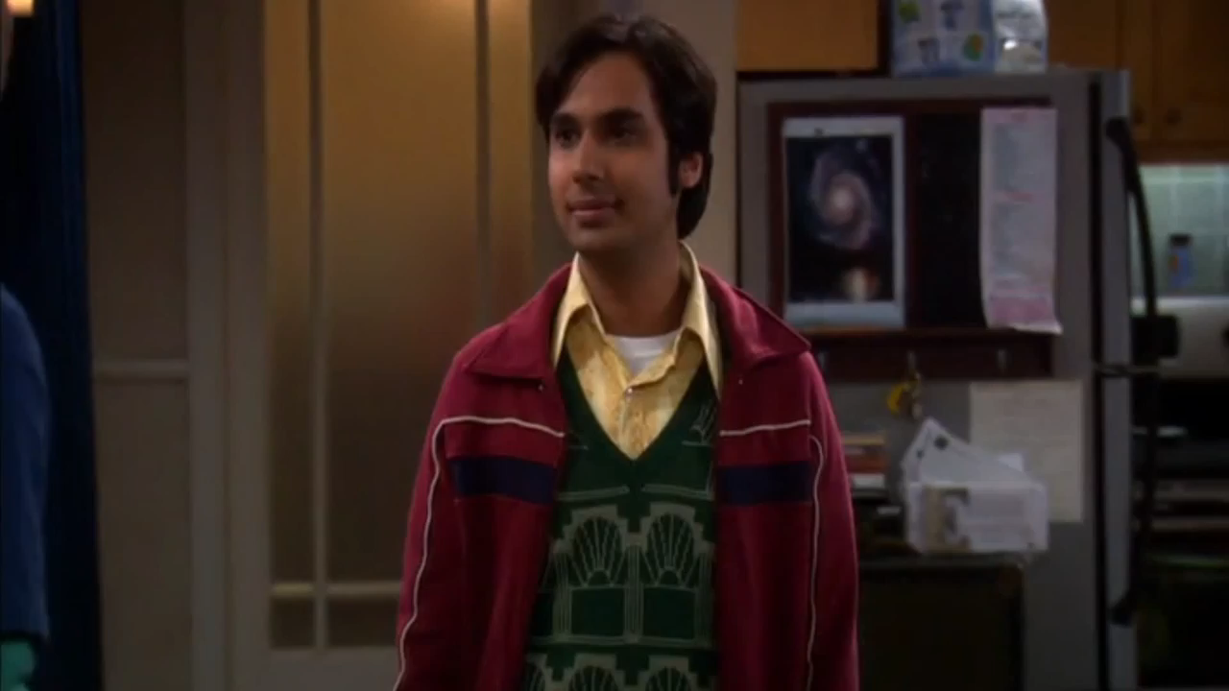
Notes:
Big Bang Video
Height: 6”
Width: 10.67
Start automatically; Play full screen

Slide 3
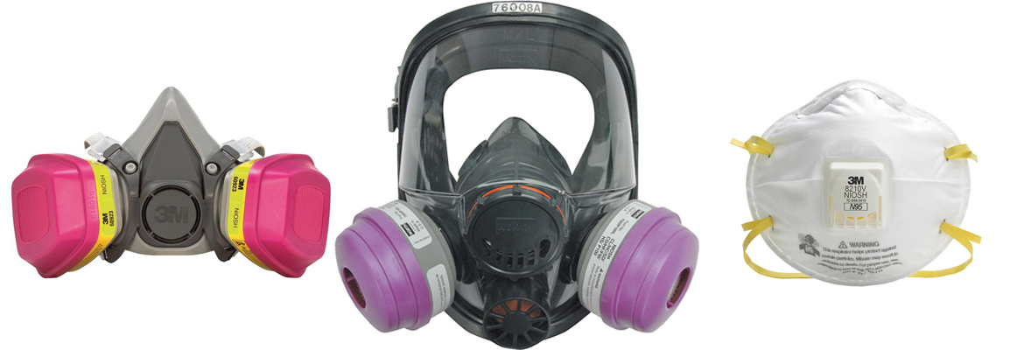
Elements of a sound Respirator Program

Slide 4
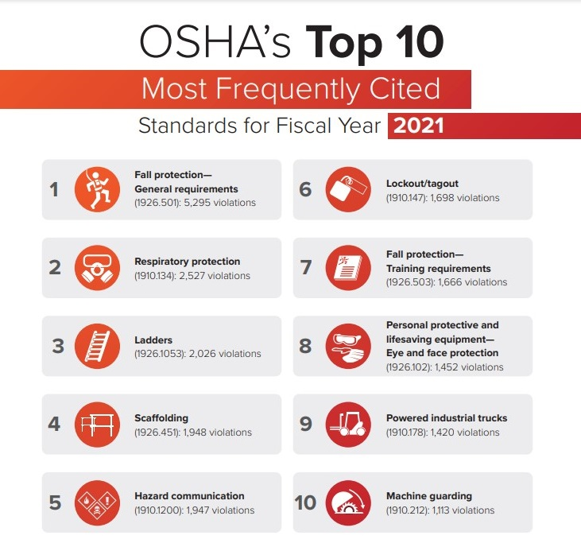
Provide a Safe & Healthful Place of Employment
Why are we here?
Top 5 Sections Cited
1910.134(e)(1) – Medical Evaluation
Violations Reported: 618
1910.134(f)(2) – Fit Testing
Violations Reported: 519
1910.134(c)(1) – Written Program
Violations Reported: 426
1910.134(k)(1) – Training
Violations Reported: 130
1910.134(d)(1) – General
Violations Reported: 117
National Safety Council

Slide 5


Key Requirements

Slide 6
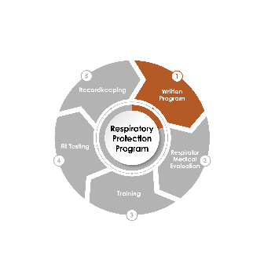
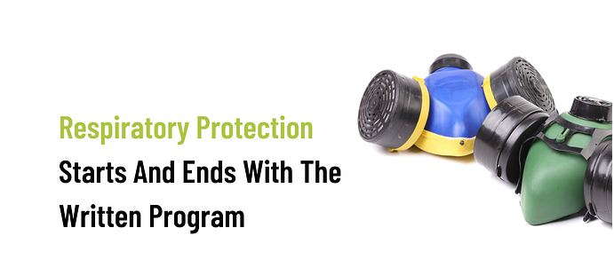
Written Program
Why is a written program important?
It is required to be OSHA compliant
Provides the structure to ensure consistent respiratory safety at your workplace
^{(#3)} 1910.134(c)(1) – Written Program
Violations Reported: 426

Slide 7

Program Administrator
Is responsible for development and implementation of plan
Must be qualified by training or experience to:
  Recognize, evaluate and control hazards in your workplace
Conducts the required evaluation of program effectiveness

Slide 8
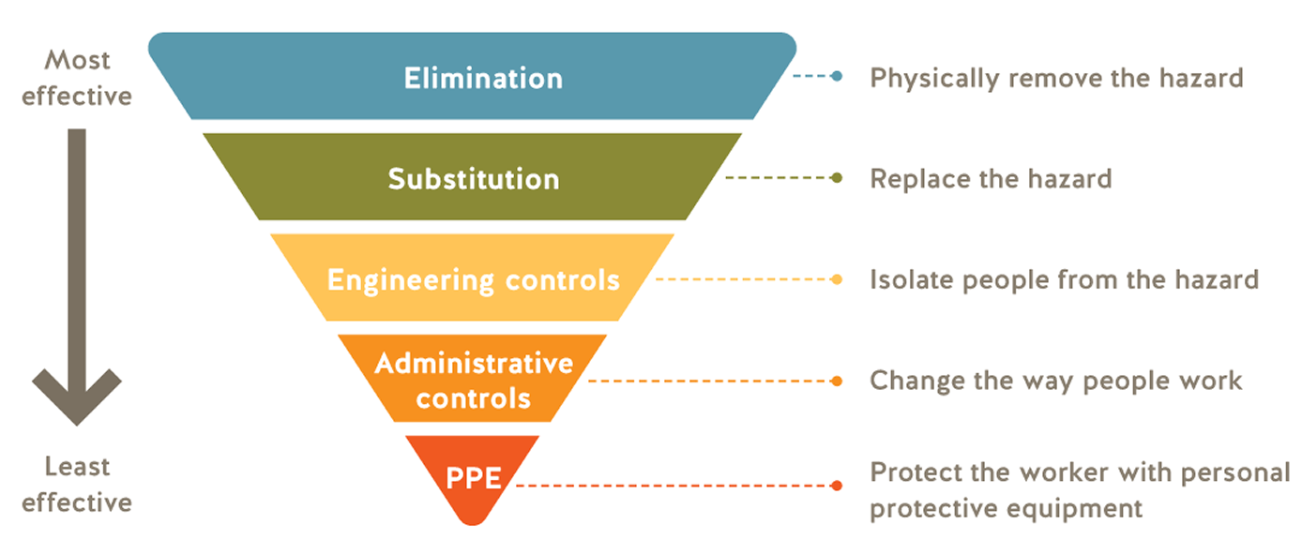
Hazard Evaluation
(Hierarchy of Control)
Our approach to controlling personal exposure to chemical, physical and biological agents in the workplace
Do not simply chose a control method because it is easy and fast to implement
Notes:
Identify the contaminants and evaluate the hazards.
Determine the physical properties of the contaminants.
Identify areas of potential oxygen (O₂) deficiency.
Estimate or measure employee’s exposure to the hazards.
Assume IDLH, when not known*
Chemical hazards
Overexposure to workplace contaminants such as: dust, spray, fumes, vapors, smoke, harmful gases.
Biological hazards
Exposure to organisms such as bacteria, viruses, fungi and other living organisms. (These organisms do not have exposure limits.)

Slide 9
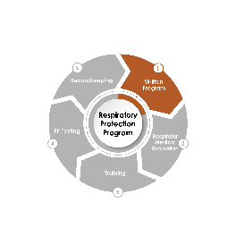
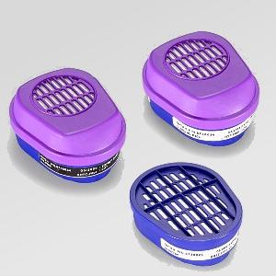
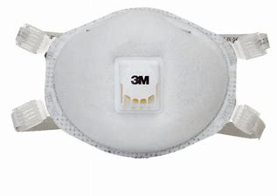
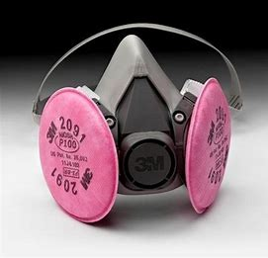
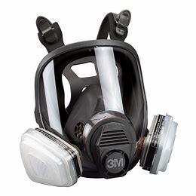
Equipment Selection
PPE section of the SDS
Worst chemical
Percentage of bad chemical(s) in a mixture
Location and task
Length of task time
Humidity/temperature
Other PPE requirements
No characterization = IDLH
1910.134(d)(1) – General
Violations Reported: 117

Slide 10

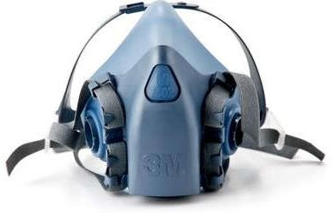

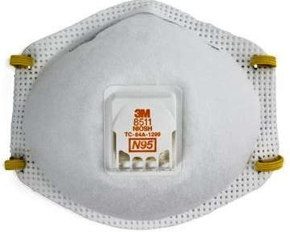
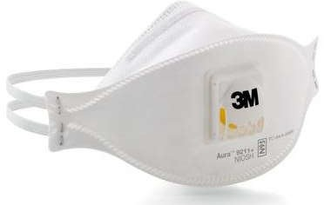
Voluntary Use
Do you need to have a written respiratory protection program if only voluntary users wear respirators at your facility?
Is when an employee chooses to wear a respirator even though the use of a respirator is not required by employer or an osha standard.
Elastomeric Facepiece
 | Voluntary Use
Fit Testing | No*
Medical Evaluation | Yes
Facial Hair Prohibited | Yes
Appendix D Provided | Yes
Training | Yes
Cleaning, Storage, Maintenance | Yes
Filtering Facepiece (i.e. N95)
 | Voluntary Use
Fit Testing | No
Medical Evaluation | No
Facial Hair Prohibited | Yes
Appendix D Provided | Yes
Training | No*
Cleaning, Storage, Maintenance | No*
*RECOMMENDED
*RECOMMENDED

Slide 11
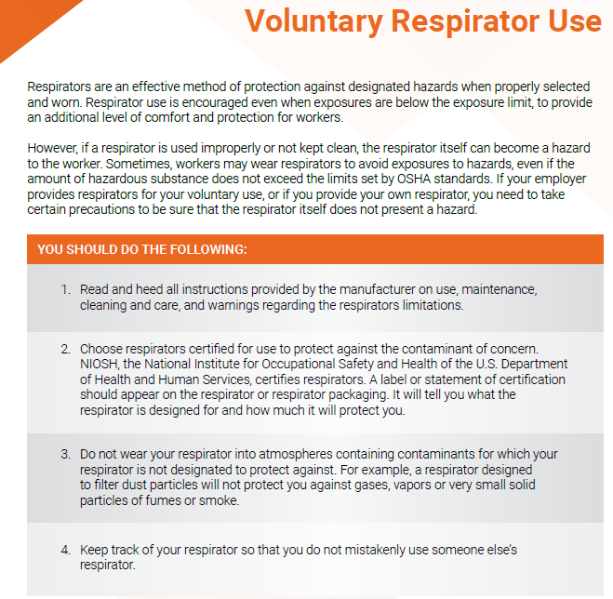
Appendix D

Slide 12

Program Evaluation
Evaluate as necessary to ensure program working effectively
Evaluate respirator program elements, such as:
  Respirator fit testing
  Appropriate selection
  Proper use
  Proper maintenance
Consult employees using respirators for their views on the program and correction of problems
Notes:
OSHA does not require us to review our programs according to a fixed schedule – we determine frequency.

Slide 13
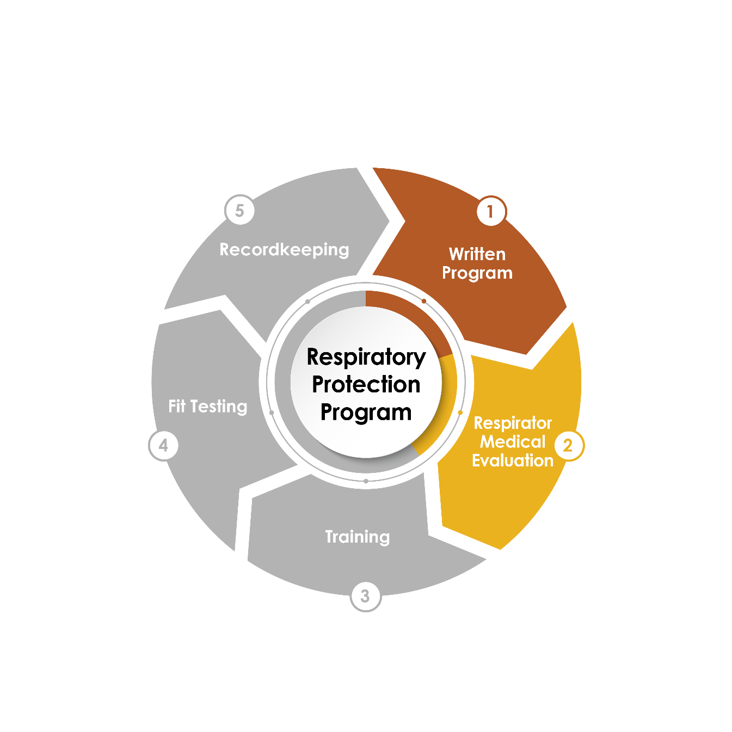
Medical Evaluation
^{(#1)} 1910.134(e)(1) – Medical Evaluation
Violations Reported: 618

Slide 14
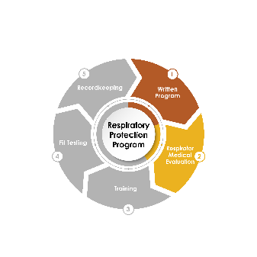

Medical Evaluation
Required before fit testing and respirator use
To assure user is physically able to wear respirator
Performed by a licensed health care professional (LHCP)
  Respirator Medical Evaluation Questionnaire
      Administered confidentially
      Completed on work time
  Initial medical examination that obtains same information
LHCP must know (supplemental information)
  Type of respirator to be used
  Duration and frequency of use
  Expected physical work effort
Employee needs to be given opportunity to discuss questionnaire or results with LHCP

Slide 15

Medical Evaluation
One-time evaluation for most people
Follow-up evaluations conducted when:
  Conditions of use change (high heat, high physical burden)
  User’s health changes (out on disability, heart attack)
  Observations during fit testing indicates a need
  Worker reports medical signs or symptoms related to ability to use respirator
  Physician, supervisor, or program administrator has reason to believe a worker needs to be reevaluated

Slide 16
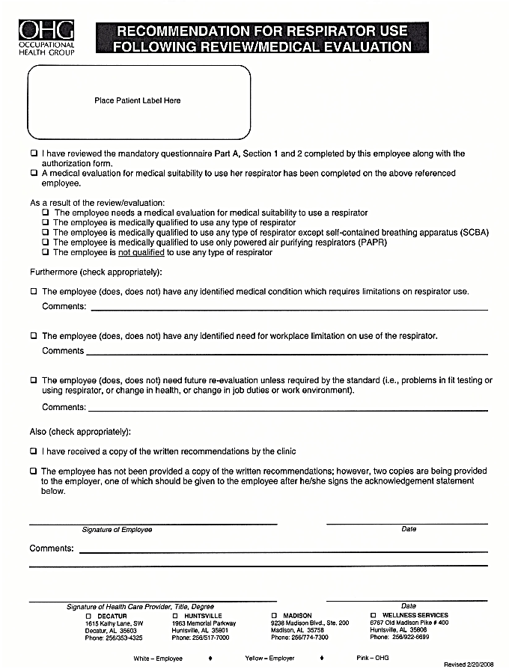
Medical
Certification

Slide 17
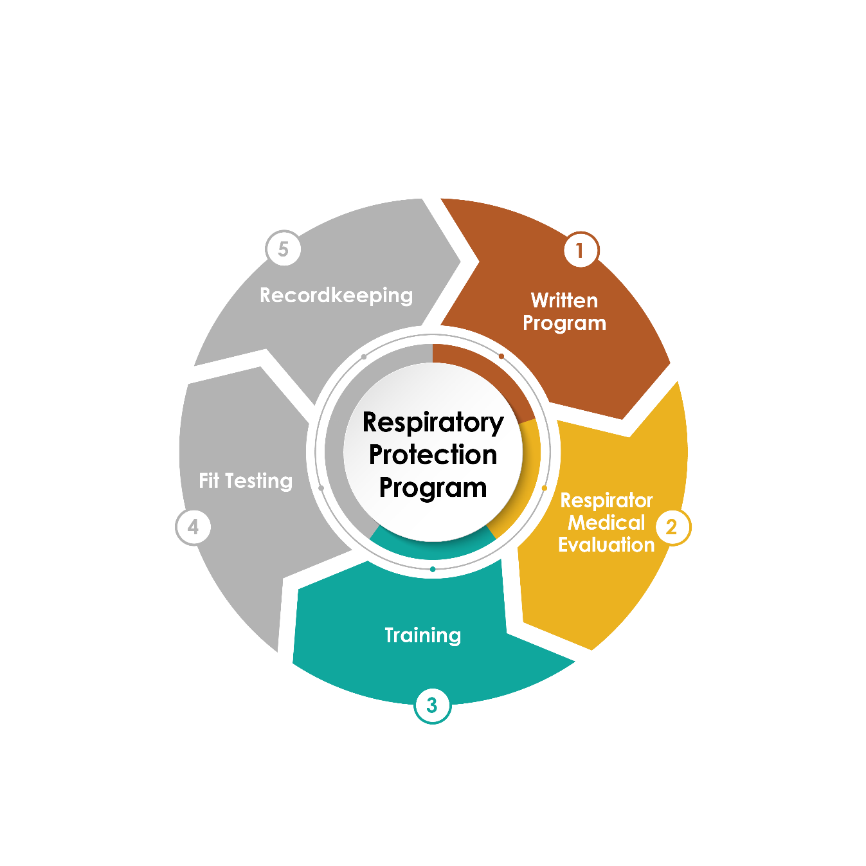
Training
^{(#4)} 1910.134(k)(1) – Training
Violations Reported: 130

Slide 18
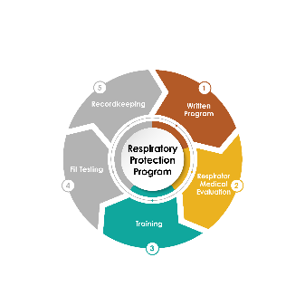

Training
Must be done prior to use
Training must address:
    Why respirator is needed
    Limitations and capabilities of the respirator
    Effective use in emergency situations
    How to inspect, put on and remove, use and check the seals
    Maintenance, care and storage
Provided annually, and more often when:
    Changes in workplace or type of respirator
    Employee has not retained knowledge or skills needed for safe use
    Other situations in which training appears needed to ensure safe use

Slide 19

Training
Notes:
Gemplers Video
After inserting, click on video, go to Video Format and set size as:
Height: 4.34
Width: 7.71

Slide 20
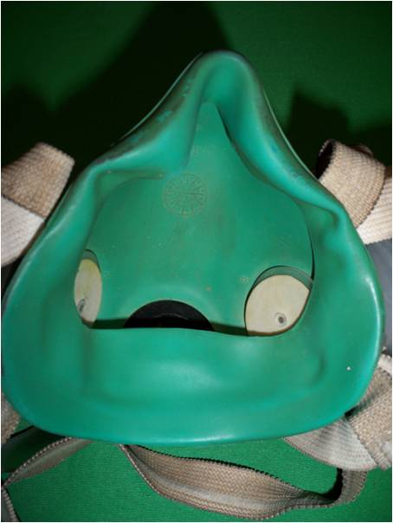
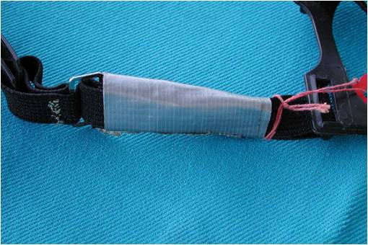

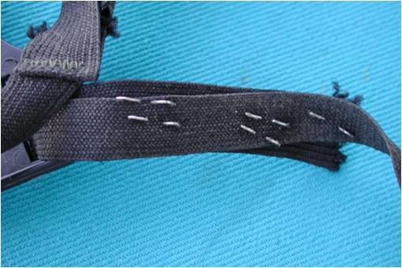
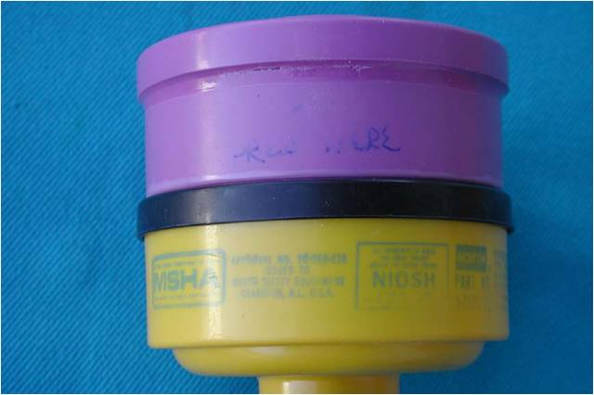
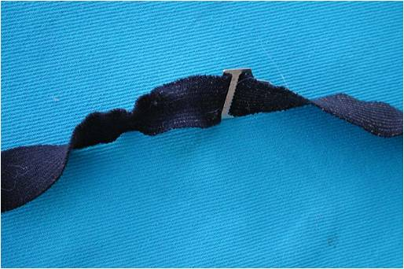
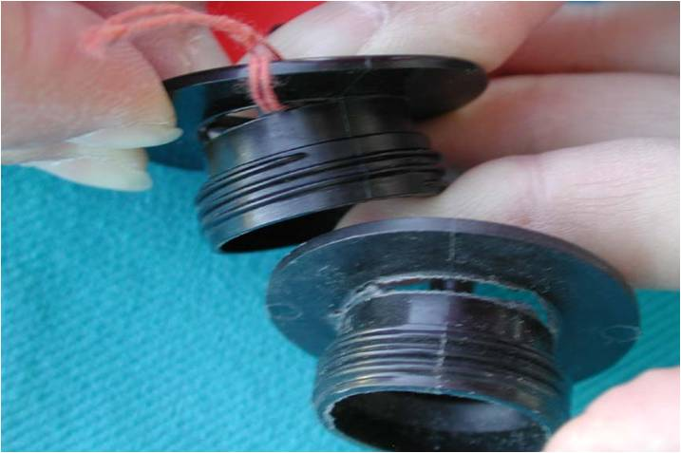
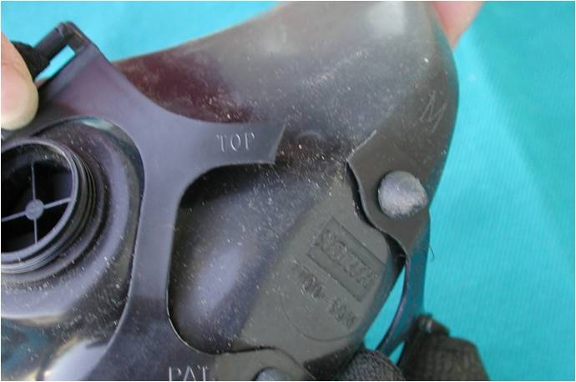
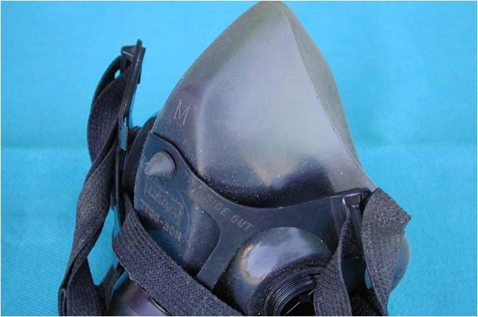
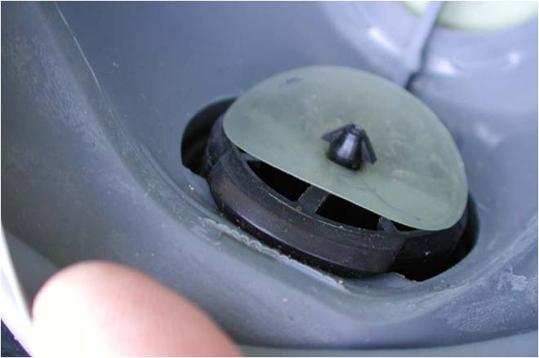
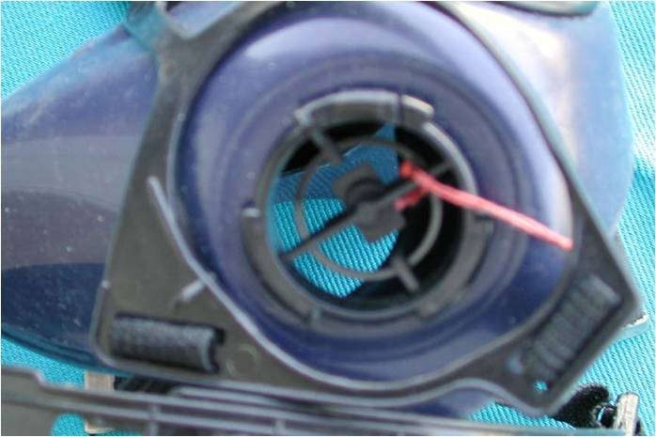
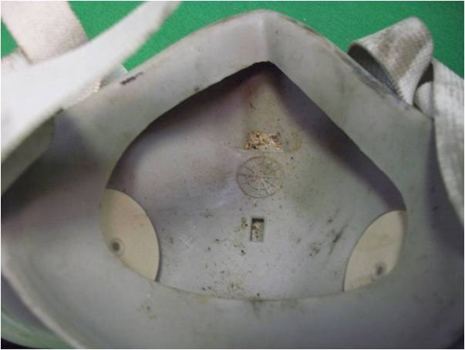
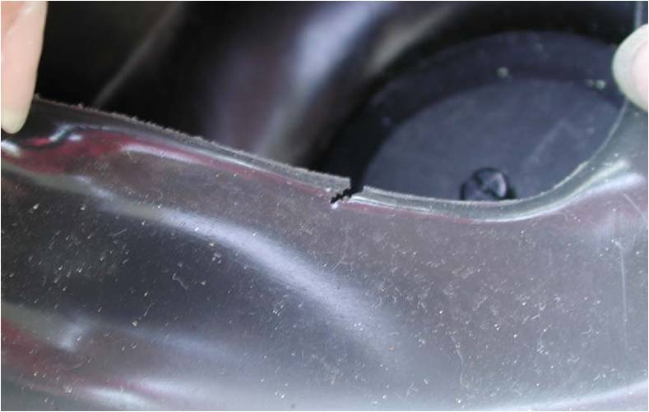
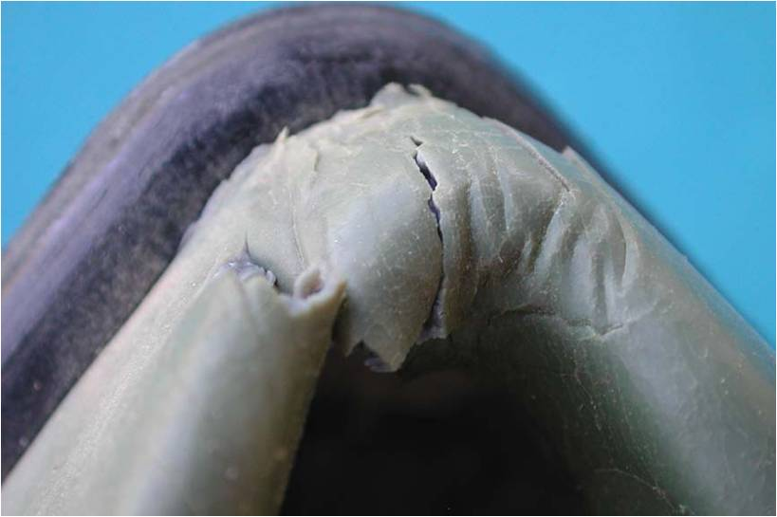
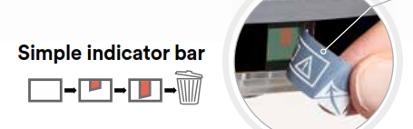

Training
Care and Maintenance
Inspecting
Check face-piece and valves for:
Excessive dirt
Distortion from poor storage
Anything cracked, torn or missing
Check Straps for:
Loss of elasticity
Anything cracked, torn, broken or missing
Cartridges
Cartridges must be changed regularly
Keep them in original packaging until ready for use
Store properly during non-use or dispose
If no ESLI, then employer must implement a change schedule based on objective information

Slide 21
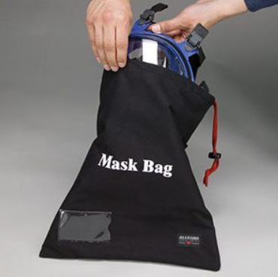
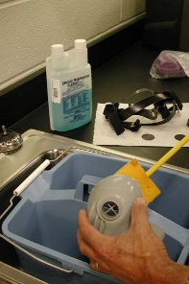
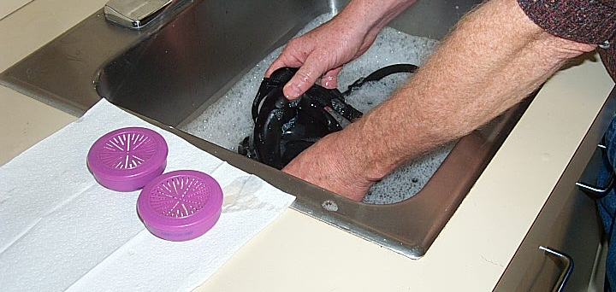
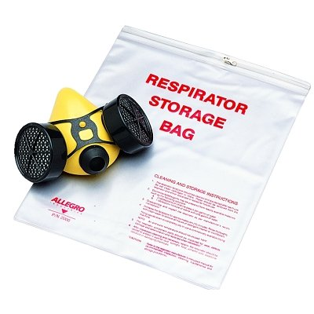
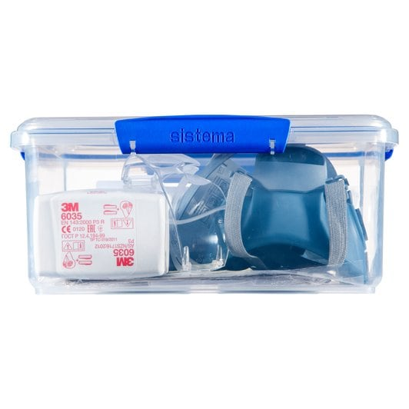
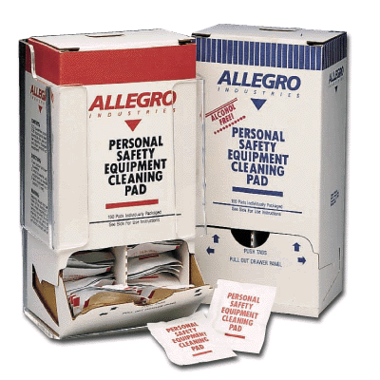
Training
Care and Maintenance
Storing
Cleaning
  Store in a sealed bag or container
  Protect against:
    Damage
    Sunlight
    Temperature
    Dirt and dust
    Moisture
    Areas to avoid:
    Glove compartment
    Behind the seat
    Hanging from hook or rearview mirror
  Must be clean, sanitary and in good working order
  Inspect prior to and after cleaning
    Clean using procedures in Appendix B 2 or according to MFG.
    If exclusive – as often as necessary to be maintained in a sanitary condition – AFTER EACH USE
    If shared by employees – prior to each use by employee
    Properly store until next use.

Slide 22
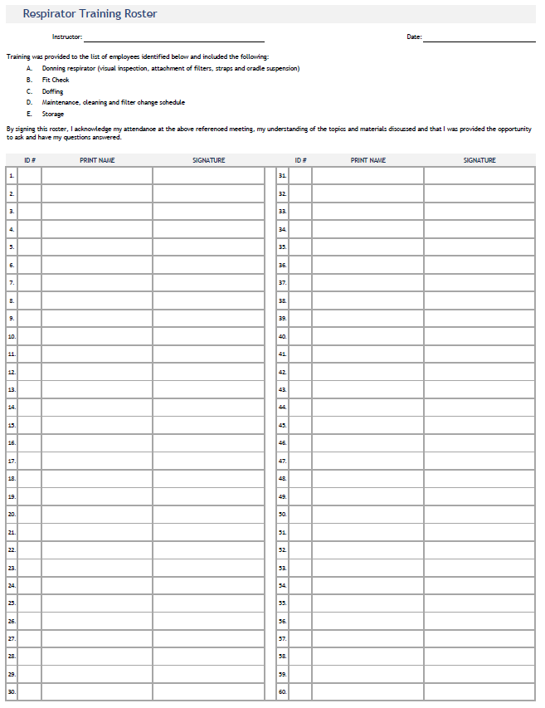
Record of Training
DOCUMENT

Slide 23
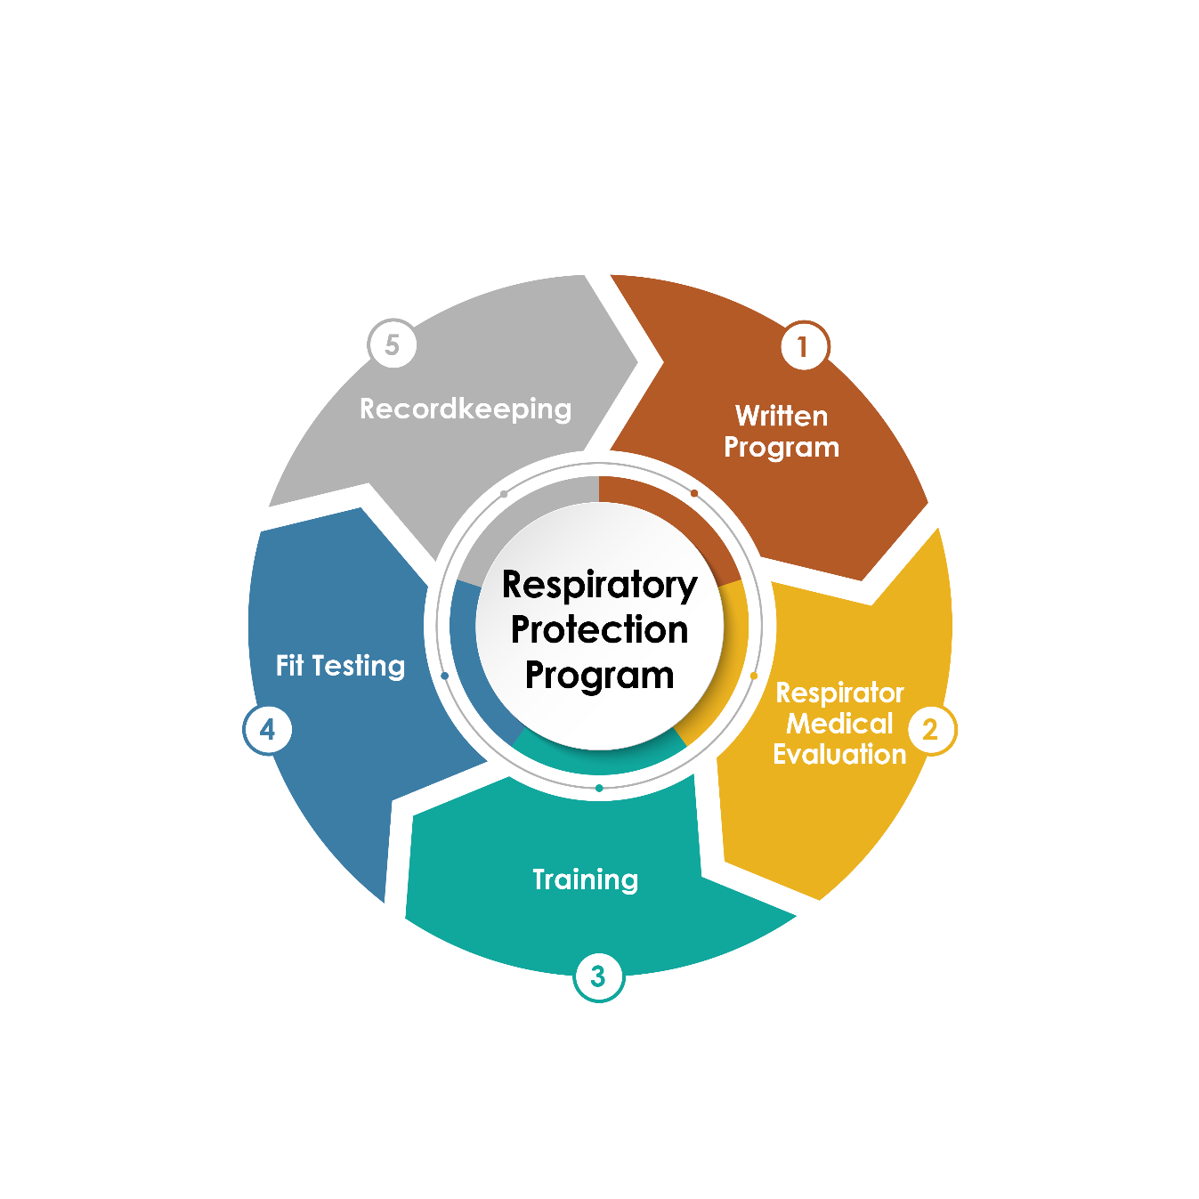
Fit Testing
^{(#2)} 1910.134(f)(2) – Fit Testing
Violations Reported: 519

Slide 24
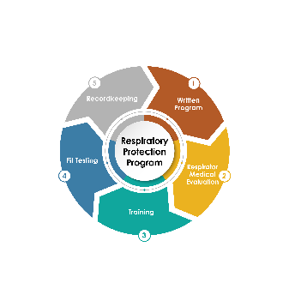
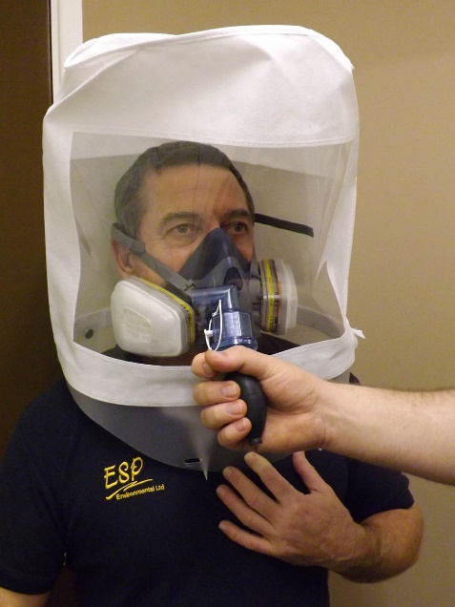
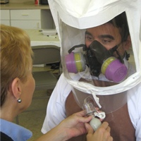
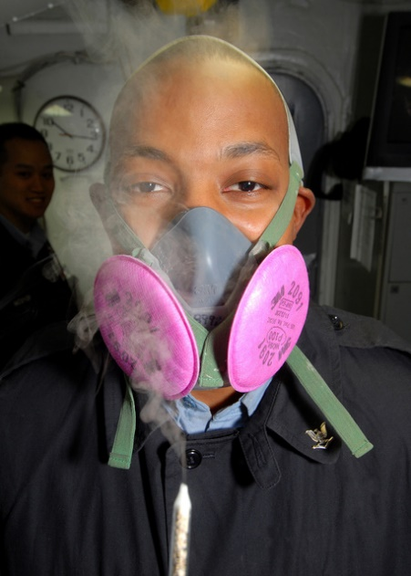
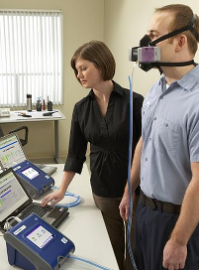
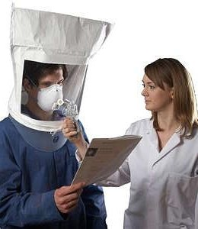
Fit Testing
Methods
Bitrex
Banana Oil
Saccharin
Irritant Smoke
PortaCount
Quantitative Method
Qualitative Methods

Slide 25

Fit Testing
Notes:
3M Fit Test Video
After inserting, click on video, go to Video Format and set size as:
Height: 4.33
Width: 7.71

Slide 26
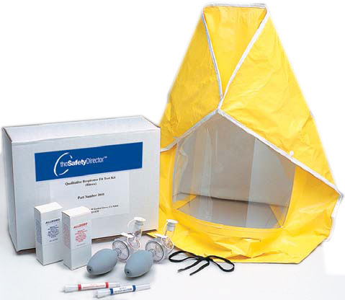
Fit Testing
Before initially using respirator
When changing to different respirator
At least annually, thereafter or sooner if:
  Changes in physical condition occur
    Recent dental work or dentures
    Facial surgery, treatments, scars
    Weight loss/gain of 15 lbs. or more
Comprised of two (2) parts

Slide 27
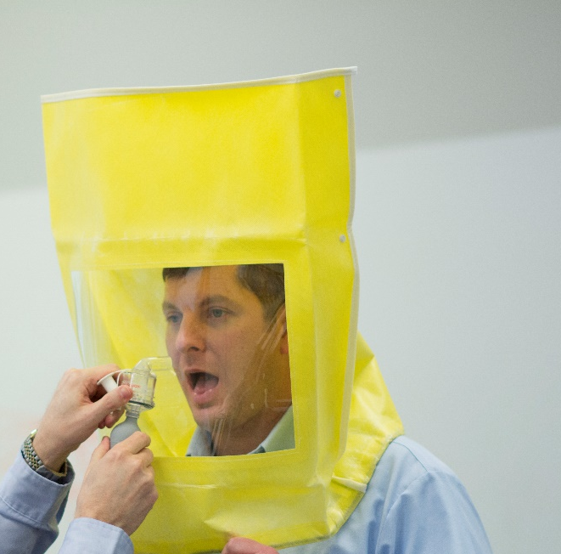
Fit Testing
SENSITIVITY TEST
Performed without respirator
Assure person being tested can detect solution
Do not eat, drink or chew gum 15 min before test
Test solution injected in increments of 10 up to max 30
If a taste response is detected from:
  1 – 10, the individual is a 10
  11 – 20, the individual is a 20
  21 – 30, the individual is a 30

Slide 28



Fit Testing
FIT TEST
Start – entire “N” (N = # of squeezes to elicit taste response 10, 20, 30)
30 seconds – ½ N
30 seconds – ½ N
30 seconds – ½ N
Remember:
30 seconds – ½ N
30 seconds – ½ N
Remind individuals to breathe through their mouth.
Ask often if they taste the aerosol inside their mask.
Check to make sure nebulizer is producing aerosol cloud.
Testing is terminated any time individual detects aerosol.
Successful fit test is demonstrated if all 7 exercises completed without detecting aerosol.
30 seconds – ½ N
30 seconds – ½ N
30 seconds – ½ N
30 seconds – ½ N
30 seconds – ½ N
30 seconds – ½ N
30 seconds – ½ N
30 seconds – ½ N

Slide 29

Record of
Fit Testing
DOCUMENT

Slide 30

Recordkeeping

Slide 31




Recordkeeping
Keeping your respirator protection plan and employee records organized is key to managing a compliant program.
Written program
Medical certifications
Fit test records
Training records
Air monitoring records

Slide 32

To Beard or
Not To Beard
Facial hair detrimental on the achievability of a successful seal
In almost all cases, the wearer will not achieve a suitable fit and will be placed at higher risk from leakage
Gases, vapors and particles will take path of least resistance and bypass what is designed to remove hazard
Recognized as a sensitive element of the Program
Evidence of tight-fitting respirator still being used with the presence of facial hair

Slide 33

Training
Care and Maintenance

Slide 34











Facial Hair
Which Respirator May Be Acceptable?

Slide 35

Facial Hair
How Do We Comply?
No solution that works for every organization.
Hazard evaluation - Hierarchy of Control
Devise an approach that works for you
  Requirement to be clean-shaven as a condition of employment,
  Permit facial hair on days that won’t require use of respirator – with understanding they will shave on spot,
  Make accommodations.

Slide 36

Facial Hair
Powered Air Purifying Respirator (PAPR)
A PAPR system typically includes a motor/blower, filter/cartridge, battery, headgear, and a breathing tube.
Higher capital expenditure
Expense may be justified in the sense that PAPR’s:
  Eliminate fit testing if used with loose-fitting facepieces, hoods or helmets,
  Potentially increase comfort to the wearer,
  Potentially integrate multiple types of PPE into one NIOSH-approved system (head, eye, face and respiratory protection).

Slide 37
Summary
Program Administrator
Hazards
Respirator Selection
Voluntary Use
Program Evaluation
Medical Clearances
Fit Testing Results
Training Records
Air Sampling Records
Initial
Annual
Changes in respirator
Physical changes
Questionnaire or Medical Exam
Clearance / Certification
Frequency
Use
Cartridge replacement
Inspection
Cleaning
Storage

Slide 38



