Slide 1


Program Overview
Return-to-Work that
Connects to Community

Slide 2





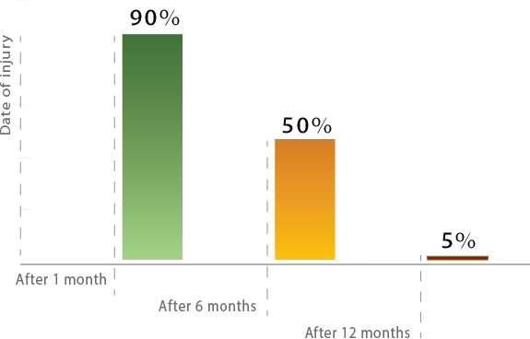

Return-to-Work Facts
Likelihood an injured worker will RTW
The likelihood an injured employee will ever RTW decreases with each passing day
Source: Bureau of Labor Statistics, American Society of Safety Engineer, A Physicians Guide to Return to Work

Slide 3






How do you currently handle Modified Duty?
Mobile Workforce
Significant Physical Limitations
Limited Onsite Options Available

Slide 4













Return-to-Work Facts
An effective RTW program can save a company
35% on medical costs and 30% in lost time days
54% savings of current workers’ compensation
costs after implementing a RTW program
60% to 70% of the lost work days involve medically unnecessary time off from work

Slide 5



What is Transition2Work?
ReEmployAbility’s Transition2WORK Program provides
transitional employment with a nonprofit agency
for an injured employee when the pre-injury employer is unable to accommodate a temporary light duty work release.
For use with work-related and non-occupational injuries and disabilities
Assignment options at nonprofit agency, employer worksite, or employee’s home (remote)
An extension of the employer’s internal RTW program
Employer continues wages during the transitional assignment period

Slide 6











Together...we connect people to a greater purpose so they can have a better life
Fear, Uncertainty, Communication, Trust,
Success

Slide 7









Transition2Work: A Win-Win Program
Benefiting employers, employees, carriers, and the community!
Bridges the gap between injured
employees’ capabilities and
employer’s ability to accommodate
modified duty on-site
Helps avoid ‘disability syndrome’, improves workplace morale, and retains a valuable employee
Encourages faster recuperation & return to work while potentially reducing medical costs
Improves employee’s sense of value & self-esteem by reintroducing employee to work routine
Promotes social responsibility, community outreach, and goodwill while exposing employee to meaningful work
Reduces claim duration and costs which can significantly impact experience modification, reserves, and future premiums

Slide 8



Transition2Work Offers Flexible Options
Transition2Work Assignment are Available:
At the employer’s worksite
Work-from-Home (remote)
At the nonprofit organization’s location

Slide 9




A Simple RTW Solution
Transition2Work Process At-A-Glance
Available Nationwide utilizing a nonprofit network of more than 40,000 organizations
Referral
Convenient online referral process
Quickly locating opportunities to accommodate physical restrictions
5-day commitment to provide update; typically scheduled to start in 5 days
Secure Opportunity
99% success rate securing assignments
Process includes search, coordination, and monitoring of nonprofit assignment
Official letters sent in accordance with jurisdictional guidelines
Placement Monitoring
Periodic updates on employees’ progress
Innovative time-tracking option
Communication with employer, adjuster, and attorney (if applicable)
Resolution

Slide 10




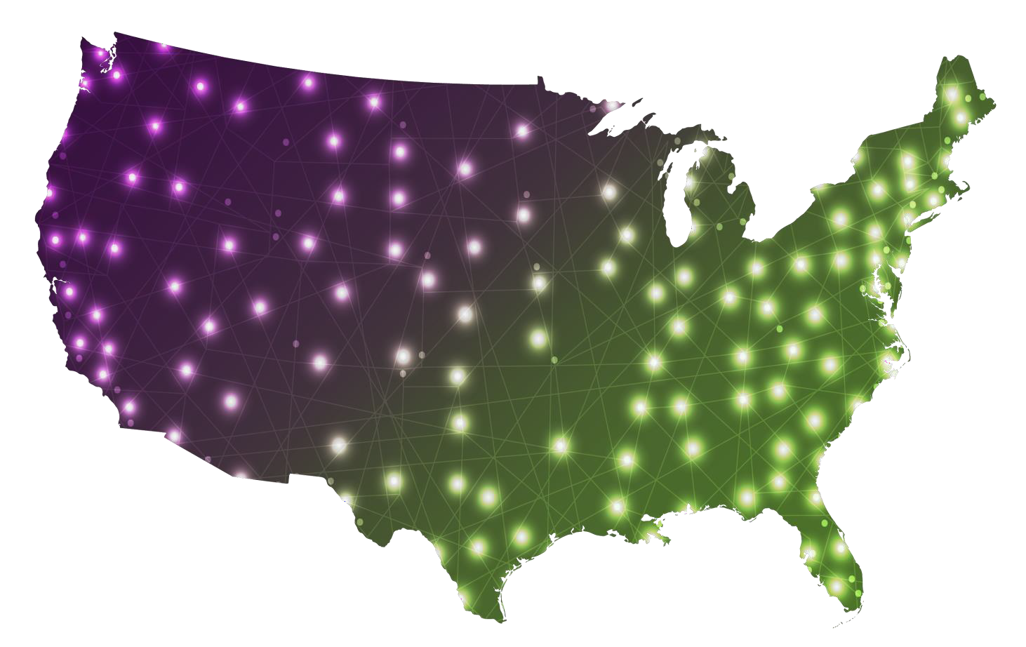








Growing National Nonprofit Network
40,000 Non-profits and more added daily

Slide 11






Bringing together businesses, employees, and communities
Thousands of local and national nonprofit agencies have benefited by hosting employees through Transition2Work
More than 1.4 million hours contributed last year

Slide 12



Transition2Work Transitional Duty Examples:
At the Nonprofit’s Location
Examples of Typical Assignments
at the Nonprofit:
Greeting customers
Stocking shelves
Data entry
Front desk attendant
Reading for literacy
programs
Tagging merchandise
Assisting customers
Handing out flyers
Sorting donated items
Placing & Answering
phones
Stuffing Envelopes
Light cleaning
Clerical assistance
Testing electronics

Slide 13







Program Outcomes
Actual outcomes on Workers’ Compensation through 12/31/2021
59% of employees referred returned to work, settled, or reached MMI
…25% do so before participating in an assignment
Outcomes – All Closed Files
1%
11%
Returned to Work, Reached MMI, or Settled
9%
Noncompliance
59%
Participation Barriers
Average of 58 days per participant
More than $4,100 average indemnity savings per claim
20%
Medical Status Change
Unable to Secure Assignment

Slide 14







The ReEmployAbility Difference
Return to work is our specialty
A comprehensive understanding of Jurisdictional Guidelines
Nationwide coverage
Leveraging technology for an exceptional client and employee experience
Measurable Outcomes with over a decade of success with proven results

Slide 15

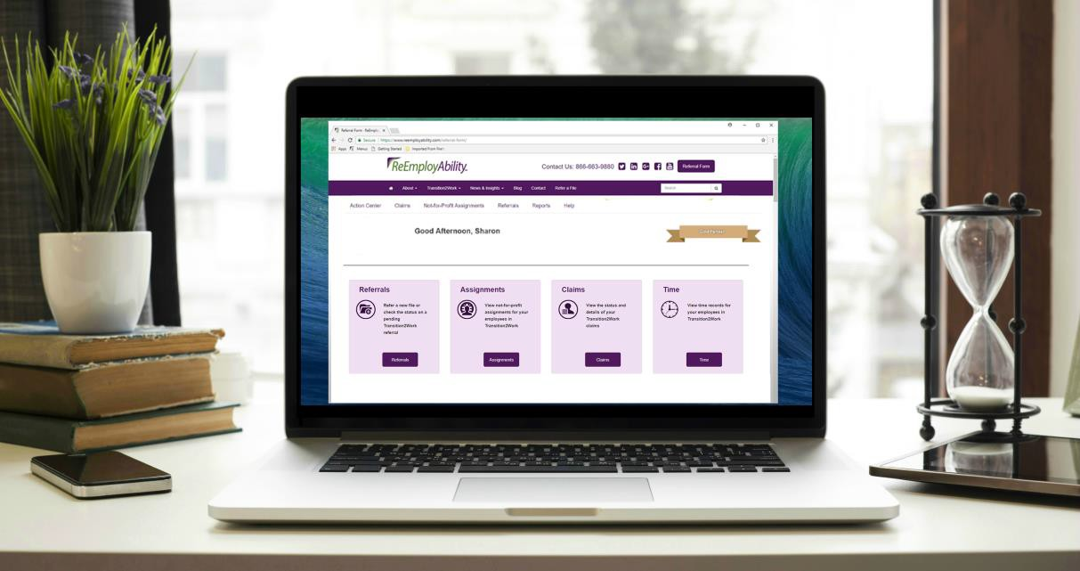

Online Portal
Access personalized reports and make referrals
through ReEmployAbility’s Online Portal
Easy referral submission
Secure 24/7 online access
View Claim and Assignment details
Optional Reporting Dashboard
Communicate with your Placement Coordinator
Watch the Demo
https://youtu.be/SaCx4cmnhUo

Slide 16


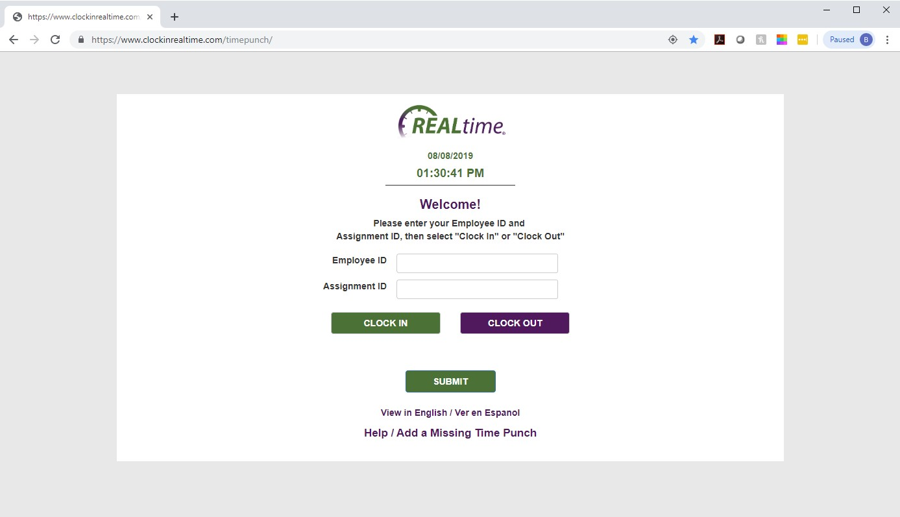
Electronic Time Tracking
Access Time Cards through ReEmployAbility’s Online Portal
Simple online or phone interface for employee to log time punches
Proprietary, custom-designed for
Transition2Work
Precise time & location tracking
Immediate, secure access to time records
Convenient reporting

