Slide 1
PestSure Resources Clay Williams, Sr. Risk Control Analyst
The information in this document was obtained from sources which, to the best of the writer’s knowledge, are authentic and reliable. Alliant Insurance Services, Inc.. makes no guarantee of results and assumes no liability in connection with either the information or recommendations obtained in this document. Moreover, it cannot be assumed that every acceptable procedure is included in this document or that abnormal or unusual circumstances may not warrant or require further or additional procedures.

Slide 2
Resources Available
PestSure.com Members Only Section
ADP (MVRs – Pre-hire and On Demand)
Origami Risk
Eos SAFE Driver
Driver’s Alert (MVRs – Annual Audit)
Safety and Loss Prevention Team (Linda and Clay)

Slide 3
PestSure.com
PestSure.com is a shared resource
Accessible by all PestSure members and employees, but must register on the site
Updated version of the site went live early 2022

Slide 4
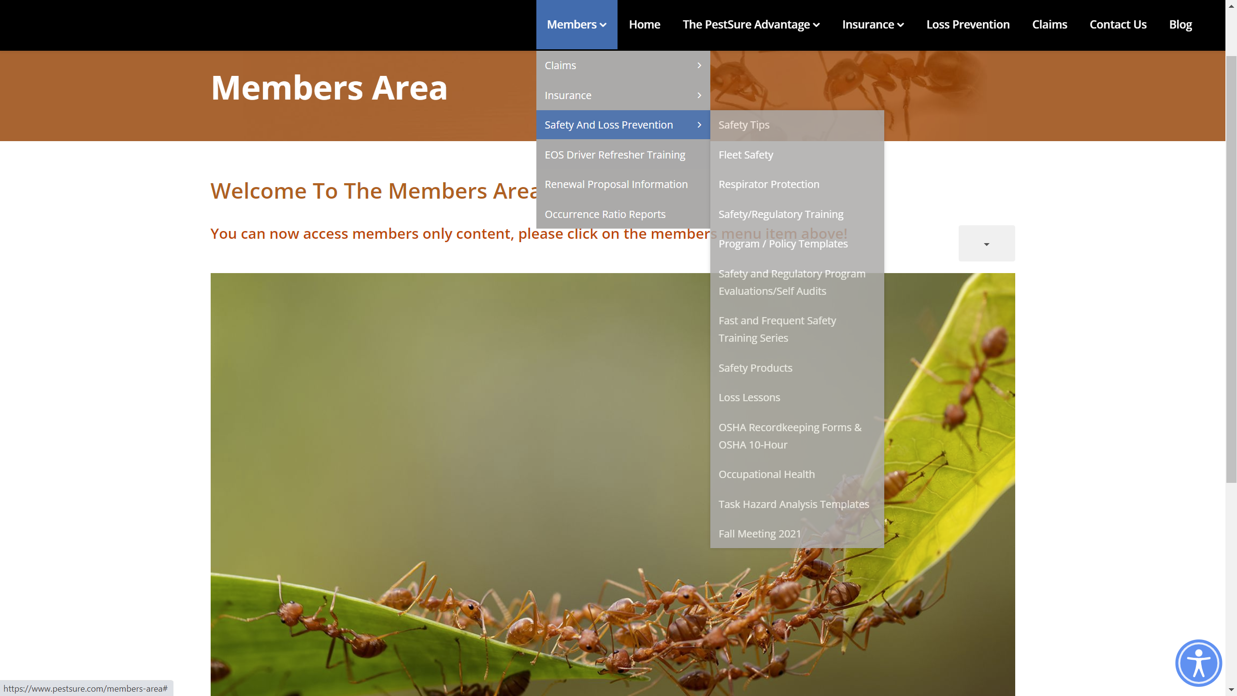
PestSure.com

Slide 5
PestSure.com
www.pestsure.com
Live Quiz Example Link:
https://www.research.net/r/AvoidLaneChangeCollision

Slide 6
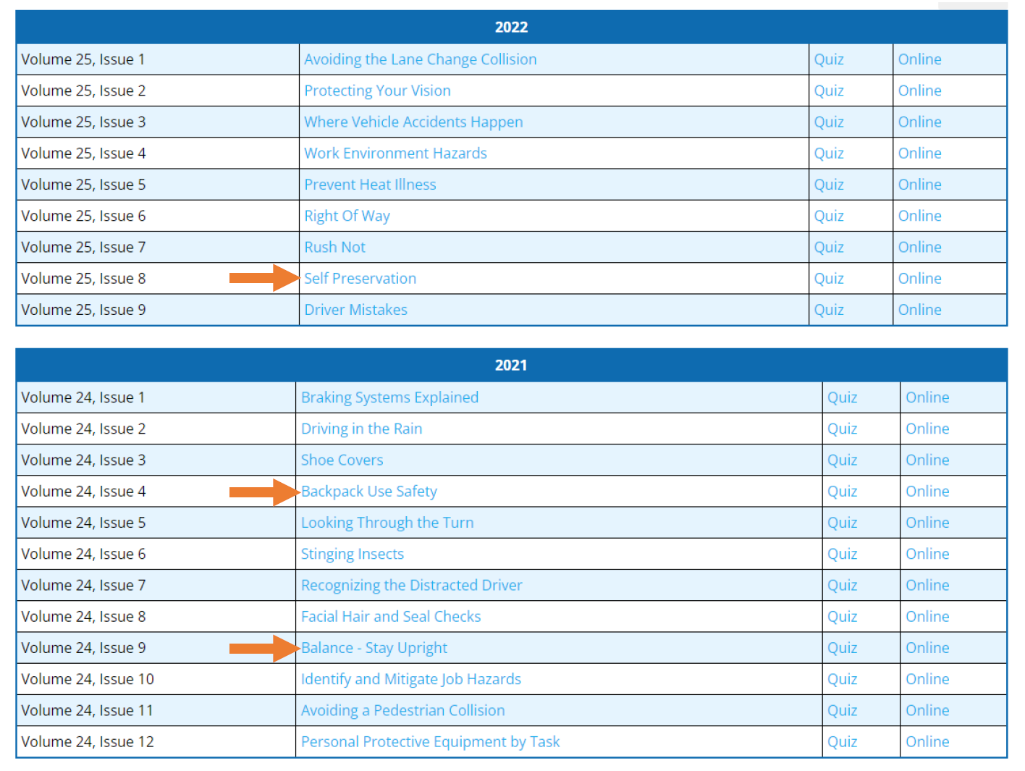
PestSure.com

Slide 7
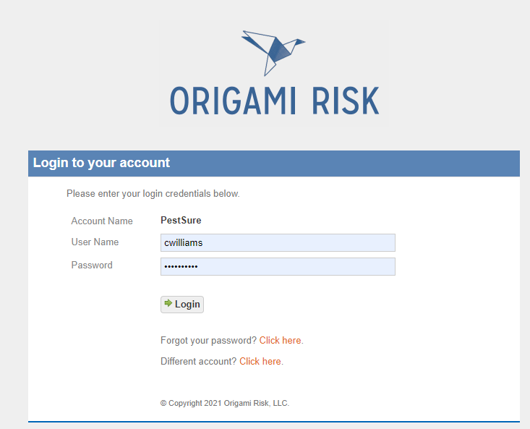
Origami Risk
Our Claims Management System (CMS)
http://live.origamirisk.com/

Slide 8
ADP – Pre-hire MVRs
www.adp.com
We must set up the initial user
Used for new hire and on-demand MVR checks
MVRs are FREE!

Slide 9
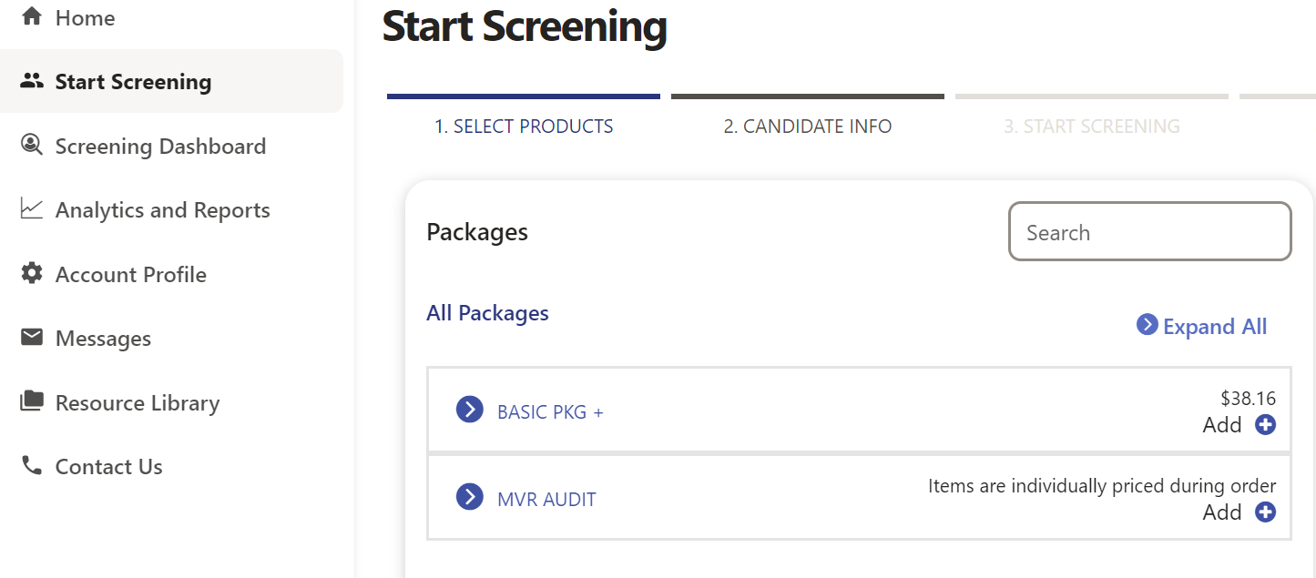
ADP – Pre-hire MVRs

Slide 10
Origami Risk
Dashboards
Claim and Incident History
Report Incidents
Run Reports
Anonymous Incident Portal

Slide 11
Origami Risk

Slide 12

Eos SAFE Driver
www.eosdriver.com
New and Improved

Slide 13
Driver’s Alert
www.driversalert.com
Annual MVR Audit using our Underwriting Criteria
Generally coincides with policy renewal, not always
Can also be used to store list of drivers throughout the year, simplifying annual audit
MVRs available post audit for your review

Slide 14
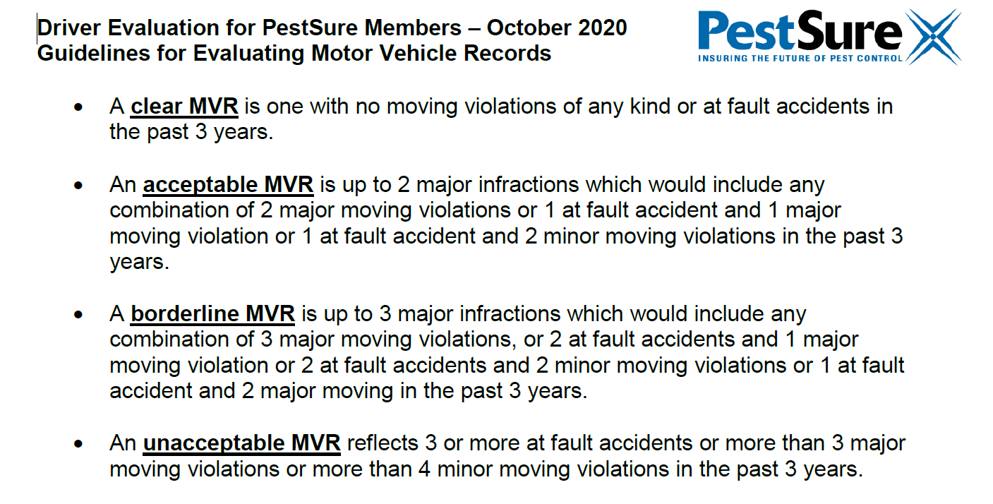
Driver’s Alert

Slide 15
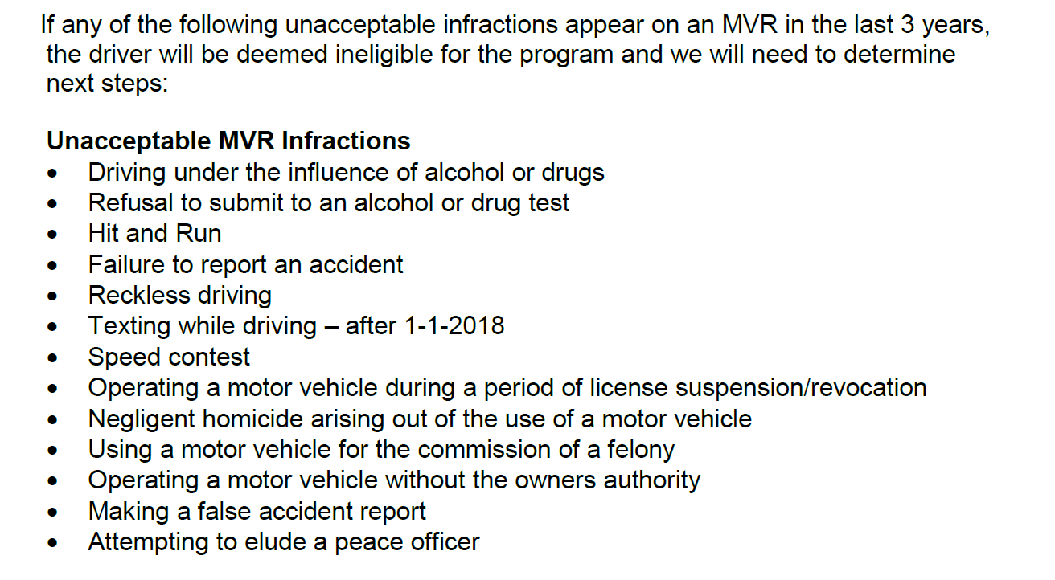
Driver’s Alert

Slide 16
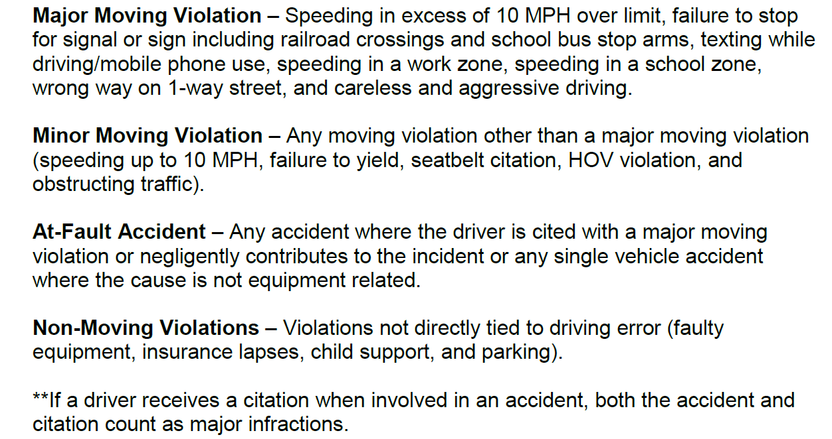
Driver’s Alert

Slide 17
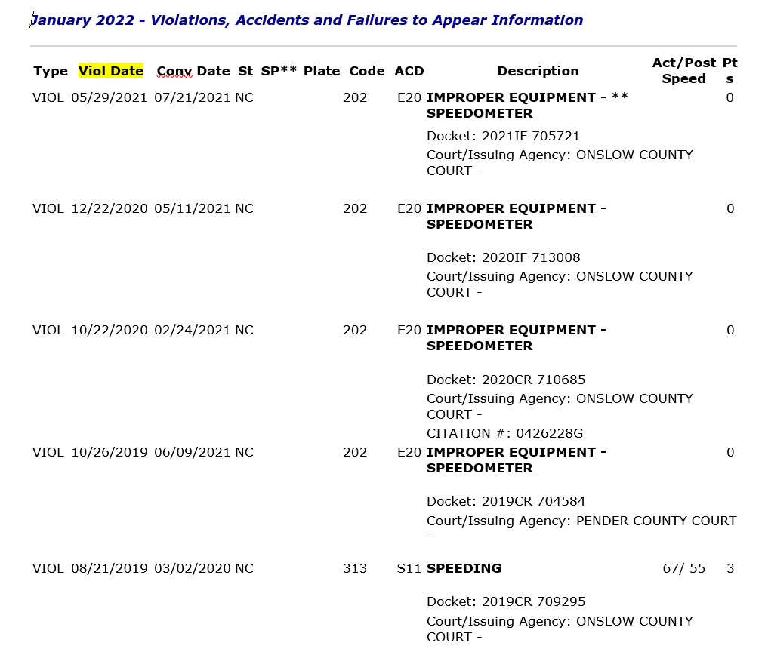
Driver’s Alert

Slide 18
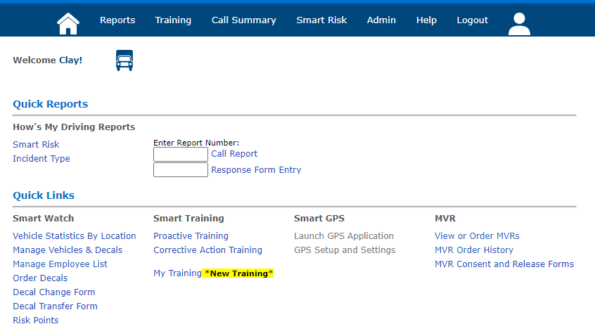
Driver’s Alert

Slide 19
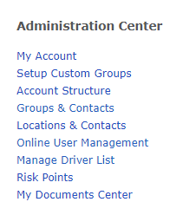
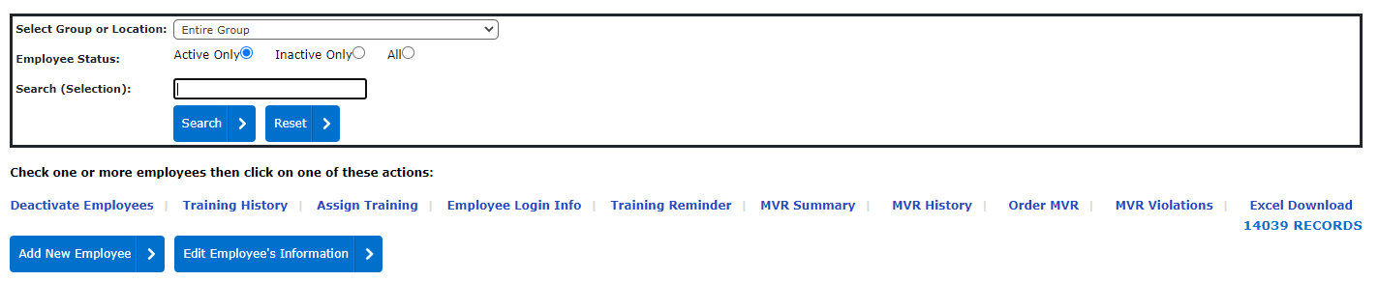
Driver’s Alert

Slide 20
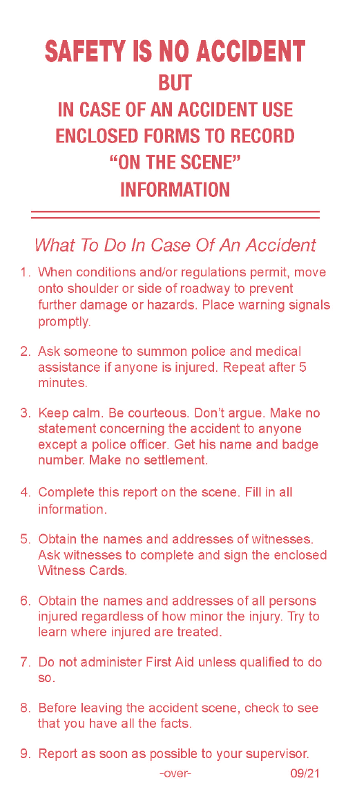
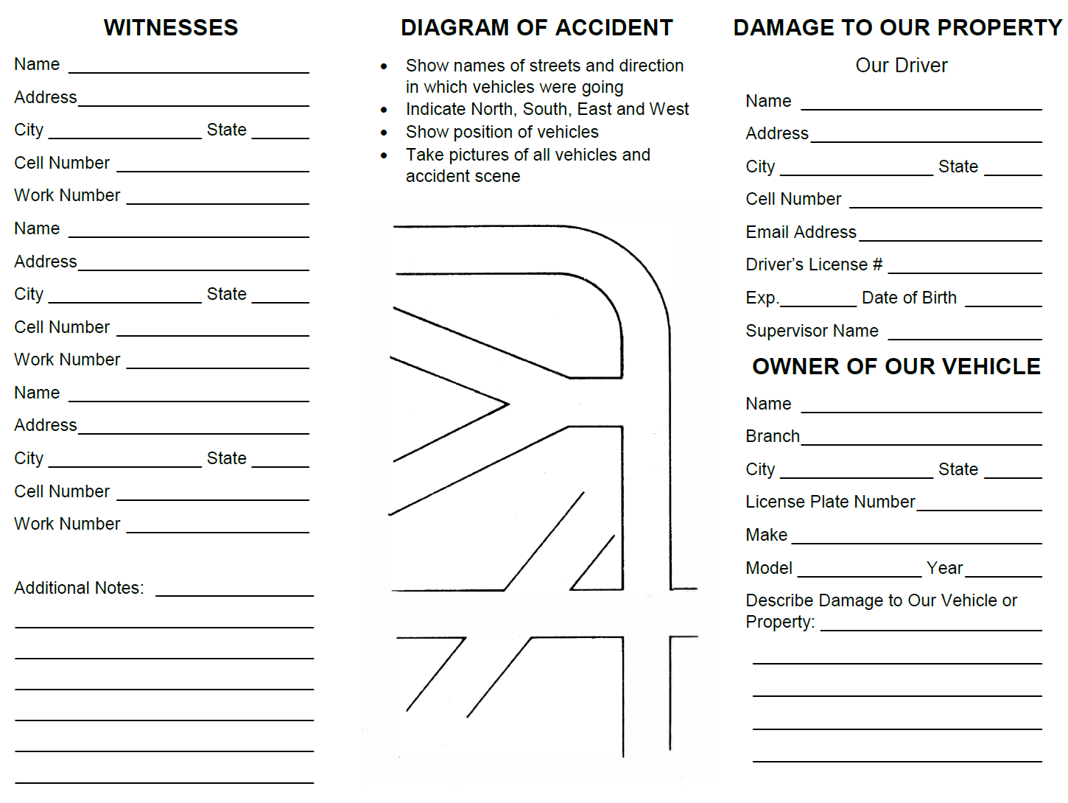
Accident Packets

Slide 21
Safety and Loss Prevention Team
Linda and Clay
Site Visits
Mock OSHA Visits
Spill Training
Loss-Specific Training
Loss Analysis
Custom Origami Reports
And More!
The information in this document was obtained from sources which, to the best of the writer’s knowledge, are authentic and reliable. Alliant Insurance Services, Inc.. makes no guarantee of results and assumes no liability in connection with either the information or recommendations obtained in this document. Moreover, it cannot be assumed that every acceptable procedure is included in this document or that abnormal or unusual circumstances may not warrant or require further or additional procedures.

