Slide 1
Occupational Health Clinics: Why bother?
Abby Thalachelloor, Director of Claims
Eileen Hand, Medical Performance Manager
Kim Barrett, Manager of WC Dedicated Unit
PestSure Loss Prevention and Safety Meeting: September 24-26, 2022

Slide 2
What is Occupational Health?
Occupational health is a field of health care dedicated to the well-being and safety of employees in the workplace.
An Occupational health clinic is a medical facility specializing in fitness evaluations and addressing any issues resulting from workplace accidents.

Slide 3
What makes a good clinic?
Quality patient care
Specializes in work-related health and safety
Knowledgeable about WC issues and the state and local process
Communicates timely and effectively
Keeps in contact with the employer
Maintains appropriate confidentiality
Understands your work environment
Assigns appropriate restrictions
Appropriately returns recovered worker to full duty
Provides the services you need
Notes:
-Quality Care is the most important and essential factor to consider. -Providers who understand your work environment can be priceless.
-you want a clinic that will work with you to understand the type of work you do generally and the specifics of an individual’s job.

Slide 4
What are the benefits?
Takes the guesswork out of where to send an injured employee
Quick access to a healthcare professional
Facilities can keep your WC insurance information on file and know how/where to submit bills for payment
Reduce costs by returning injured workers to productive work as soon as possible.

Slide 5
Interviewing an Occupational Health Clinic
Basics
Services Offered
Condition of the Facility
Communication Protocols

Slide 6
Basics
Are the physicians Board Certified in Occupational Medicine?
Is the facility a part of the Sedgwick Provider Network?
California MPN
Texas HCN
Notes:
-Research the potential clinic on line, make sure to note whether the clinic even mentions Worker’s Compensation.
-How many Work Comp cases have they treated in the past year? A low number of cases may indicate not much experience in managing WC.
-Not every provider is required to be board certified in occupation medicine.
-we recommend at a minimum the director be board certified
-Board Certification is achieved through additional training and testing as well as continuing education.
-There are clinics where there is not a Physician onsite

Slide 7
What services are offered?
Pre-employment testing/screening
Fitness for Duty/Physical
Drug screening
Physical Therapy
Occupational Therapy
Urgent appointment availability
Ergonomic assessments
Onsite Pharmacy
This can be state/location specific
Notes:
-Injured worker’s access to the clinic is service available 24hours? If not, what is plan for worker injured after hours? Most likely emergency room.
-How long does it take for an initial appointment –should be availability within 24 hours of injury
-How long do appointments typically take-New patient exams should take at least 30 minutes.
Are there other services you are looking for in an occupational health provider?

Slide 8
Condition of the Facility
Easy to find
Parking
Cleanliness of facility
Waiting Area
Interactions with Staff
Notes:
Take a tour of the clinic. This will give you a sense of what your employees will encounter.
-How easy is it to find the clinic?
-What is the parking situation?
-Are there steps to maneuver?
-IS the waiting area clean and comfortable?
-What is the atmosphere like?
-How does staff interact with the patients?
-Take time to speak with some of the caregivers, face to face introductions will help to develop a strong relationship between your business and theirs.

Slide 9
Communication Protocols
Designated contact at facility
WC reporting practices
Protocols on who facility communicates with
Return-to-Work Philosophy
Notes:
-Is there a dedicated person to contact about any issue that may come up? Having a specific person to s/w directly could help to resolve issues more quickly.
-Give the clinic a dedicated contact at your office
-Clear and timely reporting (within 24 hours of the Patient Visit) with the Employer (when appropriate) and Examiner
-Open communication with the Injured worker by the Medical provider is equally as important as it ensures a proper diagnosis and treatment plan to assure the best possible outcome.

Slide 10
Important things to note:
State and local jurisdiction considerations
Panels rules
HCN rules
Who has choice of provider?
Return-to-work policy
Return-to-work plan for specific employee
Light duty availability
Re-Employability
Any red flags?
Notes:
Having a good understanding of local, state and federal regulations is also a sign of an expert Occupational Medicine provider.
-Understanding of each states guidelines can be a challenge can sometime be quite confusing and with a Board Certified Occupational Medicine Provider, he can usually provide a level of understanding to your injured employees.
-Knowing the environment your workers are using daily, gives the Doctor a RTW guideline to assist the injured worker to return to work in the most timely fashion.
-again, important to note the overall work environment and specifics of an employees job to get accurate restrictions and RTW
This can often be reconciled through a simple copy of the Job Description or discussion with the Company contact. Or when appropriate invite the provider to your site and provide visual assessment of, for example, the employee’s usual equipment and describe a typical day.

Slide 11
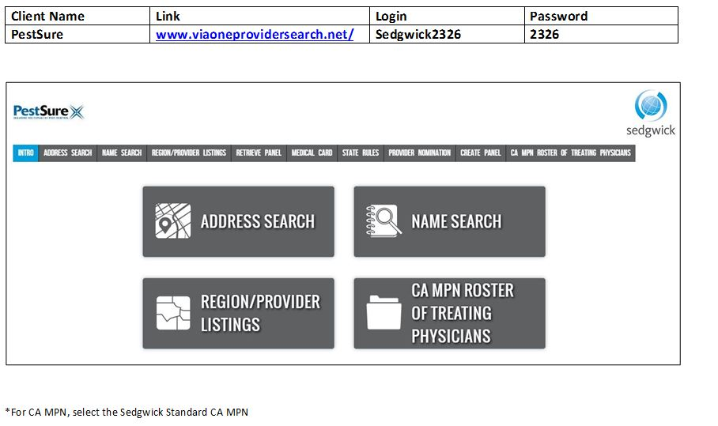
Sedgwick Provider Search

Slide 12
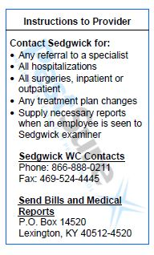
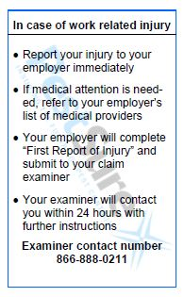
Injured Worker Wallet Cards

Slide 13
Questions?
Abby Thalachelloor
214.490.9630
abby.Thalachelloor@alliant.com
Eileen Hand
469.822.6639
eileen.hand@alliant.com
Kim Barrett
972.443.9105
kim.barrett@sedgwick.com

