Slide 1


OSHA Recordkeeping
Richard Spencer, ACE: VP of Safety & Risk Management

Slide 2


Questions before we begin:
What is your company’s injury reporting policy?
How long is a string?

Slide 3
Notes:
You should make sure you read and understand the entire 1904 standard
This course cannot cover all scenarios and regulations
Use your resources when cases arise to help you determine recordability or reportability if you are unsure
  We use Linda and a Third-Party Safety Company- Trinity Safety

Slide 4
Recordkeeping– the WHY
Helps you identify hazards your Team Members Face in the course of their Work
  Don’t forget OSHA’s General Duty Clause
These documents will be subpoenaed if council is retained by an injured worker
Commercial accounts may and do request them
Required by OSHA: 29 CFR Part 1904
These documents will be requested by OSHA if your Team Member lodges a complaint
These documents will be requested by OSHA if you must report and injury

Slide 5
The Records:
Any company with more than 10 Team Members in a calendar year must keep Injury & Illness records of incidents requiring more than first aid
Any establishment (individual and separate company entity such as a Pest Control Service Center) with 20 or more Team Members in a calendar year must report their summary information to OSHA digitally
You don’t have to use OSHA official forms if you can produce the information required by the forms in another format (excel)
If you have a needle stick or other medically sensitive injury, you will keep the name blank and keep a set of forms in a separate file

Slide 6
What is first aid: 1904.7(b)(5)(ii)
Using a non-prescription medication at nonprescription strength (for medications available in both prescription and non-prescription form, a recommendation by a physician or other licensed health care professional to use a non-prescription medication at prescription strength is considered medical treatment for recordkeeping purposes);
Administering tetanus immunizations (other immunizations, such as Hepatitis B vaccine or rabies vaccine, are considered medical treatment);
Cleaning, flushing or soaking wounds on the surface of the skin;
Using wound coverings such as bandages, Band-Aids™, gauze pads, etc.; or using butterfly bandages or Steri-Strips™ (other wound closing devices such as sutures, staples, etc., are considered medical treatment);
Using hot or cold therapy;
Using any non-rigid means of support, such as elastic bandages, wraps, non-rigid back belts, etc. (devices with rigid stays or other systems designed to immobilize parts of the body are considered medical treatment for recordkeeping purposes);
Using temporary immobilization devices while transporting an accident victim (e.g., splints, slings, neck collars, back boards, etc.).
Drilling of a fingernail or toenail to relieve pressure, or draining fluid from a blister;
Using eye patches;
Removing foreign bodies from the eye using only irrigation or a cotton swab;
Removing splinters or foreign material from areas other than the eye by irrigation, tweezers, cotton swabs or other simple means;
Using finger guards;
Using massages (physical therapy or chiropractic treatment are considered medical treatment for recordkeeping purposes); or
Drinking fluids for relief of heat stress.
Are any other procedures included in first aid? No, this is a complete list of all treatments considered first aid for part 1904 purposes.

Slide 7
The Forms:
First – Always question/investigate if the reported injury is work related
  Not all injuries that happen in the workplace are work related
Designate & Train one person within your company to review the medical information, determine if the injury is recordable/reportable, and log the injury on the forms
Create and train a review Team for cases that are, or may be, reportable directly to OSHA
You MUST report any fatality to OSHA and let them determine if it is reportable. Don’t play a guessing game with fatalities!

Slide 8
Panel of Providers:
Make sure you have a panel of providers posted at your location(s)
If your state allows it, make sure your injured worker seeks medical attention from a panel provider
Update your Panel annually
There are third party companies who provide panels

Slide 9

Information needed to complete the logs:
Company injury report (Arrow Worker Injury Report)
State injury forms (First Report of Injury)
Drs Notes from the visit
Panel of Providers

Slide 10
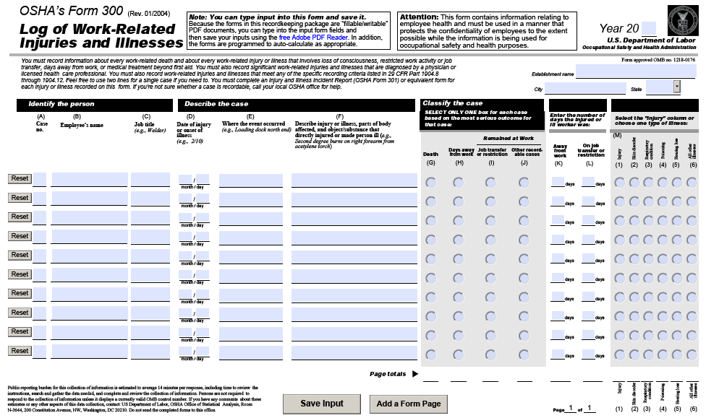
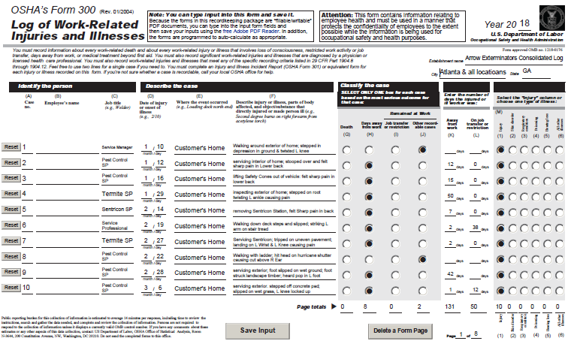
The Forms: Form 300 Log of Work-Related Injuries & Illnesses

Slide 11
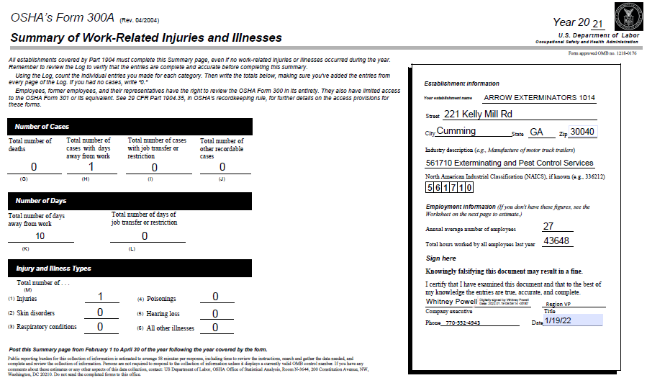
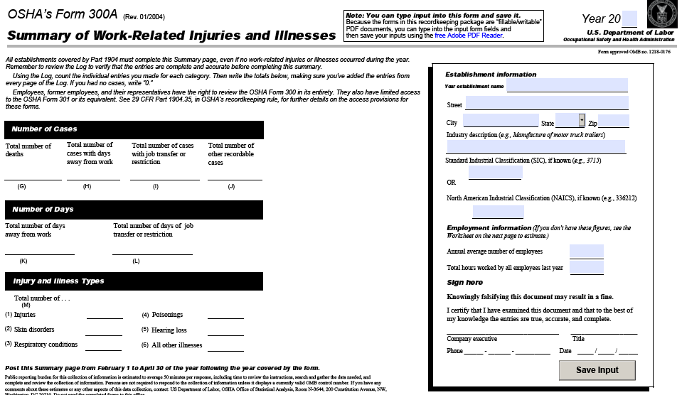
The Forms: OSHA 300A – Summary of Work-Related Injuries & Illnesses

Slide 12
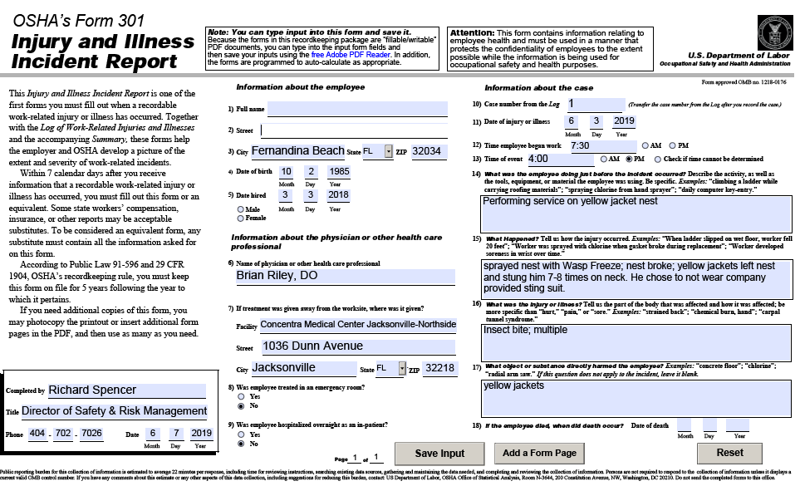
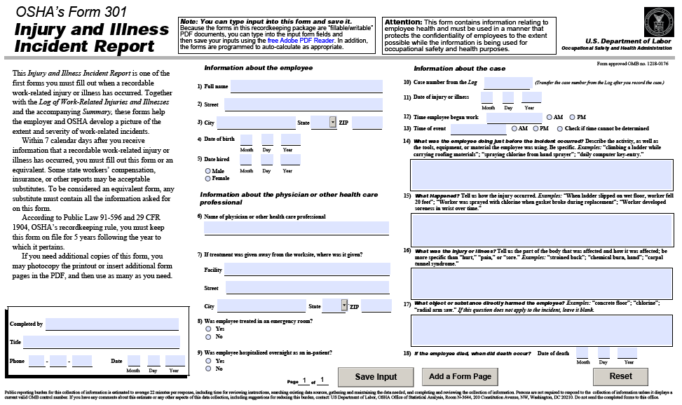
The Forms: OSHA form 301- Injury & Illness Incident Report

Slide 13
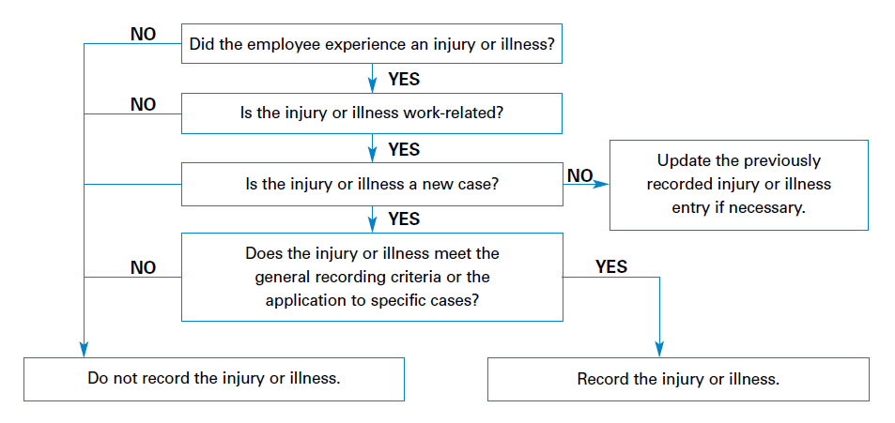
The determination: IS the injury recordable on your OSHA logs?

Slide 14
Reporting Injuries to OSHA:
Fatalities, In-patient hospitalization, amputation, loss of eye
Fatality – you have 8 hours from the time you were notified of the fatality to contact OSHA
In-patient hospitalization, amputation, loss of eye – you have 24 hours from the time you were notified of the injury to report the injury to OSHA
How to contact OSHA:
  Call 1-800-321-OSHA (6742)
  Call you closest area office during normal business hours
  Use the online form
I have both called and used the online form
The online form is much more efficient and provides record of the communication

Slide 15

Prepare for the eventual:
OSHA logs
Verified Training
Incident investigation process
A Team to review response
Root cause analysis

Slide 16
Game: Is it recordable?
Admin gets up from desk, looses balance, and fractures ankle
Team Member reports to manager that their Red Wing boots have caused a blister on their ankle that needs medical attention beyond first aid
Team Member is on way to work from home in company vehicle, is in collision that requires medical attention beyond first aid
Team Member is at customer home to provide service. Asks customer if dog is friendly, customer says “yes”. Team Member leans down to pet dog and dog bites him on face causing lacerations that need medical attention beyond first aid
Team Member slips down customer stairs and breaks ankle requiring 6 weeks no work

Slide 17
OSHA Rapid Response Documents:
Initial letter received after reporting an injury that required in-patient hospitalization

Slide 18
Our response:

