Slide 1
PestSure Clinical Consultation

Slide 2
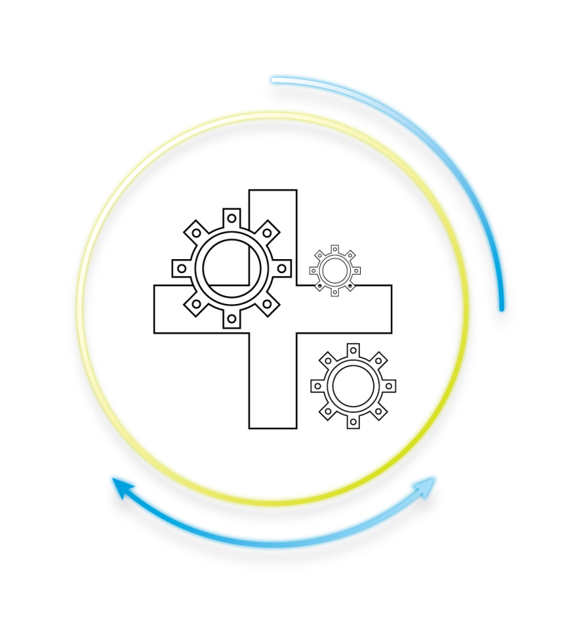
What is Clinical Consultation?
Clinical Consultation is a 24/7/365
nurse triage line staffed by
a registered nurse.
Clinical consult provides
medical assessment and
care recommendations.

Slide 3
PestSure Dedicated Triage Line
Nurse Consultation
  Call PestSure’s dedicated nurse line 1-855-291-0540 with injured employee to speak with a Sedgwick Registered Nurse
Report the Claim
  Calling the nurse does not substitute for claims reporting
  Be sure to follow normal reporting protocols
Process Exceptions
  Employee emergency or
  Employee already sought treatment from a doctor

Slide 4
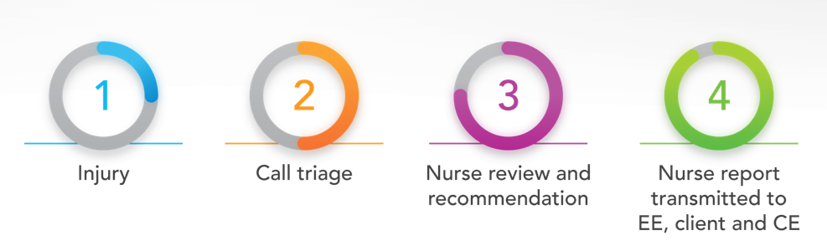
What You Can Expect
Referral Options
First-Aid/Self-Care ● In Person Treatment

Slide 5
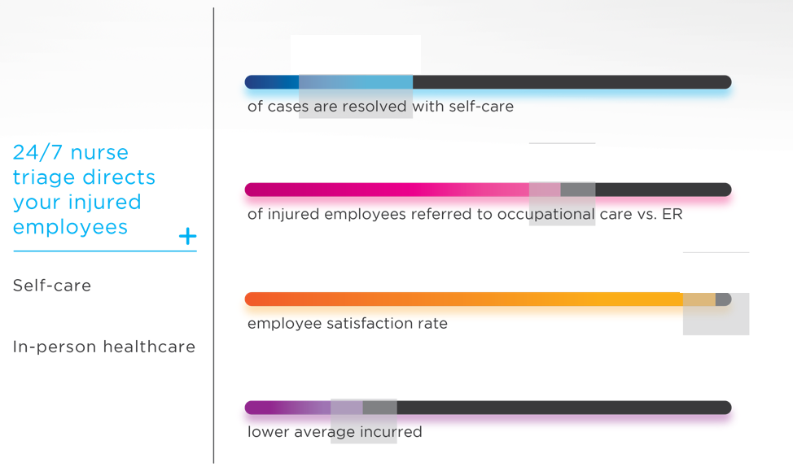
Sedgwick Book of Business Results
22%
64%
97%
29%

Slide 6





Program Benefits
Critical information is gathered at the time of injury
Allowing a medical professional to determine treatment
protocol
Medical appointments arranged/scheduled at the time of the injury
Savings achieved through an overall reduction in the average cost per claim
Information is shared with the designated client contacts and Sedgwick claims examiner

Slide 7
Self Care and Provider Referral PestSure Calls

Slide 8
Next Steps
What we need from you:
  Clinic information – Names/Addresses of doctors/clinics where your employees treat for work related injuries
  Contact information for triage report recipients
  Send information to:
    carmen.andreini@sedgwick.com
    carrie.layton@sedgwick.com

Slide 9
PestSure Nurse Consultation
QUESTIONS?

