Slide 1
Large Loss Review: Partnering for Better Outcomes
Angela Guitar, Head of Excess Claims
North America
October 25, 2022 – Park City, Utah
Notes:
WARNING: if you try to copy/paste slides from a PPT presentation that doesn’t have this layout, you will probably face some technical issues. To avoid such thing, you can click on ‘new slide’ in the top menu of this presentation and copy/paste the elements from your former slide onto the new one (but not the slide itself).

Slide 2


Slide 3


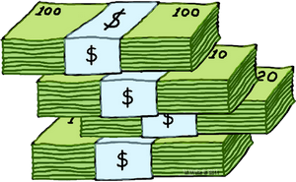
Social Inflation and Nuclear Verdicts – Definition and Causes
Social Inflation
The rising costs of insurance claims that are a result of societal trends and views toward increased litigation, broader contract interpretations, plaintiff friendly legal decisions, and larger jury awards
Larger
and
Less Predictable
Jury Awards
and
Settlement Values
Being Fueled By
Societal Factors
Litigation Funding
Plaintiff’s Bar
Judiciary
Jurisdictional Issues
Nuclear Verdicts
Verdicts of $10 million or more which are unexpected and impact future claim values

Slide 4
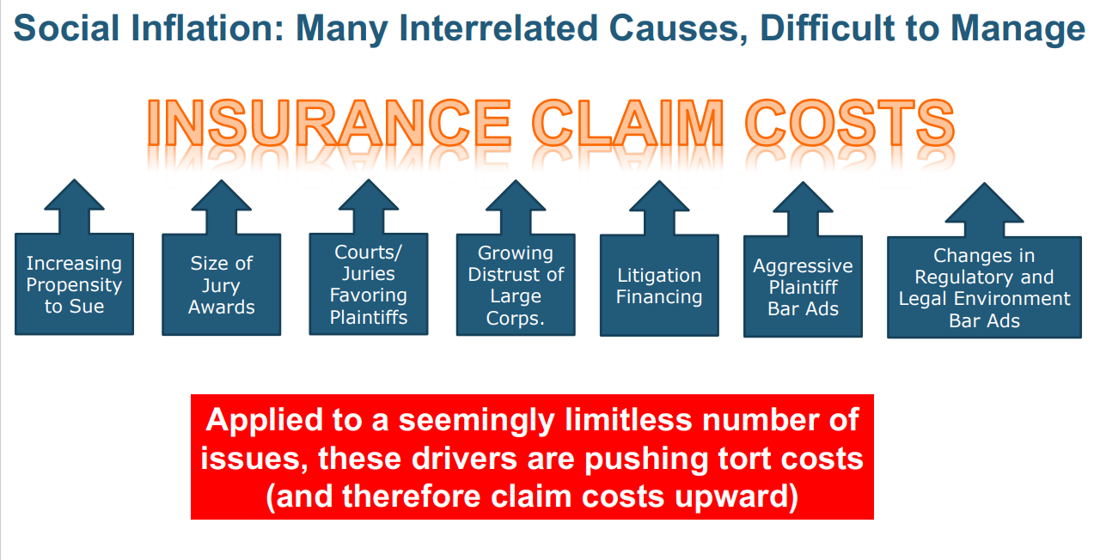

Slide 5
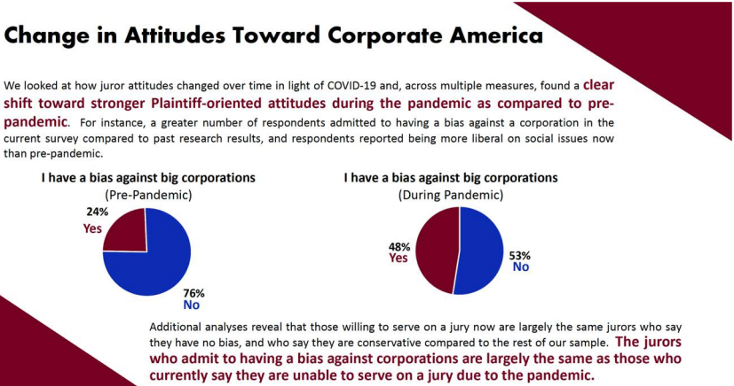
How Would Juries React in a Covid Environment?
One Legal Research Group’s Findings

Slide 6
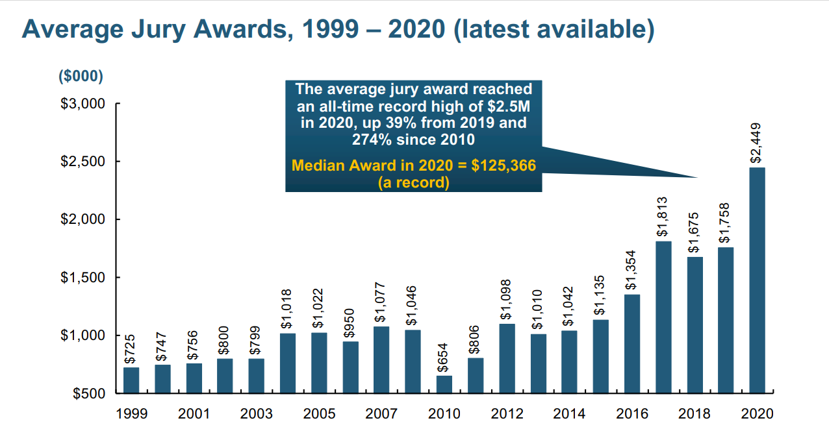

Slide 7
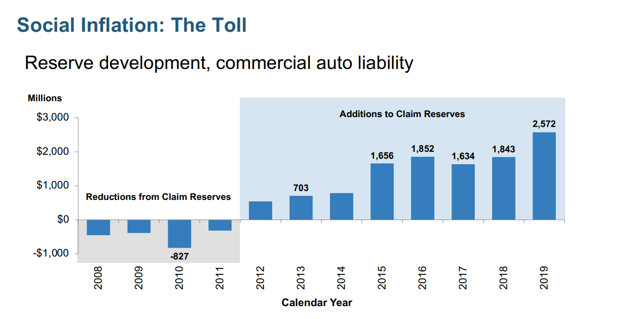

Slide 8
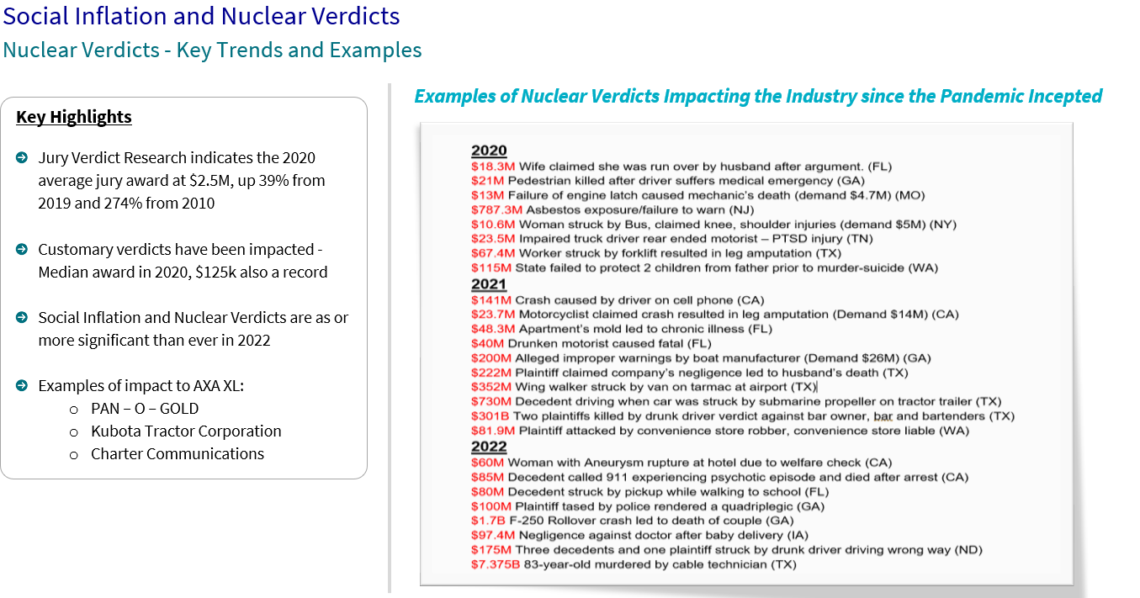


Slide 9
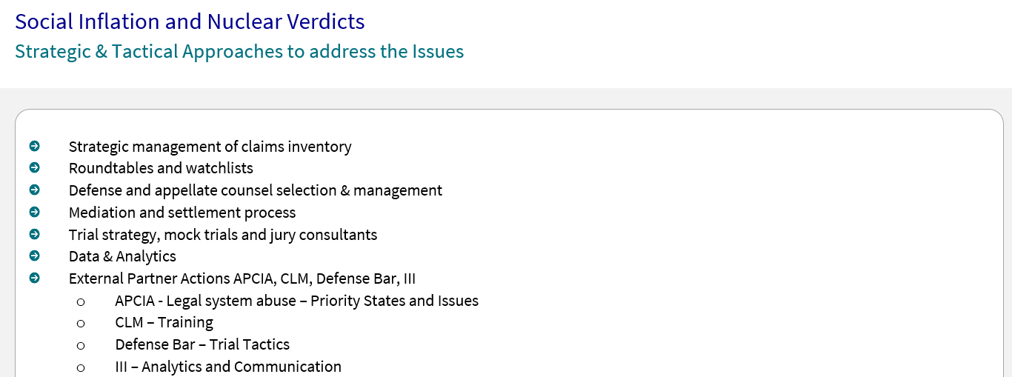

Slide 10
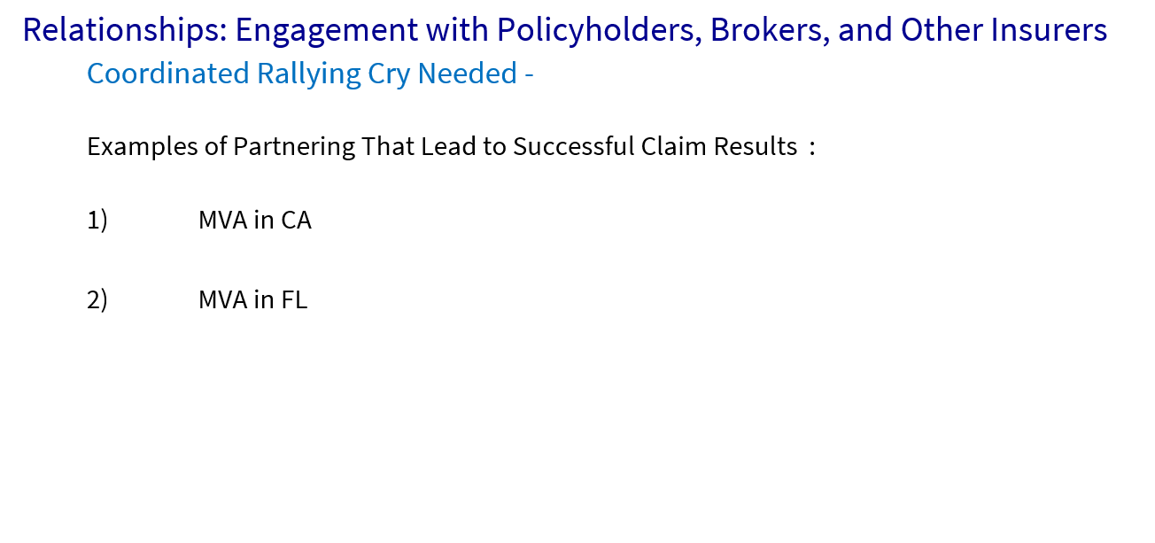

Slide 11
Take Aways
Social Inflation and NVs are remain challenging – Courts have been fully operational since end of 2021
The litigation environment is difficult but manageable – many complex reasons contributing – industry issue
Impacting related cost, indemnity results and relationships
We’re continuing and refining our approach to case resolution
We believe relationships and partnering with insureds, brokers and other carriers where possible including and beyond claims is an opportunity

Slide 12
Success Looks Like….
You treat us as a member of your team, knowing that we are here to help
You notify us early and often!
You help us understand the issues you’re facing and you understand that we have resources and access to an extensive network of lawyers, experts, and consultants
You collaborate with us before conceding liability

Slide 13
QUESTIONS?
10/26/22 – Park City, Utah
Notes:
WARNING: if you try to copy/paste slides from a PPT presentation that doesn’t have this layout, you will probably face some technical issues. To avoid such thing, you can click on ‘new slide’ in the top menu of this presentation and copy/paste the elements from your former slide onto the new one (but not the slide itself).

