Slide 1
Fleet Safety Basics
The unintentional mixed message

Slide 2
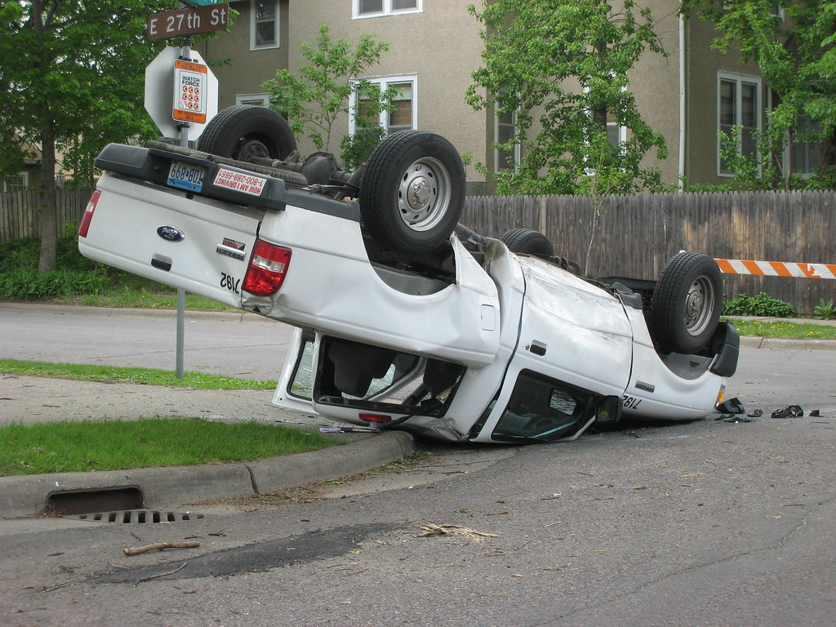
Basics
Most dangerous activity
Largest exposure or potential for loss
Daily discussions are warranted

Slide 3
Let’s Get this out of the way
Cognitive distractions occur when a driver’s attention or concentration is hindered by some sort of mental distraction. It’s when part of your mind is on something else, instead of solely on the road.
Hands free too.

Slide 4
Cognitively distracted drivers:
Have slower reaction times. In fact, one study found that legally drunk drivers had faster response times than cognitively distracted drivers.
JUST DRIVE
Are blind to their surroundings. Researchers found that nearly half of the information in a cognitively distracted driver’s immediate environment—traffic signs and signals, other vehicles, etc.—went unnoticed.
Have reduced activity in parts of the brain that are usually active while driving. For example, parts of the brain that are dedicated to processing visual information, spatial information, and overseeing navigation show less activity when a driver is engaged in conversation, listening to news or talk shows, or listening to audio books.

Slide 5

This is Difficult and Time Consuming
Involves new and existing drivers
It never ends
No “magic pill” solution

Slide 6
Perception of Expectations
Perception is reality
Our team of entrepreneurs
Our discussions and the result
Go – go – go Culture
What is meant by being entrepreneurial?
Someone who makes money by starting their own business, especially when this involves seeing a new opportunity and taking risks.
Notes:
Perception is reality so we must figure out perceived and manage it.
We choose entrepreneurs so we must understand that means
If we talk production continually without including safety – we get production over anything else
routing/idling/#of stops/ time at stop
Room for both messages in perfect harmony. Go – go – go Culture = injuries and crashes

Slide 7

Cause and Effect
Habits – we all have unsafe driving behaviors
Desire to change
We can talk about preventing crashes once we accept the cause and effect of the crash
Driver training focuses on changing habits
Notes:
Driving is habitual and we started learning to drive long before age 16
habits that are sooo engrained are very difficult to change
we need the desire to change, first
This is where I think we sometimes fail. We assume people choose to not change or that they consciously engage in unsafe driving practices when it is simply engrained habits.
Employers and our training can be directed toward changing habits rather than knowledge intense. We know how to turn the wheel and push the pedals since 16.
We need to change our language and get our drivers to do the same:
My pen dropped the vehicle in front of me stopped
I dropped my pen I could not stop and hit the vehicle in front of me
Then we can talk about preventing this from happening again by changing our habits and behaviors.

Slide 8
Safe Driving Culture
BHGAVBTE (big hairy ginormous awful very bad terrible event)
We must always react to accidents . . . . however!
Culture comes when we give this level of attention prior to the BHGAVBTE
Reactionary vs Culture
Notes:
If we only react to accidents or vehicle damage as opposed to having a constant level of attention, then this becomes our culture. Reactionary

Slide 9

Uncompromised driver selection
Who is selecting
What is the criteria
What does the MVR show you

Slide 10
Uncompromised Selection
Your insurance rates
The driver history
Driving experience
The “loved one” test
You can’t afford them so welcome them to re-apply when their driving record improves.
Notes:
Your crashes effect your per vehicle rate – not the rate for 1 driver or 1 vehicle.
MVR
Time behind the wheel – never be their drivers ed.
Ask your managers if they will loan their personal vehicle or have this driver take their child to school.
Give them tips on how to improve their driving record and welcome them back when they have.

Slide 11

Constant Discussions
Have a driver training program
Weekly touches at minimum
Resources
Monthly focus areas
Daily dose – reminders and knowledge
What message if you don’t talk about driving
Notes:
Not “we get the highway patrol to come in or our carrier used to come in once a year – but rather, a program that teaches technique and addresses poor habits and unsafe driving practices.
A program puts everyone on the same page, clarifies expectations, and give you a common language to discuss safe driving.
Then: Support that program with everything else you do –
weekly touches
tailgate talks
emails
any and every meeting
go out to the parking lot “load, fasten, and unload a ladder”
truck organization and truck drive readiness
practice mirror adjustment
talk about near misses
talk about accident cause and effect
create campaigns by grouping safety tips
Weather
Construction zones
Stories from yesterday

Slide 12
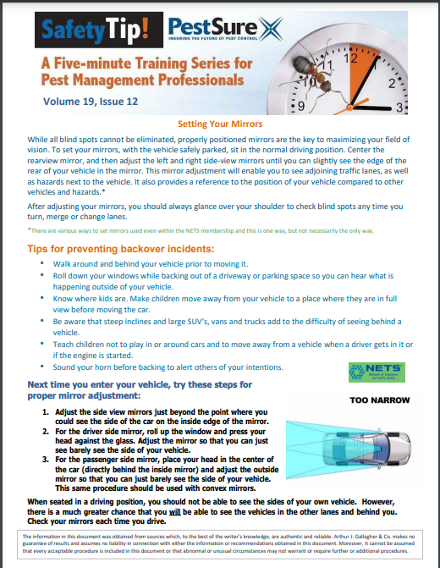
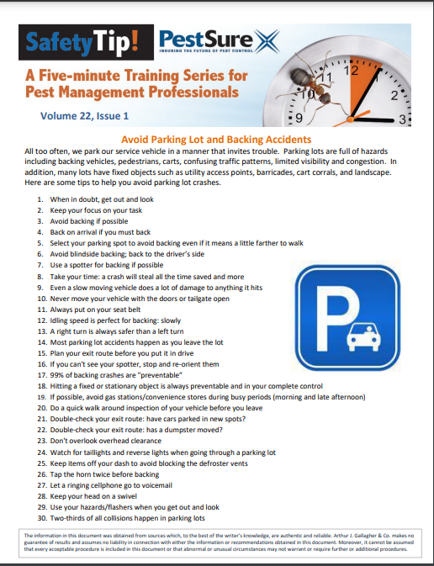
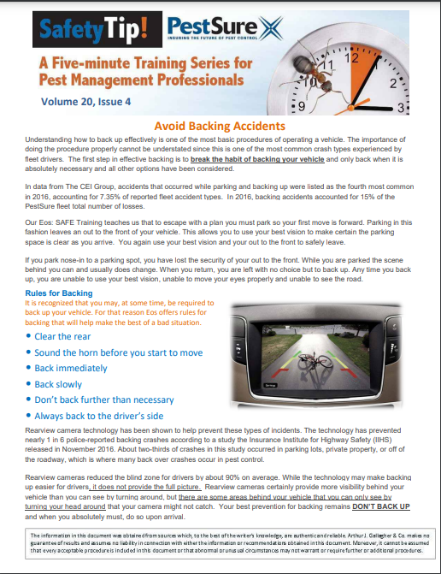
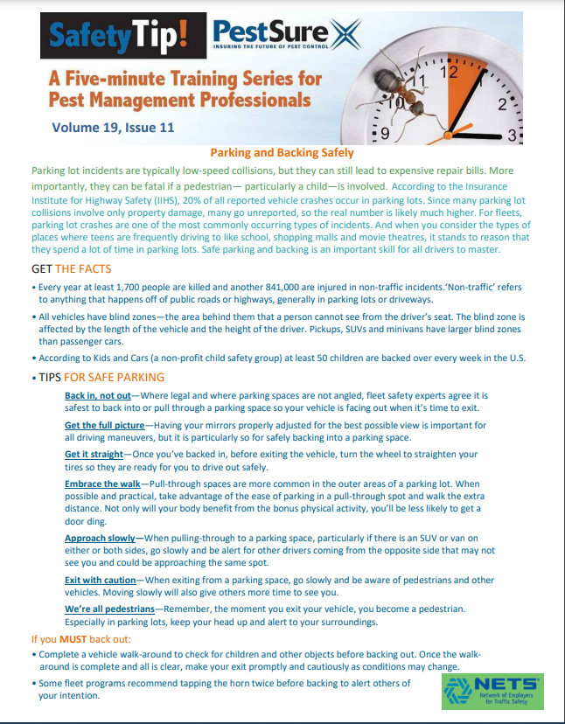

Slide 13
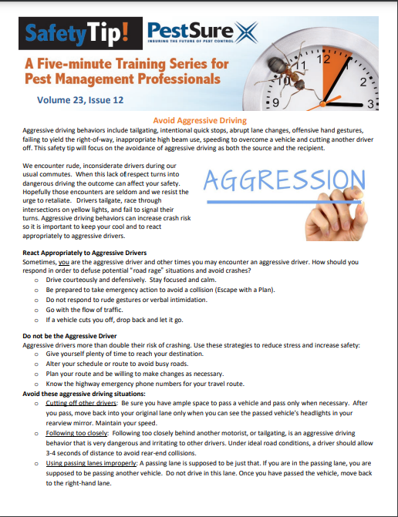
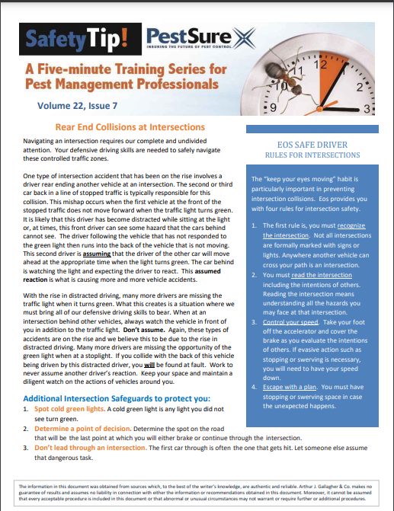
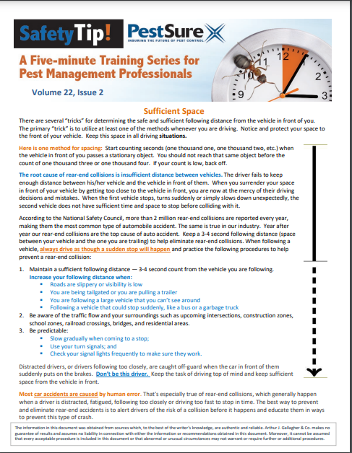
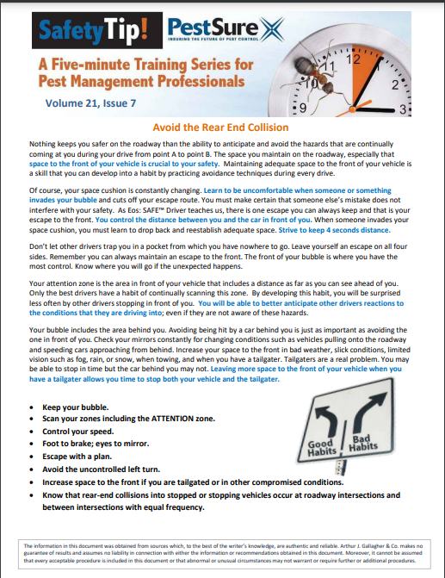

Slide 14
Obtain the driver’s commitment
Explaining it
Asking for it
Agreeing to it
ben·e·fi·ci·ar·y
/ˌbenəˈfiSHēˌerē/
Learn to pronounce
noun
a person who derives advantage from something, especially a trust, will, or life insurance policy.

Slide 15
Driver’s Commitment
Driver policy
Your true expectations
Their obligations to:
Control distractions
Operate safely
Follow the rules
Keep the vehicle in safe operating condition

Slide 16

Helping them keep their promise
Inter-company communications
Teach alternatives
Re-sign the driver policy each year
Notes:
Inter company
Ok to wait till safely parked to call bacl
Don’t talk to customers while driving
Managers – be sure they sing from the same hymnal
Alternatives
Scheduling communication breaks
Planning your day during pre-trip
Checking the weather

Slide 17
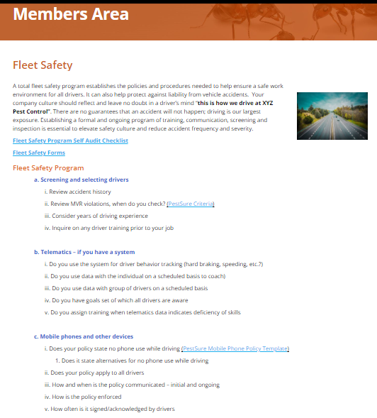
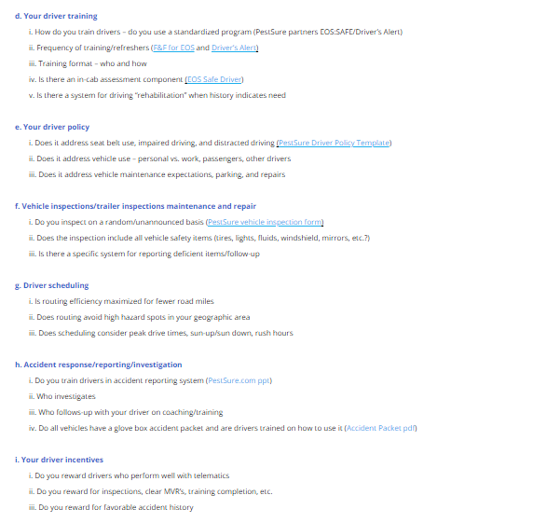
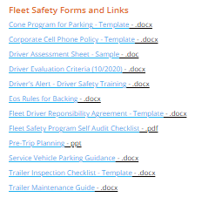

Slide 18
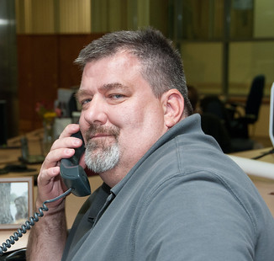
Leaders – our managers and supervisors
Not automatically supportive
A Leader Should Be Able to:
Conduct in-cab assessments
Conduct and teach pre-trip planning and inspection
Deliver driver safety talks
Coach driving behaviors
Lead by example and mentor
Notes:
Managers and supervisors need training too
Especially if this is a new initiative and you are trying to engrain culture
Safe driving initiatives by seem, on the surface, as detrimental to other production goals.
They need the big picture
You need their 100% buy-in
Examples: contraindications

Slide 19
Productivity Discussions
Continual part of our communication with mangers, supervisors, and the front-line employee
If we discuss idling – then also discuss alternatives to idling when we are stopped on a “communication break”
If we discuss stops per day – then also discuss what we do when we can’t complete the # that day
If we discuss . . . .
If your productivity discussions don’t include safe driving and how that affects their number of stops, etc., you might be encouraging them to make up time on the road or multi-task while driving.
Notes:
Never discuss productivity without discussing the safe methods involved with the change or the practice.

Slide 20
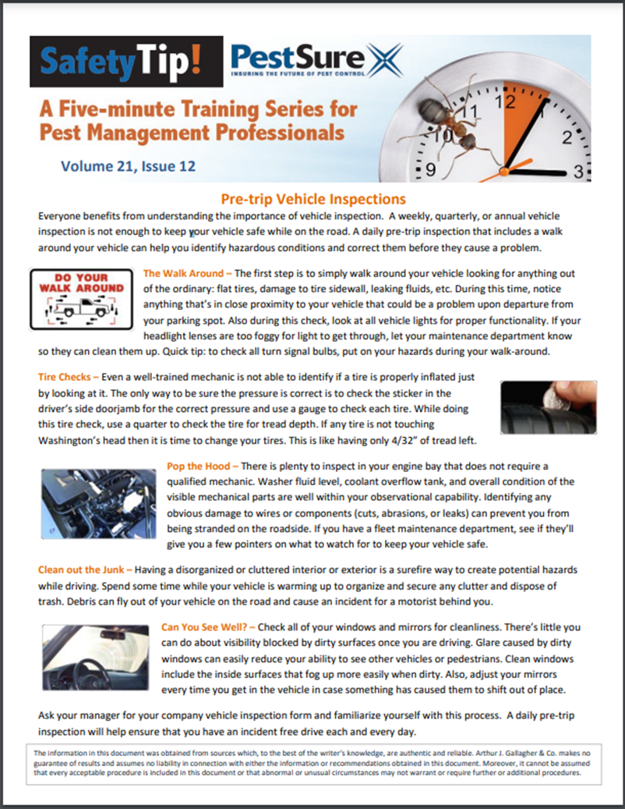
Revive the Pre-trip
Driver champions
A ritual
Practice together regularly
Truck inspections
-
-
-
Notes:
It is your time to discuss road safety on all levels.
Cab organized
Items secure
All supplies to reduce trips
Mirrors adjusted
Sunglasses clean and within reach
Beverage secure
Route reviewed
How about that correctly sized ladder for the work ahead?
Navigation – voice and cradle
Pat on the back for job well done

Slide 21
Technology – icing on the cake
Assisting them to keep their promise
Not a magic pill
If you have it – use it
Measure the right things
Use the data to coach pre-crash

Slide 22
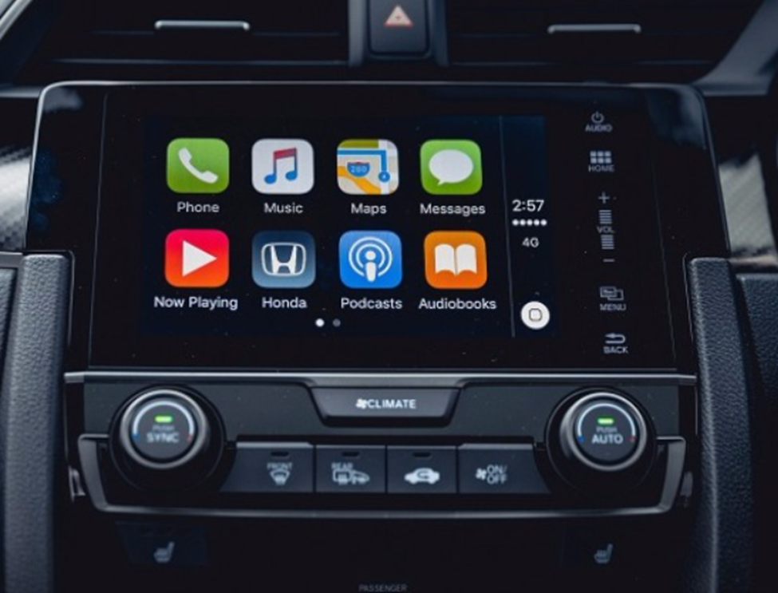
Hands Free Whaaaaat?
Talk about this regularly
Acknowledge the difficulty
Ask for their effort
Explain the big picture
Avoid the “mixed message”
Notes:
Employees are adults and will make decisions based on their background, prior experience, and beliefs.
You must protect the company with a policy
You must convey your expectaions and inspect and respect what you expect
You must give alternatives for the ever constant temptation

Slide 23
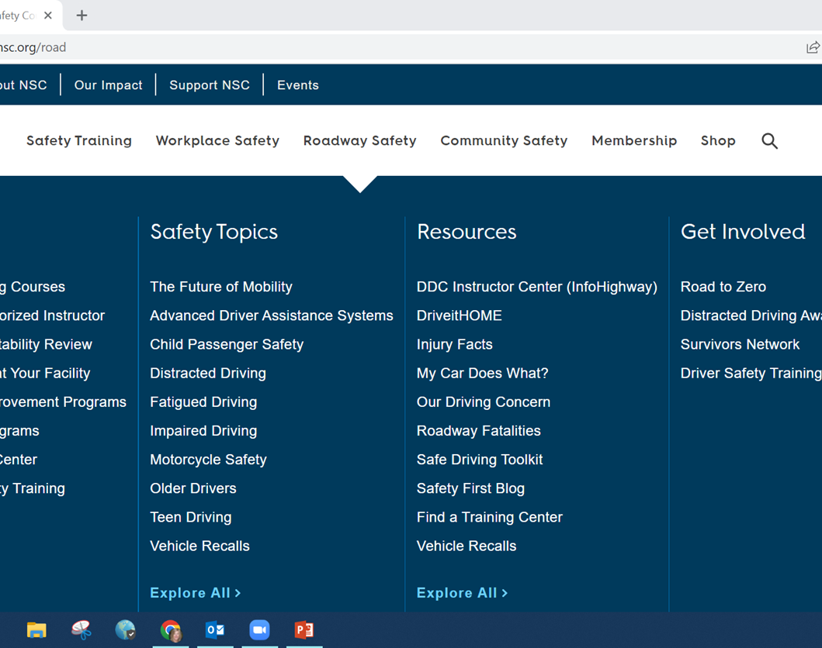

Our lives are more valuable than any call, email or text that arrives while we are driving.
Employers: Enact a distracted driving policy banning all employee use of cell phones or mobile devices while they are driving on or off the job, including hands-free and voice command systems.
Employers can and should be at the forefront of a cultural change to make the use of in-vehicle technology while driving unacceptable. Ban phone meetings and other communications with employees while they are driving.
Notes:
Don’t do this alone. We can help when you are ready to commit.

Slide 24

Discussion
Linda Midyett
Vice President
Loss Control Director -PestSure
Alliant Specialty
Alliant Insurance Services, Inc.
C: 214-490-2980
O: 214-273-3137
www.pestsure.com

