Slide 1

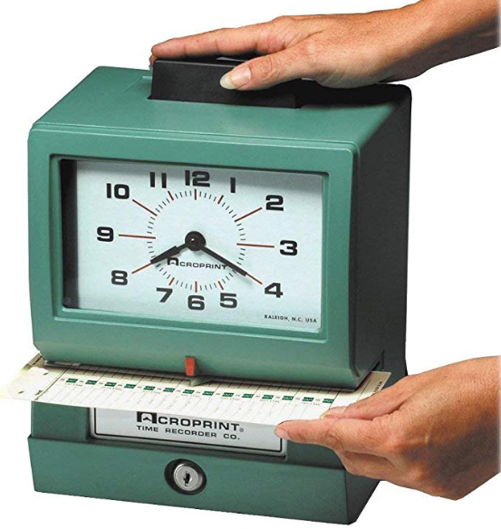
Creating A Return-To-Work Program
Methods to reduce lost time post incident

Slide 2
Nearly 4.9 Million workers compensation claims made each year
Average claim is worth $41,000.00
Average sprain is $34,309.00
Worker comp claims pay out more than $62 Billion each year

Slide 3

Some Important Terminology
A Return to Work (RTW) position is a temporary position to which an employee is assigned when he/she/them is unable to return to their regular position following an on-the-job injury or illness. The Return-to-Work position temporarily addresses the restrictions placed on an individual by the employee’s treating doctor. This new role is most often different than their normally assigned role.
Modified Duty is when a technician works in their normally assigned role with modifications made to accommodate restrictions placed by their attending physician.
Employment related injury is an injury or occupational disease, which arises out of the course and scope of employment and is a compensable injury or illness, as defined under the states of New Jersey, Pennsylvania, Delaware, and Maryland Workers’ Compensation Plan.
Physician in this policy means a doctor of medicine, osteopathic medicine, optometry, dentistry, podiatry, or chiropractic who is licensed and authorized to practice as defined in the State Workers’ Compensation Rules.
HIPAA (Health Insurance Portability and Accountability Act) is a federal law that required the creation of national standards to protect sensitive patient health information from being disclosed without the patient’s consent or knowledge.

Slide 4

The problem…
Multiple employees receiving indemnity payments for long periods of time
Possible exaggerated claims to achieve time off
Disruption of employee pay/benefits
Non-productive situation for both the injured party as well as the company

Slide 5
What was the outcome?

Slide 6
Why a Return-to-Work program?
This program helps achieve the following:
Keeps employee productive that would otherwise be receiving indemnity payments
Minimizes impact on employee regarding compensation and benefits
Discourages frivolous or exaggerated claims

Slide 7

How RTW Differs From Modified Duty
Modified Duty accommodates restrictions on the employee's current role. These accommodations are made at the local branch level and are normally temporary in nature. Some examples may include:
Removal of lifting and moving more than a given weight as described by a doctor, i.e., no ladder work, use of backpack sprayers, etc.
Having the tech ride with another for training purposes.
Assignment of tasks that meet restrictions, i.e., performing Sentricon check, being a second n bed bugs treatments, or performing QC inspections

Slide 8

Modified Duty Of Current Role
It is often easier and less disruptive to modify current job TASKS than move to RTW program.
Removing certain tasks or job types may keep the person working (i.e. No use of backpack sprayers or misters or removing ladder work).
Best for minor injuries with minimal restrictions
Coordinator should work with branch manager and physician to identify job task modifications

Slide 9
Types of Restrictions
SR: Sedentary Restrictions is defined as a job which involves mostly sitting. In addition to sitting and limited walking and standing, sedentary work can include a slight amount of lifting, such as up to 10 pounds.
LR: Lifting Restrictions are broken down into several categories:
• Light work generally means lifting 20 pounds maximum with frequent lifting and/or carrying of objects weighing up to 10 pounds.
• Light medium work means lifting 30 pounds maximum with frequent lifting and/or carrying of objects weighing up to 20 pounds.
• Medium work means lifting 50 pounds maximum with frequent lifting and/or carrying of objects weighing up to 25 pounds.
OHR: One Handed Restrictions means the work intended to be performed by the injured worker involves the use of only one hand. The restrictions, in some cases, may allow light assist using the injured hand or arm.
-Courtesy of HG.ORG

Slide 10
SR | LR | OHR
 | X |  | Cleaning, sorting, sharpening tools
 | X |  | Ordering and restoring supplies
X |  |  | Reviewing invoices
X |  | X | Shredding documents
 | X |  | Power washing building, sidewalks, driveway
X | X |  | Mow lawn with a riding mower
X |  |  | Competitor research
X |  | X | Make sales calls
 | X |  | Conduct safety audits
 | X |  | Safety check electrical tools
 | X |  | Maintain safety bulletin boards
 | X |  | Perform vehicle detailing
X |  |  | Mentor and train new employees
X |  |  | Take fleet vehicles in for oil changes and light maintenance
X |  |  | Take vehicles through the car wash
X |  |  | Clean computer screens
X |  |  | Remove face plates from telephones and clean underneath
X |  |  | Tip keyboards upside down to remove debris that falls between the keys
SR | LR | OHR
X |  |  | Create or update safety manuals
X |  |  | Develop a written Early-Return-to-Work program
X |  |  | Review safety policies/procedures
X |  |  | Develop safety training program to present to staff
X |  |  | Create a disaster plan
X |  |  | Study the OSHA website to learn why the accident/ injury occurred and write up a safety paper to share with other workers
X |  |  | Attend training or programs
X |  |  | Paint the employer’s name on all hand tools and equipment; this is an anti-theft measure
 |  | X | Paint
 | X | X | Light housekeeping/cleaning
 | X |  | Fill soap dispensers in restrooms
 | X |  | Wash and disinfect lunch room tables and lockers
 | X | X | Clean windows
 | X | X | Paint concrete car stops in the parking lot
 | X | X | Scrape and paint metal handrails
 | X | X | Paint contractor’s equipment
 | X |  | Yard cleanup and grounds work
 | X | X | Spray weed killer on weeds that grow around the building
 | X |  | Cut and trim bushes round the building
 | X | X | Dust office furniture
 | X |  | Record contractor’s equipment serial numbers
 | X |  | Inventory
 | X |  | Update SDS binder
 | X |  | Collect old/unused chemicals and dispose of properly
X |  |  | Time sheet preparation
X | X | X | Conduct a daily inventory of fleet keys (car dealership)
continued...
-Courtesy HG.ORG

Slide 11
Discourages Exaggerated and Fraudulent Claims
Insurance fraud steals at least $308.6 billion every year from American consumers.
-Coalition Against Insurance Fraud

Slide 12

How this benefits the employee
Keeps them a productive member of the company
Ability to continue working may reduce the negative psychological impact of incident/injury
Minimizes disruption to pay and benefits
Additional job role training increases employee knowledge level
Improves morale by reducing negative impact of time off on scheduling dissuading exaggerated/fraudulent claims

Slide 13

Designing The Program
Determine who will administer the program
Identify your states specific requirements
Create process support documents
Program review
  HR
  Attorney review
  Insurance provider
Communicate plan
Identify training needs to implement program
  Management training
  RTW employee job task training

Slide 14

The Coordinators’ Role
To ensure all steps in the process are followed
To match RTW role to physicians limitations
To communicate with the employee, their physician, and the insurance company
To coordinate training dates to learn new role if needed
To act as the employee’s direct supervisor while on the program

Slide 15

Choosing a Coordinator
Should have a strong working knowledge of HR regulations
Organized
Capable of leading others
Excellent communicator
Understands physical requirements of various job roles

Slide 16
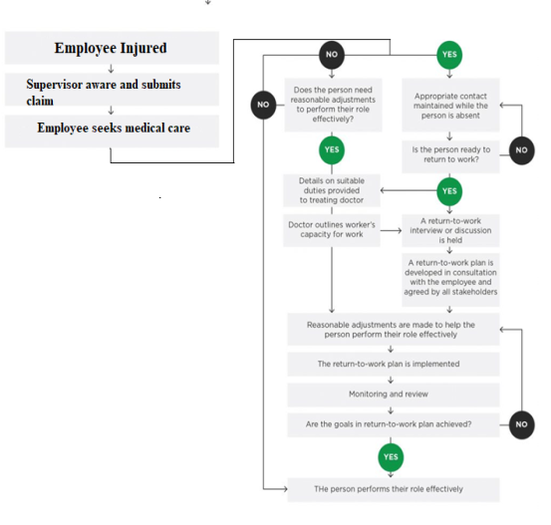
How The Process Works

Slide 17

Legal Considerations
The program must be available to all, not just Workman’s Compensation!
You may or may not be able to adjust wages for the new role. Difference may become indemnity.
Duration may be limited by state or local laws.
Specific statements must be present pertaining to training, duration, compensation, and acknowledging work limitations.
Protecting HIPAA sensitive information.
Correspondence must be tracked with all involved parties.
Work closely with PestSure to ensure compliance.

Slide 18


Specific Things To Avoid
Only offering this to Workman’s Compensation cases.
Adjusting wages (varies by state).
Sharing protected information.
Creating a role that is difficult to train for.
Creating a role with a limited/seasonal need.
Being inconsistent with implementation.

Slide 19

Above all, avoid the following:
Do not push injured employees to get back to their regular roles. This often occurs due to:
Project deadlines/behind on work completion
Injured employee’s department is short staffed
You believe the injury to be healed or not severe
Never exceed the limitations placed by the attending physician

Slide 20
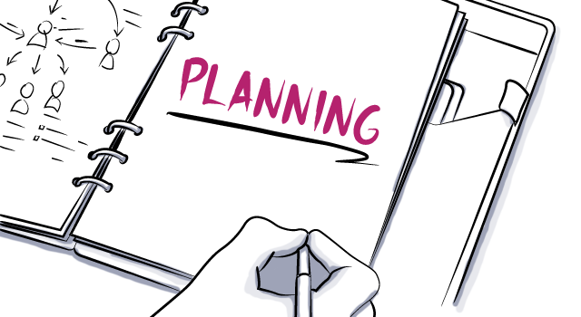
Considering Logistics and Sustainability
Location of new role
Location of employee
Equipment needed to complete task
Software permissions needed to perform new task
Additional accommodations that may be needed
Training time needed
Start date for new role

Slide 21

Determining the RTW Job Task(s)
Ideally a good return to work role should consist of:
Minimally physical in nature
Easy to train to accomplish task
Enough work available to support all potential users of the program
The ability to work remotely is a plus
Determine what equipment needs they may have to accomplish the job task

Slide 22
Assessing RTW Role
Filing and Clerical
Pros | Cons
Easy | Lack of available work
No heavy lifting | Range of motion
Adaptable to limitations | Standing/walking
Training
Pros | Cons
Easy | Range of motion
Employee development | Standing/walking
 | Sitting
 | Limited availability
Accounts Receivable
Easy | Requires a computer
May be performed remotely | Requires a phone
Adaptable to limitations | Must be a good communicator
Availability of work

Slide 23
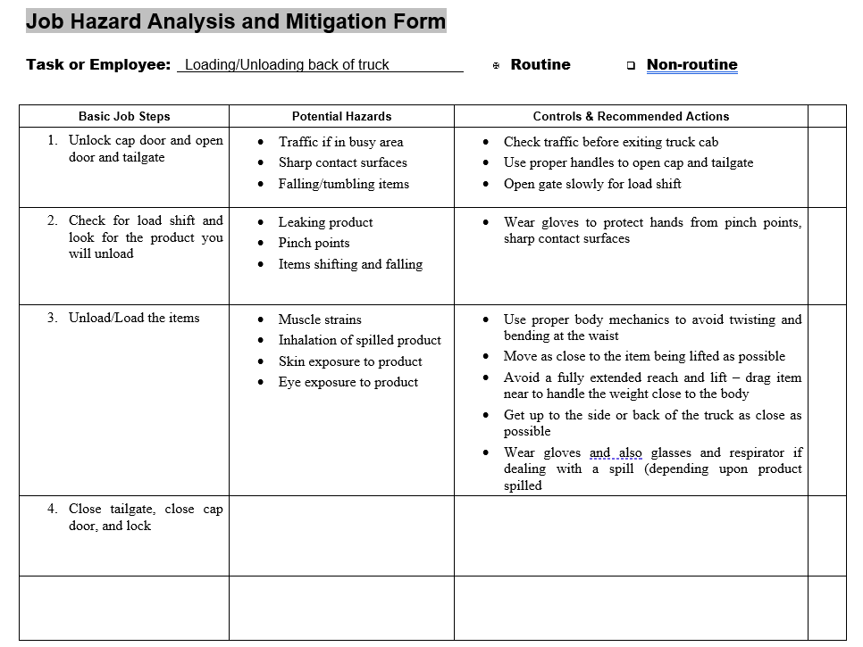
Assess Job Tasks
Job Hazard Analysis should be performed for all roles being considered to determine compatibility with limitations.

Slide 24
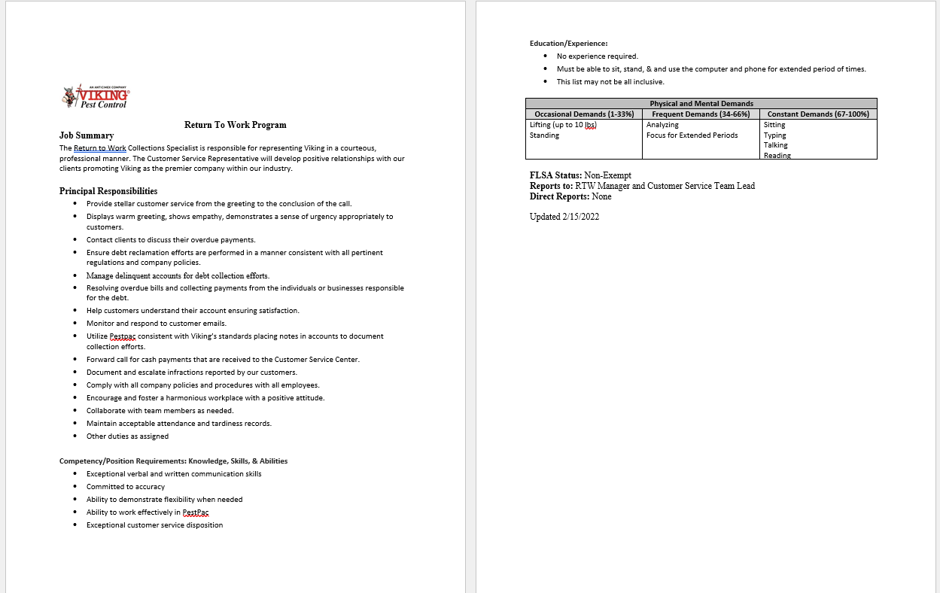
Written Job Description

Slide 25

Equipment Needs
New role may require:
A company PC
Phone or access to phone system
Printer
Reasonable accommodation (Stand up workstation?)
Vehicle
Cellular device/tablet
Software licenses

Slide 26

Wages
Some states allow for wages to be adjusted to reflect the average wages of others in that same role. Some do not.
Wage differences or reduced hours may lead to indemnity payments being required for the difference.
Wages may change if employee decides to stay in new role at new wage if offer letter made and accepted for permanent position at end of program.
Wage cost center may be changed to new department.

Slide 27

Available To All In Need
This program needs to be made available to all, not just those on Workman’s Compensation.
This includes those on disability and those seeking leave if requested.

Slide 28


Correspondence With The Injured Party
Must be performed in an appropriate manner
Must be free from threats or coercion
Must include statement regarding wages
Must include statement stating training is available for the new role
A statement describing how long the program is for
A statement acknowledging that the employer is knowledgeable about and will abide by the limitations under which the treating physician has authorized the return to work

Slide 29

What if they do not respond?
Your written program should describe your escalation process for employee contact.
Example:
After a set number of emails and phone calls a certified letter is mailed to the individual
The insurance company should be contacted and informed of the lack of communication
Direct communication with the physician may be needed

Slide 30

What if medically approved but they refuse the offer?
The employee may be subject to termination and indemnity payments revoked if the employee refuses the program in most states.

Slide 31

What if they have retained legal counsel?
All correspondence for the program should be provided to the insurance company to be shared with the employee's legal council.
The insurance company should act as the communicator as all documents must flow trough their legal counsel

Slide 32

Corresponding With The Physician
A form is sent to the physician asking them to detail any all restrictions the employee may have
After reviewing the completed form and limitations, the program coordinator may request approval of the program by the physician if it meets the restriction requirements
Modifications may be made until the program meets the needs of the individuals' restrictions and an agreement reached regarding the capabilities of the employee

Slide 33

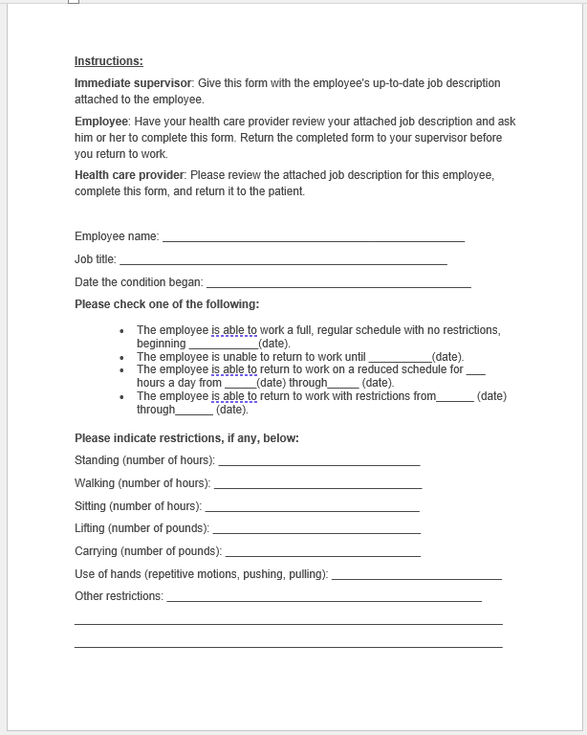
Forms Used:

Slide 34

Training For The New Role
The new role ideally will take advantage of the employees existing skill sets when possible
The ideal role will have minimal training required
It should be robust enough to allow the employee to be successful at the new task
May need to be done routinely or on demand

Slide 35

Working Remotely
While working remotely presents certain challenges in regard to oversite and support, it has several benefits as well.
Increased probability of acceptance/approval by employee and physician
Decreased need to host employee where space may be limited
Lack of travel time may be viewed as a positive by employee
Employee may be able to better accommodate restrictions working from home

Slide 36

Limiting The Duration of The Program
Define a program limit
Describe how extensions will be granted
How long will exceptions be granted for
Describe what happens if the employee is unable to return to their role at the end of the program
May apply for leave if program has expired

Slide 37

Extending The Program
The program should clearly define if and how it will be determined to extend the program for a participating individuals
The amount of time the program will be extended for if approved should be spelled out in the written program
These extension guidelines must be applied uniformly to all employees on the program
Upon completion of the program, options for those who are not yet ready to return to their full role must be described

Slide 38
Moving Employee Back To Prior Role
If the new role is outside of the current employee's skill set and existing role within the company, training must be provided.
Training must be sufficient to enable the employee be successful at the new task.
If the employee has the existing skill set, the new job description should be employed to the employee, so expectations are clear for the new position.
When returning to their previous role, ensure no job tasks are still outside of the limits placed by there physician.

Slide 39
Evaluating The Program
It is important to evaluate the program at least annually
All stakeholders should be involved in the review including the coordinator, head of safety, and management team

Slide 40
Questions?

