Slide 1
Certificates Of Insurance
Maria Maldonado

Slide 2
What is a COI?
Evidence of Coverage or Proof of Insurance

Slide 3
What is a Certificate of Insurance?
A Certificate of Insurance is a document that provides information about insurance policies.
A COI is intended as a “snapshot” of the policy and DOES NOT change or amend a policy.
COIS are issued as a form of information only and do not provide any rights under the policies evidenced.

Slide 4

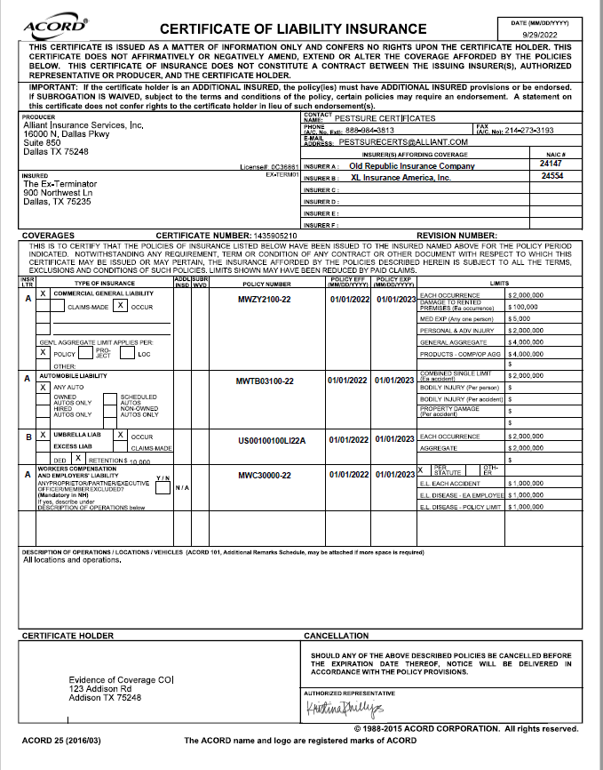
What information is included on a COI?
Producer Info / PestSure Contact Info
Insured Name and Address
Carrier Info
Policies in place
Effective Dates
Limits
DOO – Descriptions of Operations
Certificate Holder Info

Slide 5
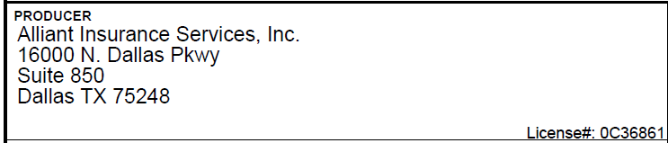

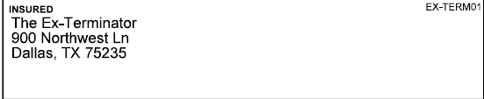
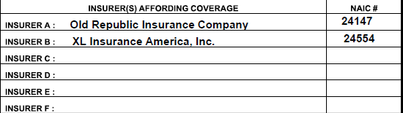
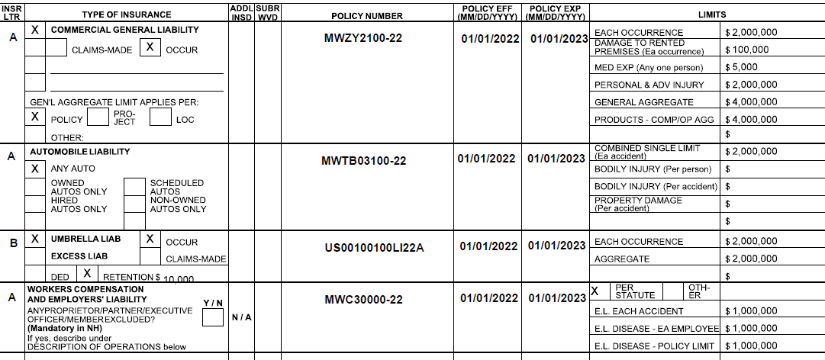
PestSure Contact Info
Producer Info
Named Insured Info
Carriers / NAIC #
Policies In place, Policy #’s, Effective Dates, Limits

Slide 6
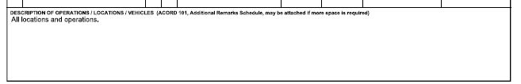
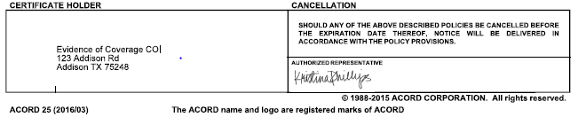
DOO: Descriptions of Operations
Certificate Holder, Cancellation, Authorized Representative, and ACORD 25 (2016/03)

Slide 7
Knowing what coverages and limits your company has in place with PestSure
GL AL WC Umbrella
Other Policies
Current Edition Endorsements

Slide 8

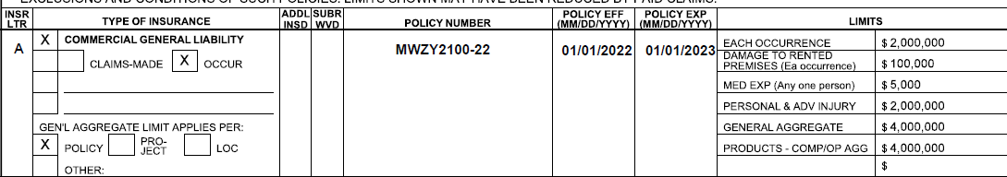
General Liability
GL Insurance is designed to protect business owners and operators from a wide variety of Liability exposures. Exposures could include liability from accidents resulting from insured’s premises or operations, operations completed by the insured, and contractual liability.
Your policy is written on an Occurrence Basis
Limits typically reflect Per Policy
The policy allows for the limits to apply Per Project (by request only)

Slide 9
General Liability
Current Edition Endorsements (12-19)
CG 20 10 12 19 – Additional Insured
CG 20 37 12 19 – Completed Operations
CG 20 01 12 19 – Primary Non-Contributory
CG 24 04 12 19 – Waiver of Subrogation
CG 25 03 05 09 – GL Per Project
GL 291 008 0119 – P&H / Pesticide & Herbicide *

Slide 10
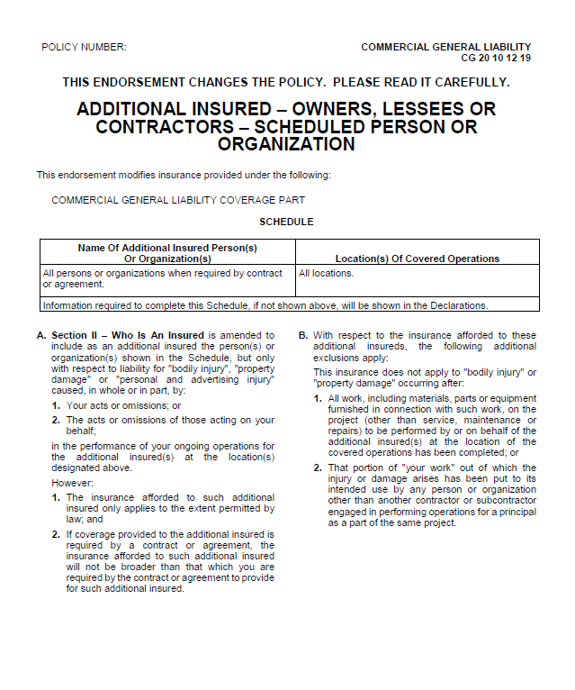
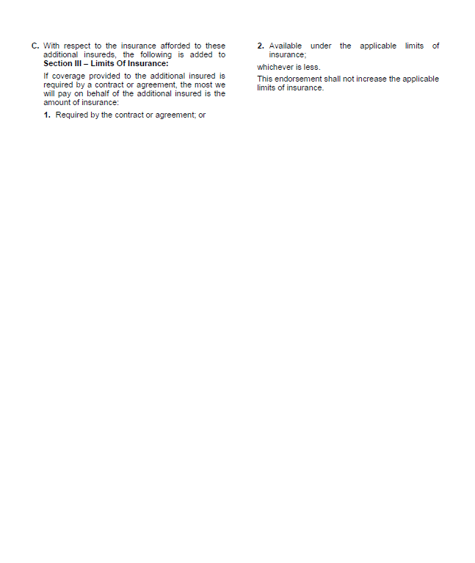
CG 20 10 12 19 Additional Insured
What is Additional Insured?
Additional Insured – A person or organization not automatically included as an insured under an insurance policy, but who insured status is arranged, via endorsement.
Why would a Cert Holder want AI status?
It provides additional coverage in an event of a claim.
DOO Language typically reflects:
“The Certificate Holder is named as additional insured.”
Sample language is considered if requirements are provided
Blanket language is included in the Scheduled Areas

Slide 11
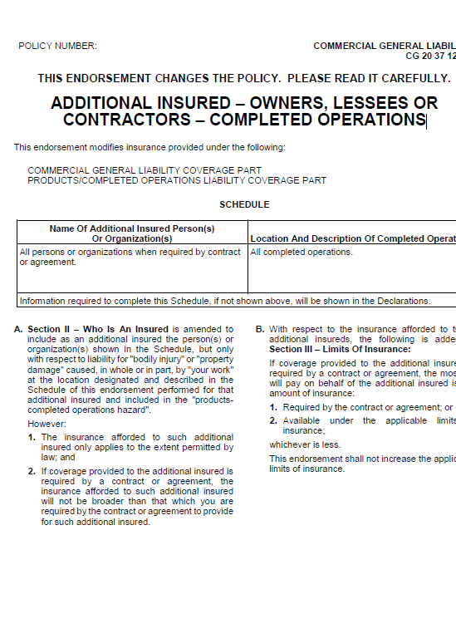
CG 20 37 12 19 Completed Operations
What is Completed Operations?
Completed Operations – includes coverage for liability resulting from your business’ products or completed operations performed away from your premises.
This pertains to both property damage and bodily injury.
DOO Language typically reflects:
“Completed Operations is included on the General Liability Policy.”

Slide 12
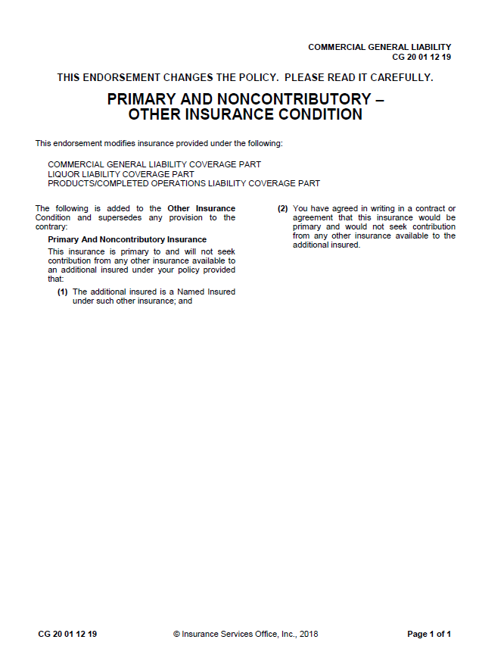
CG 20 01 12 19 Primary Non-Contributory
What is Primary and Non-Contributory?
PNC – Stipulates the order of which multiple policies triggered by the same loss are to respond.
PNC Language “Insurance is Primary and Non-Contributory.”

Slide 13
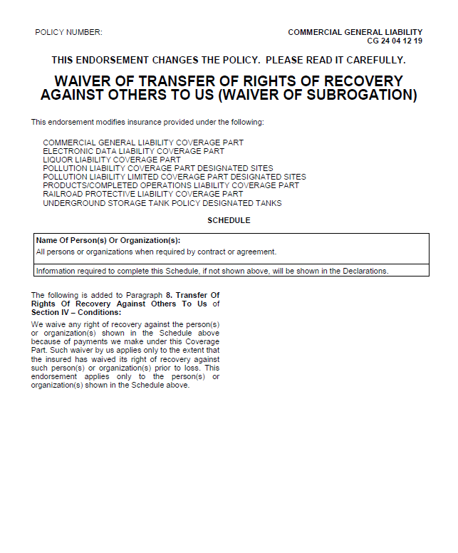
CG 24 04 12 19 Waiver of Subrogation
What is a Waiver of Subrogation?
WOS is a relinquishment by an insurer of the right to subrogation. Or the right to collect from another party for damages paid on behalf of the insured.
We encourage you to negotiate out of all waivers as they are slanted towards certificate holder only.
WOS Language
“Waiver of Subrogation applies in favor of the Certificate Holder.”
“Waiver of Subrogation applies in favor of the Additional Insureds.”
Sample language is considered if requirements are provided
Blanket language is included in the Scheduled Areas

Slide 14
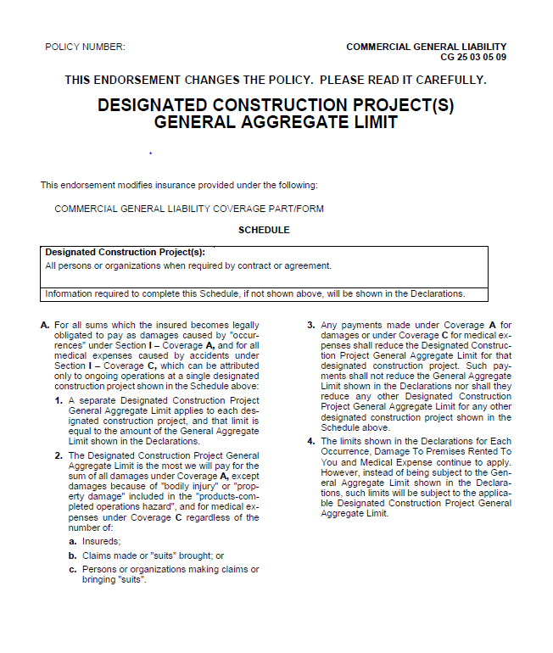
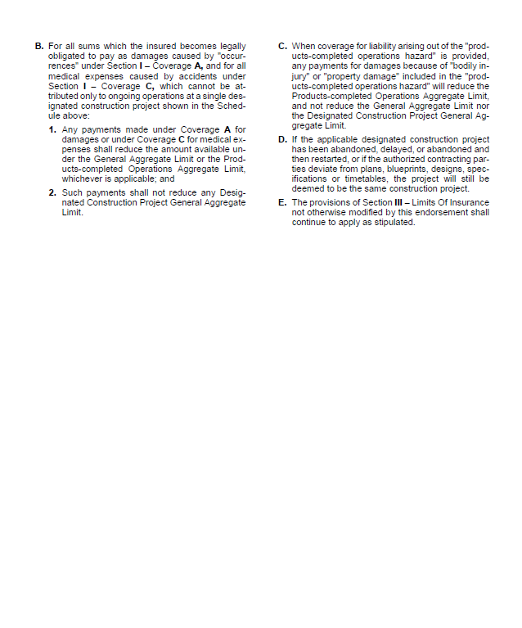
CG 25 03 05 09 GL Per Project
Limits apply on a Per Policy or Per Project Basis only
Anytime we see a Per Location request, we can only evidence Per Project.

Slide 15
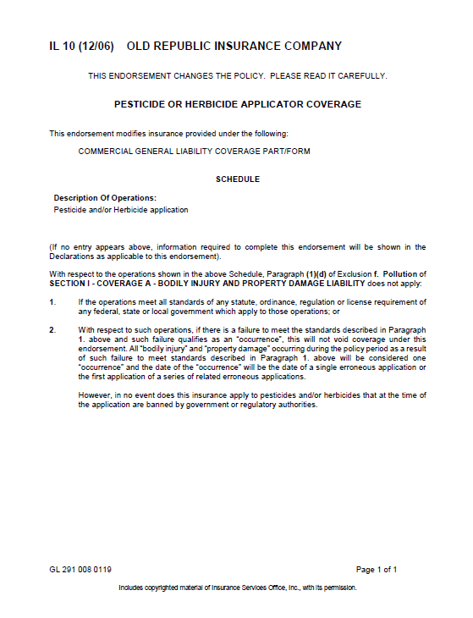
GL 291 008 0119 P&H / Pesticide & Herbicide
What is P&H?
This endorsement eliminates the pollution exclusion under the CGL coverage form for pesticide and herbicide application operations; provided operations meet all federal, state and government regulations.
Coverage applies AWAY from your premises.
This endorsement is evidenced when Pollution or Environmental Liability is requested.
P&H/Pollution Language
“Pollution Liability is included on the General Liability Policy, as respects Pesticide and Herbicides endorsement.”
“Pollution Liability is included on the General Liability Policy at full policy limits, as respects Pesticide and Herbicides endorsement.”

Slide 16

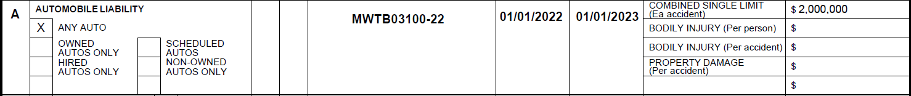
Automobile Liability
3rd party coverage (Bodily Injury/Property Damage)
Your policy contains a Combined Single Limit
One limit for all of the split limits below
Bodily Injury - per person / Bodily Injury - per accident / Prop Damage (per accident)
Covers Any Auto

Slide 17
Automobile Liability
Endorsements
PCA 001 10 13 – Additional Insured
PCA 024 10 13 – Waiver of Subrogation
PCA 048 09 19 – Primary Non-Contributory

Slide 18
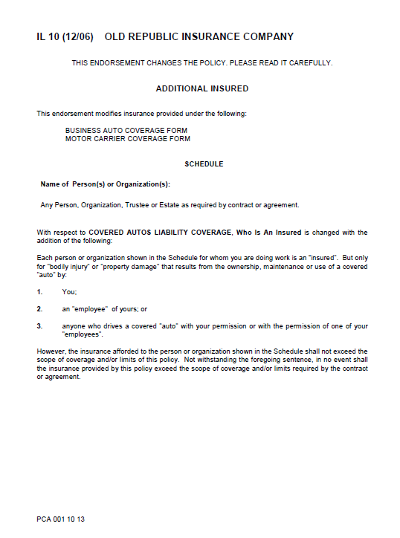
PCA 001 10 13 Additional Insured
Similar to GL / AL DOO Language typically reflects:
“The Certificate Holder is named as additional insured.”
Sample language is considered if requirements are provided
Blanket language is included in the Scheduled Areas

Slide 19
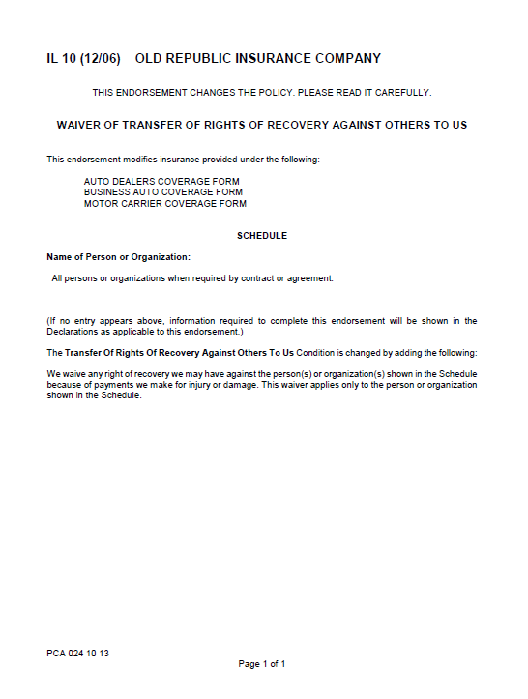
PCA 024 10 13 Waiver of Subrogation
Similar to GL / AL WOS Language
“Waiver of Subrogation applies in favor of the Certificate Holder.”
“Waiver of Subrogation applies in favor of the Additional Insureds.”
Blanket language is included in the Scheduled Areas

Slide 20
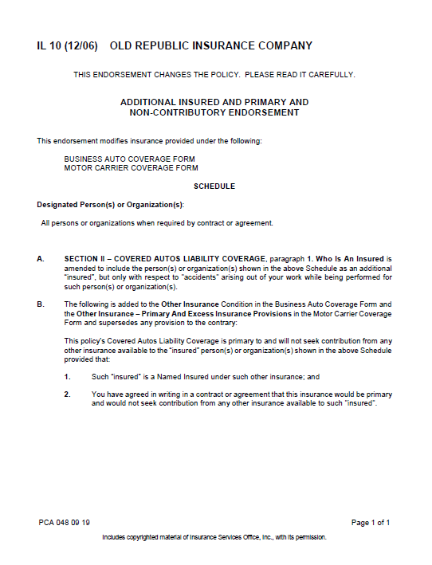
PCA 048 09 19 Primary Non-Contributory
Similar to GL / AL PNC Language
“Insurance is Primary and Non-Contributory.”

Slide 21
PCA 024 10 13 Waiver of Subrogation
Similar to GL / AL WOS Language
“Waiver of Subrogation applies in favor of the Certificate Holder.”
“Waiver of Subrogation applies in favor of the Additional Insureds.”
Blanket language is included in the Scheduled Areas

Slide 22

Workers Compensation
Two Parts: Workers Compensation & Employers Liability
WC – Statutory Limits
Employers Liability – Coverage pays on behalf of employer, the amount of loss that the insured is legally liable to pay because of employee’s injury in the course of employment
Your WC policy limits apply per statute requirements (unlimited)
The Y/N Box is to indicate if Officers are included or excluded on the policy.
Notes:
(add to note card explanation of officers or refer to KP to explain in further detail)

Slide 23
Workers Compensation
Endorsements
WC 00 03 13 – Waiver of Subrogation
WC 04 03 06 – Waiver of Subrogation (Specific to California)

Slide 24
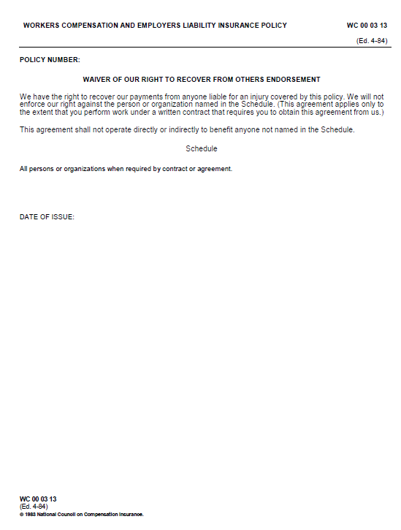
WC 00 03 13 Waiver of Subrogation
What is a Waiver of Subrogation?
WOS is a relinquishment by an insurer of the right to subrogation. Or the right to collect from another party for damages paid on behalf of the insured.
WOS Language
“Waiver of Subrogation applies in favor of the Certificate Holder.”
“Waiver of Subrogation applies in favor of the Additional Insureds.”
Sample language is considered if requirements are provided
Blanket language is included in the Scheduled Areas

Slide 25
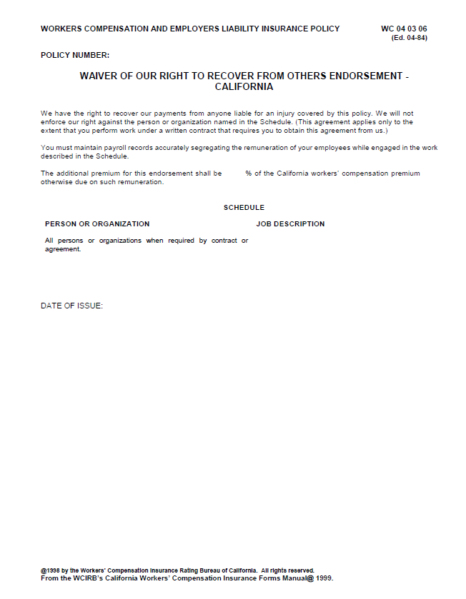
WC 04 03 06 Waiver of Subrogation (Specific to California)
WOS Language
“Waiver of Subrogation applies in favor of the Certificate Holder.”
“Waiver of Subrogation applies in favor of the Additional Insureds.”
Sample language is considered if requirements are provided
Blanket language is included in the Scheduled Areas

Slide 26

Umbrella Liability
Coverage for losses above the limit of an underlying policy or policies (such as General Liab, Auto Liab, and Employers’ Liab)
Differs by account. Policy contains a “schedule of underlying policies”
Umbrella is written on an Occurrence Basis
Retention is $10K
Umbrella follows form language.

Slide 27


Other Policies
All policies that fall outside of the liability policies are evidenced in the “Other” Section of the COI
If handled by another broker, it will be a separate COI
Property
“Limits on File” is evidenced unless otherwise specified or Property Specific details are provided and confirmed by Prop AM
Crime
Must have third party crime to evidence on the COI.
Cyber
Get with your assigned AM to place coverage or inquire further

Slide 28
COI Requests and how it translate to your COI Examples vs What is Evidenced Client Insurance Requirements Compliance Companies
COI request form
Sample vs Your COI
COI requirements
Compliance Requirements vs Reality

Slide 29
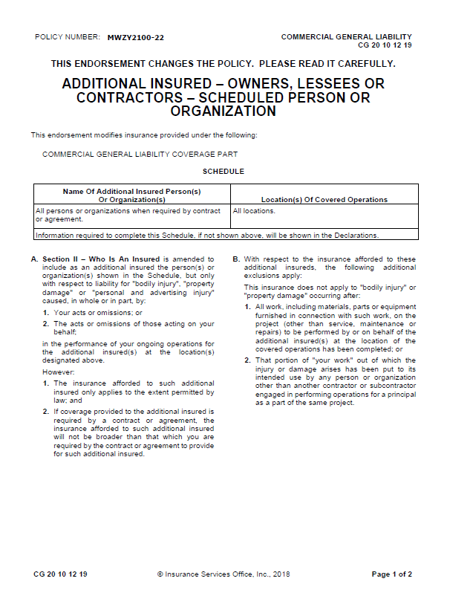
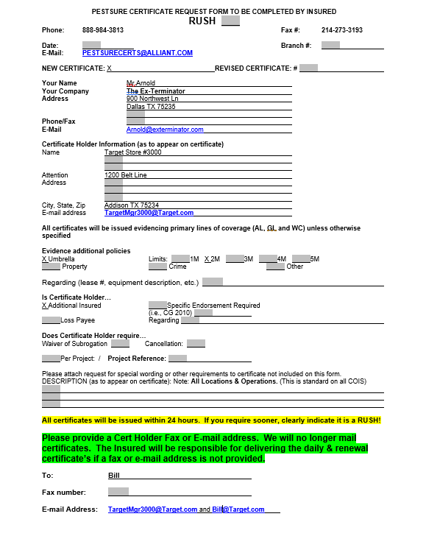
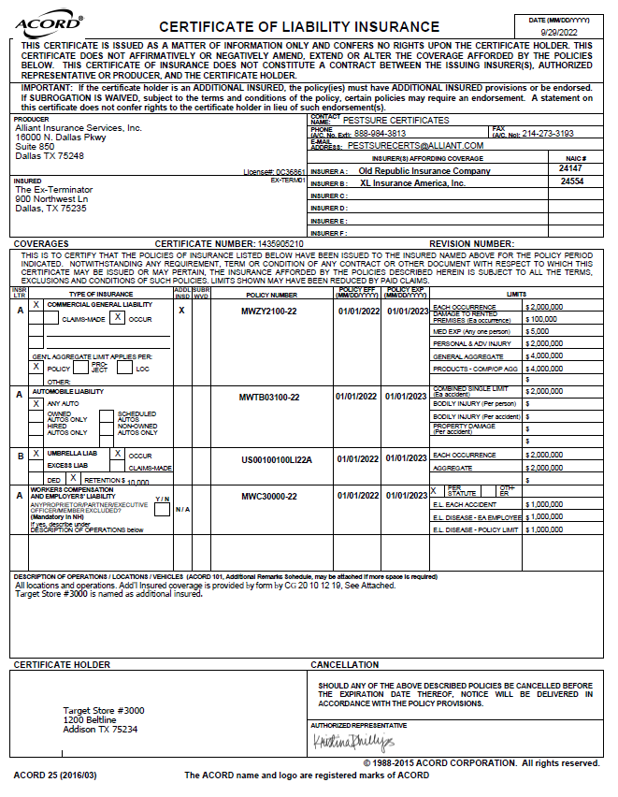
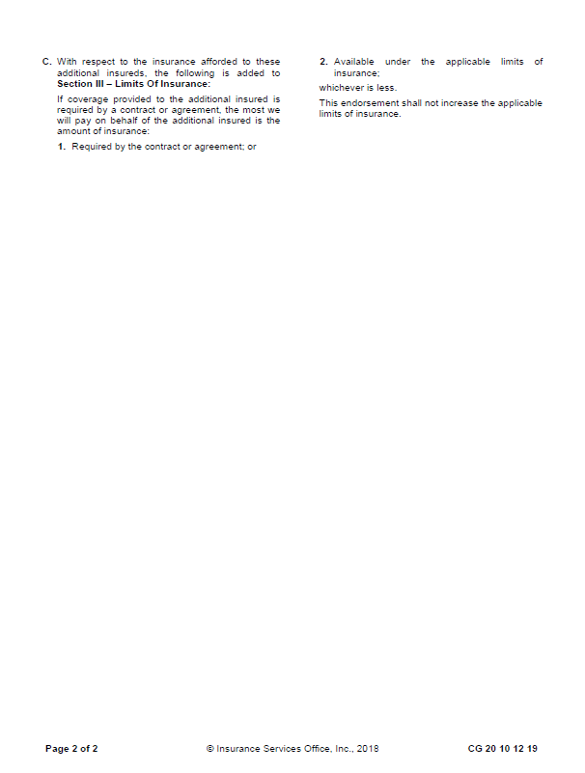
COI Examples VS What is Evidenced – Additional Insured

Slide 30
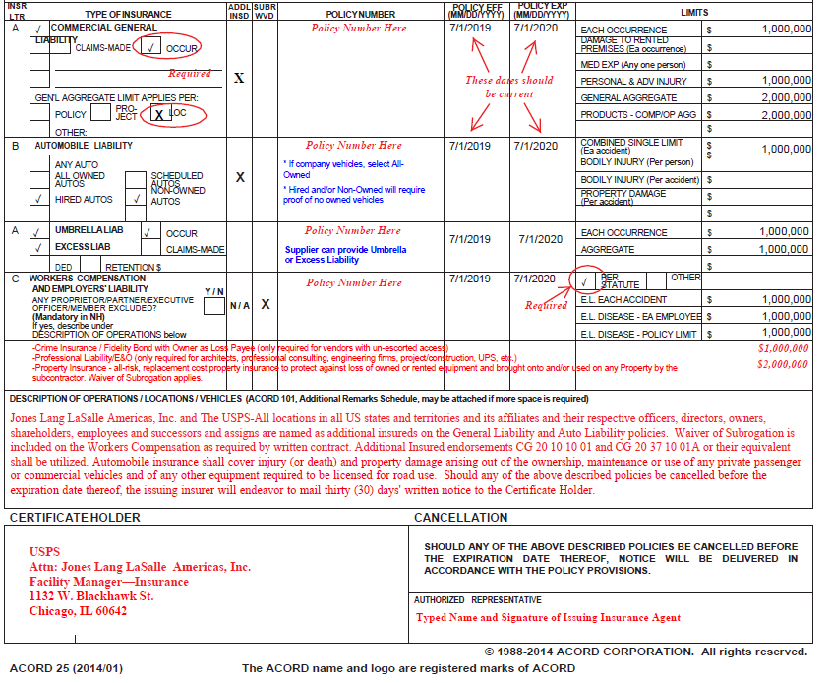
COI Examples VS What is Evidenced
- GL Per Loc
$1MUmbrella
Crime
Professional Liab
Property
Additional Insured (GL, AL) and WC Waiver
“Arising out of” language
Descriptions of Operations – PestSure Version
All locations and operations. Add’l Insured coverage is provided by form by CG 20 10 12 19, See Attached.
Jones Lang LaSalle Americas, Inc. and The USPS-All locations in all US states and territories and its affiliates and their respective officers, directors, owners, shareholders, employees and successors and assigns are named as additional insureds on the General Liability and Auto Liability policies. Waiver of Subrogation is included on the Workers Compensation as required by written contract. Professional Liability is included on the General Liability Policy.
30 Days Notice of Cancellation (10 Days for Non-Payment of premium).

Slide 31
Additional Coverages that fall within the GL
Contractual Liability
Errors & Omissions (E&O)
An Insurance form that protects the insured against liability for committing an error or omission in performance of professional duties.
Professional Liability
Coverage designed to protect traditional professionals against liability incurred as a result of errors and omissions in performing professional services.
30 Day NOC language

Slide 32
Insurance Requirement Review
Contract Review
An important part of the sales process is finalizing the contract.
Included in that is usually indemnification language and insurance requirements.
This is our one opportunity to protect ourselves and negotiate.
Do you have a designated person reviewing these contracts?
Do you know PestSure will review these?
Interested in learning? We will teach you!

Slide 33
Compliance Companies
What is a compliance company?
Compliance Depot, RealPage, myCOI, VendorCafe/VendorShield
They typically offer or advertise themselves as a platform that enables or oversees property managers and vendors working relationships (at a cost to the insured/vendor)
How does it work?
The property managers engage the compliance company and categorize your company and requirements based on scope of work or category.
Insurance requirements are compiled based on a few things
Info the property manager requires (limits, add’l ins, project references)
Info the compliance company believes you should have based on the vendor category (Pollution Liab, Deductibles, SIR limits)

Slide 34
Compliance Companies
What is the process?
Insured completes their tasks for Compliance Company
Reviews Requirements/Signs Agreement
Provides Agent(s) info
PestSure is notified and begins the process of issuing a COI within what your policies permit
PestSure tracks compliance until fully certified as “Compliant”

Slide 35
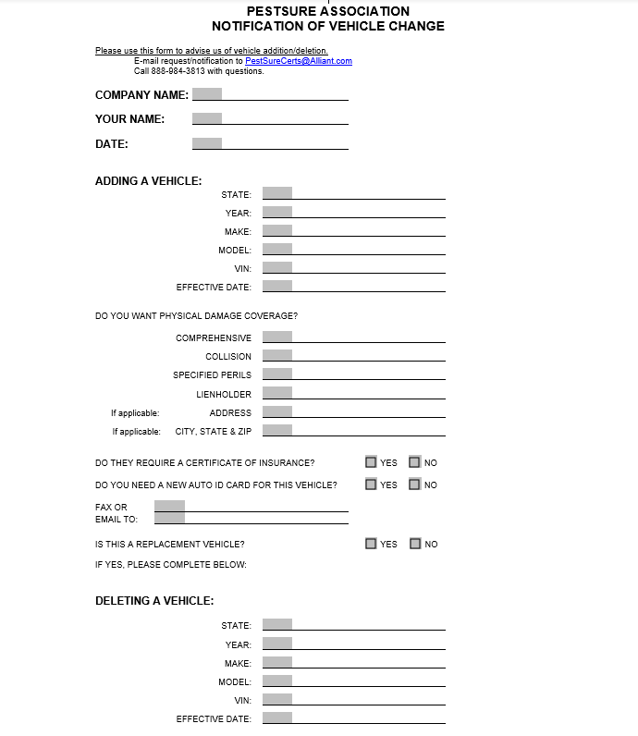
Vehicle Change Form
Purpose of this form:
To use as a notification of information on the new/or removal vehicle(s)

Slide 36
PestSure SOP
All requests for COIS should be submitted in writing via the COI request form
Emailed to PestSureCerts@Alliant.com or Faxed to 214-273-3193
24 Hr Turn Around Time for Standard requests / 2-4 Hr Turn Around Time for Rushes
How to request a COI
Using the request form will help the processor identify your account and process without holding it up for clarification.
When samples or requirements are provided, please include with your request.
We will consider the requirements and evidence all coverages/limits within what your policies permit.
If ever you negotiate out of a certain requirement or limit just be sure to let us know (that way we only evidence what your company is comfortable showing).

Slide 37
QUESTIONS?

