Slide 1
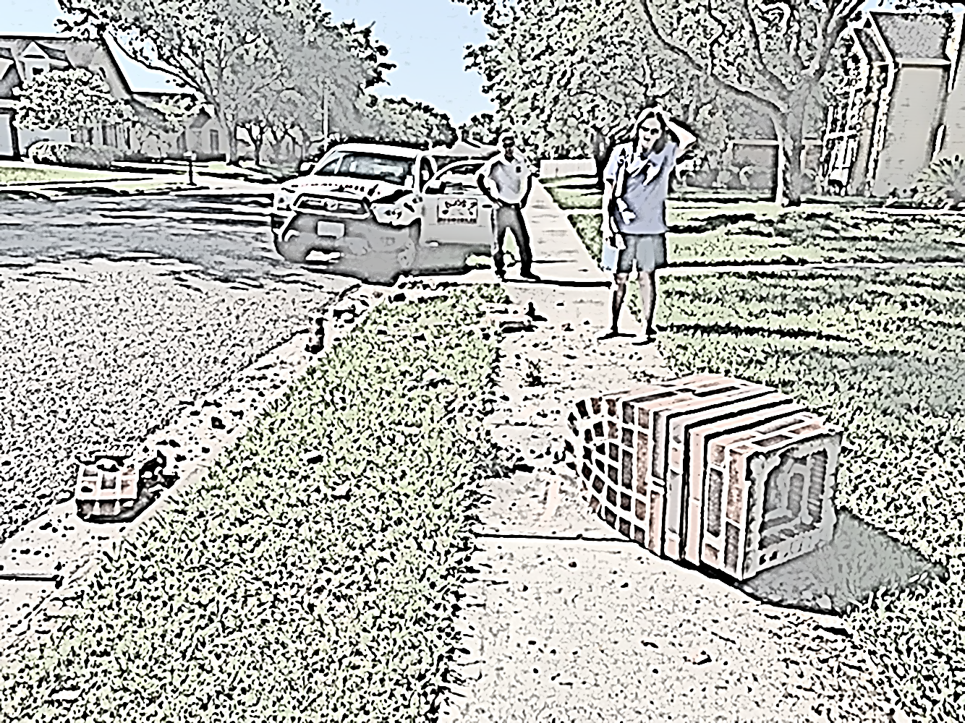
Pre-Trip Planning
For a focused drive

Slide 2
No matter if you do your pre-trip planning and preparation at the end of your workday or in the morning before you drive, a plan is essential to your safety.
The pre-trip plan anticipates our needs for the day. We start with a safe vehicle, the products and equipment we will need, and our intentions and route for the day reviewed. Working to refine and develop your specific pre-trip preparation routine is time well spent.

Slide 3
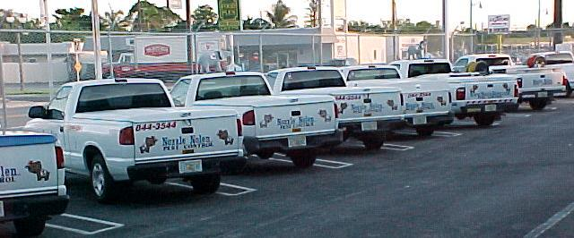
Just a Word About Eliminating Focus Thieves
Focus thieves steal the focus of our eyes and in doing so make us likely to make driving errors and more likely to be victimized by the mistakes of other drivers. It is important to identify these focus thieves so we can prevent the threat they pose to our safety. Pre-trip planning will help to eliminate many focus thieves.
Notes:
In-cabin thieves are generally activities we perform inside the operator cabin while we drive that require our eyes to focus on them instead of the potential hazards we face. For example, tuning the radio, dealing with food or drink items (especially when they spill), dealing with children and cell phone use are all in-cabin thieves. Fight off in-cabin distractions by dealing with these activities prior to starting your drive or by pulling off the road when they demand your attention. Think before you start your trip and eliminate in-cabin focus thieves before the trip begins.

Slide 4
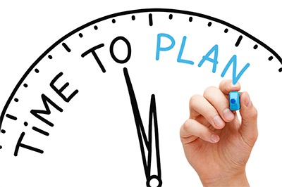
Pre-Trip Planning
Pre-trip planning refers to the practice of taking time at the beginning of your shift to develop a good plan for the day before you ever get behind the wheel of your vehicle. The pre-trip plan should always include vehicle readiness, mapping your route of travel for the day as well as determining your equipment and product needs and checking PPE.
Notes:
Poor pre-trip planning is a type of focus thief and it is entirely preventable. Not having a carefully planned route of travel, not knowing exactly where you are going or what road to take at an intersection can cause you to become focused on signs and numbers rather than hazards and other drivers. Whatever you do, don’t try reading a map or looking for scraps of paper while you drive. These become in-cabin thieves and expose you more to risk.

Slide 5
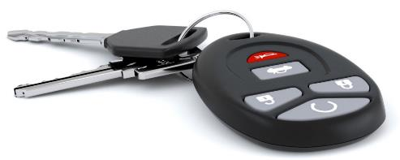
What is a pre-trip plan
Your plan for the time you will spend in the vehicle that day
When you ensure the vehicle is in good working order.
Safety-related vehicle parts (tires, fluids, brakes, windshield wipers, lights)
Car-related (seat adjustment, mirror adjustment, seat belt)
Comfort-related (air conditioning/heat, music, navigation)
Emergency kit (spare tire and tools to change it, flashlight, flares, jumper cables)
Unsecured items in the cab (cups, bottles, pens, phones, tablets, trash)
Personal items (sunglasses, hat, water)
Necessary papers (insurance, registration, accident report)

Slide 6
A Good Plan
General Components of a Good Plan
MAP YOUR ROUTE take note of construction zones, rush hour, events, school zones, etc.
INSPECT YOUR VEHICLE
TAKE INVENTORY OR YOUR PRODUCT
INVENTORY AND INSPECT PERSONAL PROTECTIVE EQUIPMENT (PPE)
INSPECT TOOLS AND EQUIPMENT
PLAN TIME TO MAKE/RETURN CALLS
PLAN TIME FOR LUNCH
Notes:
The pre-trip plan should always include mapping your route of travel for the day as well as determining your equipment and product needs and checking PPE. The

Slide 7
Personal Benefits of a Good Plan
ELIMINATES BACK-TRACKING
IMPROVES YOUR ATTITUDE
ELIMINATES SURPRISES
ENSURES EQUIPMENT AND VEHICLE READINESS
QUANTIFIES DAILY SUPPLY NEEDS
REDUCES STRESS
IMPROVES EFFICIENCY
INCREASES INCOME
SAVES YOU TIME
REDUCES THE CHANCE OF AUTO ACCIDENTS
REDUCES THE CHANCE OF PERSONAL INJURY
IMPROVES ORGANIZATION
Notes:
A well-planned day holds personal benefits too. Good pre-trip planning might allow you to stop for lunch or shorten your workday. In addition, a planned day is much less stressful than the
constant surprises that plague an unplanned workday. Less stress leaves you with more energy at the end of your day to enjoy your life outside of work and you will complete your job with less
chance of injury.

Slide 8
Vehicle Check – Physical Inspection
Circle check every day
Objects under or behind
Damage to any part of body
Fluids under the vehicle
Tire inflation
Ladders secured
Access hatches closed and locked
Windows and lights clean

Slide 9
5 things before starting your vehicle
Walk around your car
Seat position
Mirrors
Seatbelt
Listen as you start the car
mikechimmy
Tires, bumpers, scratches, dings, dents and no obstructions around you.
Hear any problems as the engine cranks.
Starting your driving experience in the best way.

Slide 10
Keep the following tips in mind for safe driving:
Don’t drive when drowsy. This could significantly impact your driving ability. Getting a good night’s sleep before leaving can make a huge difference.
Avoid distractions. Don’t use the cell phone to make a call or text. If it’s necessary to respond to a phone call or message, pull over or wait till your next stop. Don’t eat or drink while driving; instead, pull off to a rest stop or another safe area.
Driving in the dark. It can be difficult to stay focused when driving in the dark. Put on some music or keep the window cracked. Be sure your headlights and windshield are clean and you have your glasses; if needed.
Don’t drive impaired. It goes without saying that consuming alcohol before getting behind the wheel is not only illegal but dangerous. Yet motorists don’t always think about the potential consequences of taking a prescription medication that may interfere with their ability to safely operate a motor vehicle. Stay away from any substances that could impair your driving abilities.

Slide 11
Before you start your travel for the day plan for your safe return
Consider the safety of your vehicle, items for your comfort in your cab, items you need to do your work safely, and your focus for your drive.

Slide 12
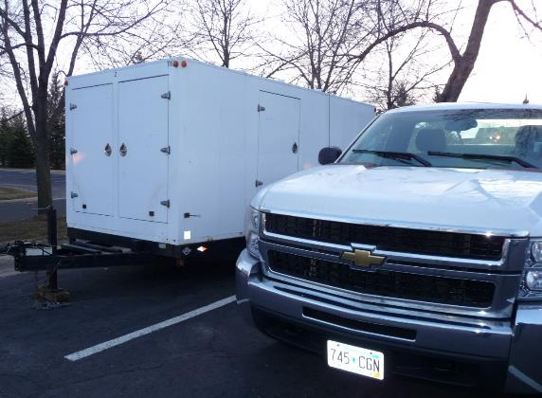
Discussion
Do you use a process like this?
Do you see a value?
Can/should you develop a process?
Can we make this a “habit”?

