Slide 1

Vehicle Collision: Now What?

Slide 2
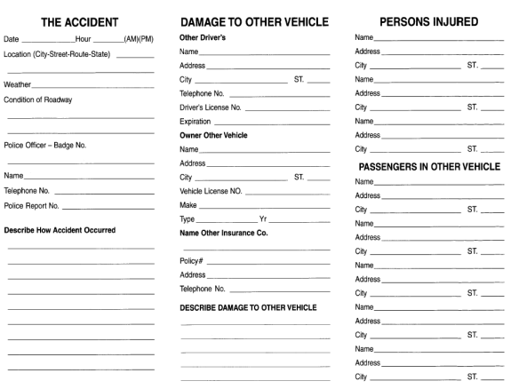
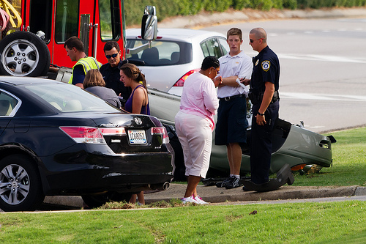

Vehicle Collision: What to do next?
On scene
1. Determine if vehicle is drivable
2. Contact authorities and manager
3. Complete accident report 4. Take photos

Slide 3
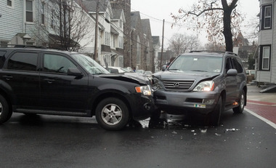
Move to a safe area (if possible)
If it's safe to do so and you are not injured, move your vehicle out the path of travel, possibly to the shoulder of the road. If moving your car is not possible, turn on your hazard flashers to warn other drivers that your vehicle is immobilized.
Notes:
Get yourself out of harms way.

Slide 4
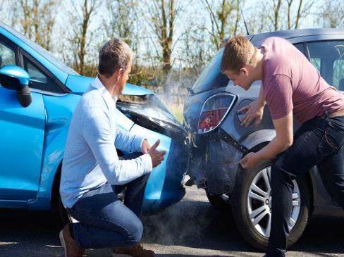
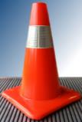
Stop your vehicle and get out
Make sure your vehicle is no longer moving, turn off the engine, shift to park, or set the hand brake if you drive a manual. Check your surroundings before opening the door.
If you have flares, cones or hazard triangles, consider using them.

Slide 5
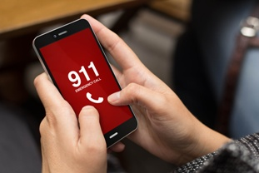
Check on others involved
Check on all parties involved, including drivers, passengers, and pedestrians, to make sure no one is injured. Call 911 if anyone is injured. Even a minor symptom like dizziness should be medically evaluated.

Slide 6
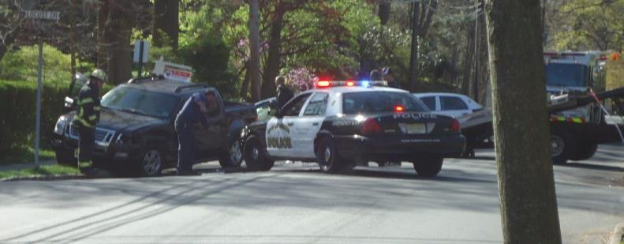
Call the police to the scene
Even in minor accidents, a police accident report can be of value when dealing with your insurance company and other drivers. Let the police objectively judge events and determine who, if anyone, is at fault in the crash. If the police can't make it to the scene (which is more likely if there are no injuries), you can file an accident report through your state's DMV.

Slide 7
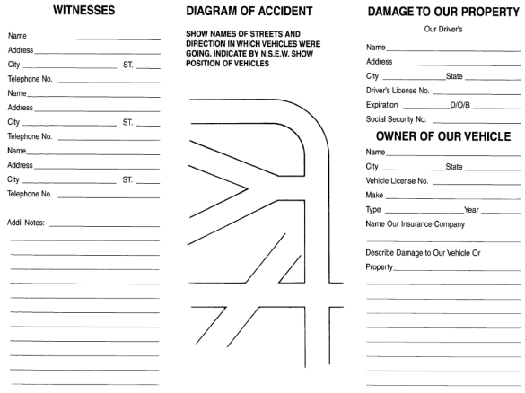
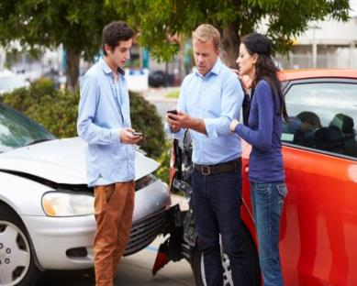
Gather information
Try to write down as much info as possible in the accident aftermath, including:
Driver and passenger names
License plate numbers
Insurance coverage details
Makes and models of all vehicles involved
Contact information for any eyewitnesses
Exact location and time of the accident
The name and badge number of any responding police officers

Slide 8
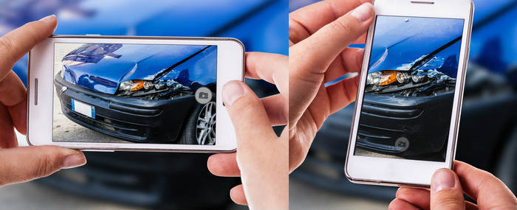
Document the scene
If you have a smartphone with a camera, snap some photos of the accident scene and vehicles involved.
Take photos of damage, no damage, location, and all vehicles involved.

Slide 9
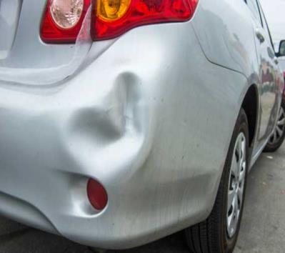
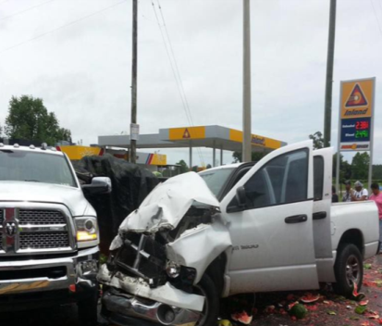
Determine if vehicle is drivable
Drivable
Non Drivable
If you feel uncomfortable driving a vehicle after a crash, have it towed to the nearest repair facility or contact your manager for direction (if applicable).

Slide 10
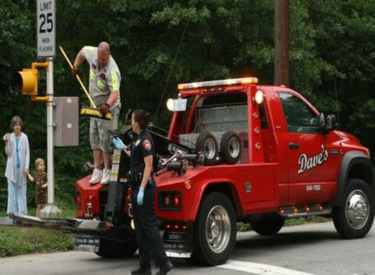
Who to contact?
If you are driving for your company, you should immediately notify your manager. This includes driving a company vehicle, personal vehicle, etc.
If you are in an accident involving your company vehicle, there will be specific steps to follow on reporting the accident.
If your vehicle is determined to be non drivable, you will need to call a tow company to have it towed to the nearest repair facility. Before towing your company vehicle, be sure to know how your company wants it handled.

Slide 11
Glove Box Accident Report

Slide 12
Vehicle Collision: What to do next?
Pack a Safety Kit
Camera/Phone: Keep track of all the damages for your insurer by snapping a few photos. Pen and paper: To record contact and insurance info at the scene and on the glove box accident report.
First-aid kit: A comprehensive one will let you quell minor bumps and bruises
Use these handy tips to make sure you're ready for the unpredictable:
Keep important documents easily accessible (ID, additional insurance company contact information, vehicle registration, health plan information, etc.).
Have your phone with you and charged whenever you hit the road.
Keep loose items in the center console or glove box, and not on the seats, where they can get lost or fly around in an accident.

Slide 13
Vehicle Collision: Be Prepared.
Questions
Discussion

Slide 14
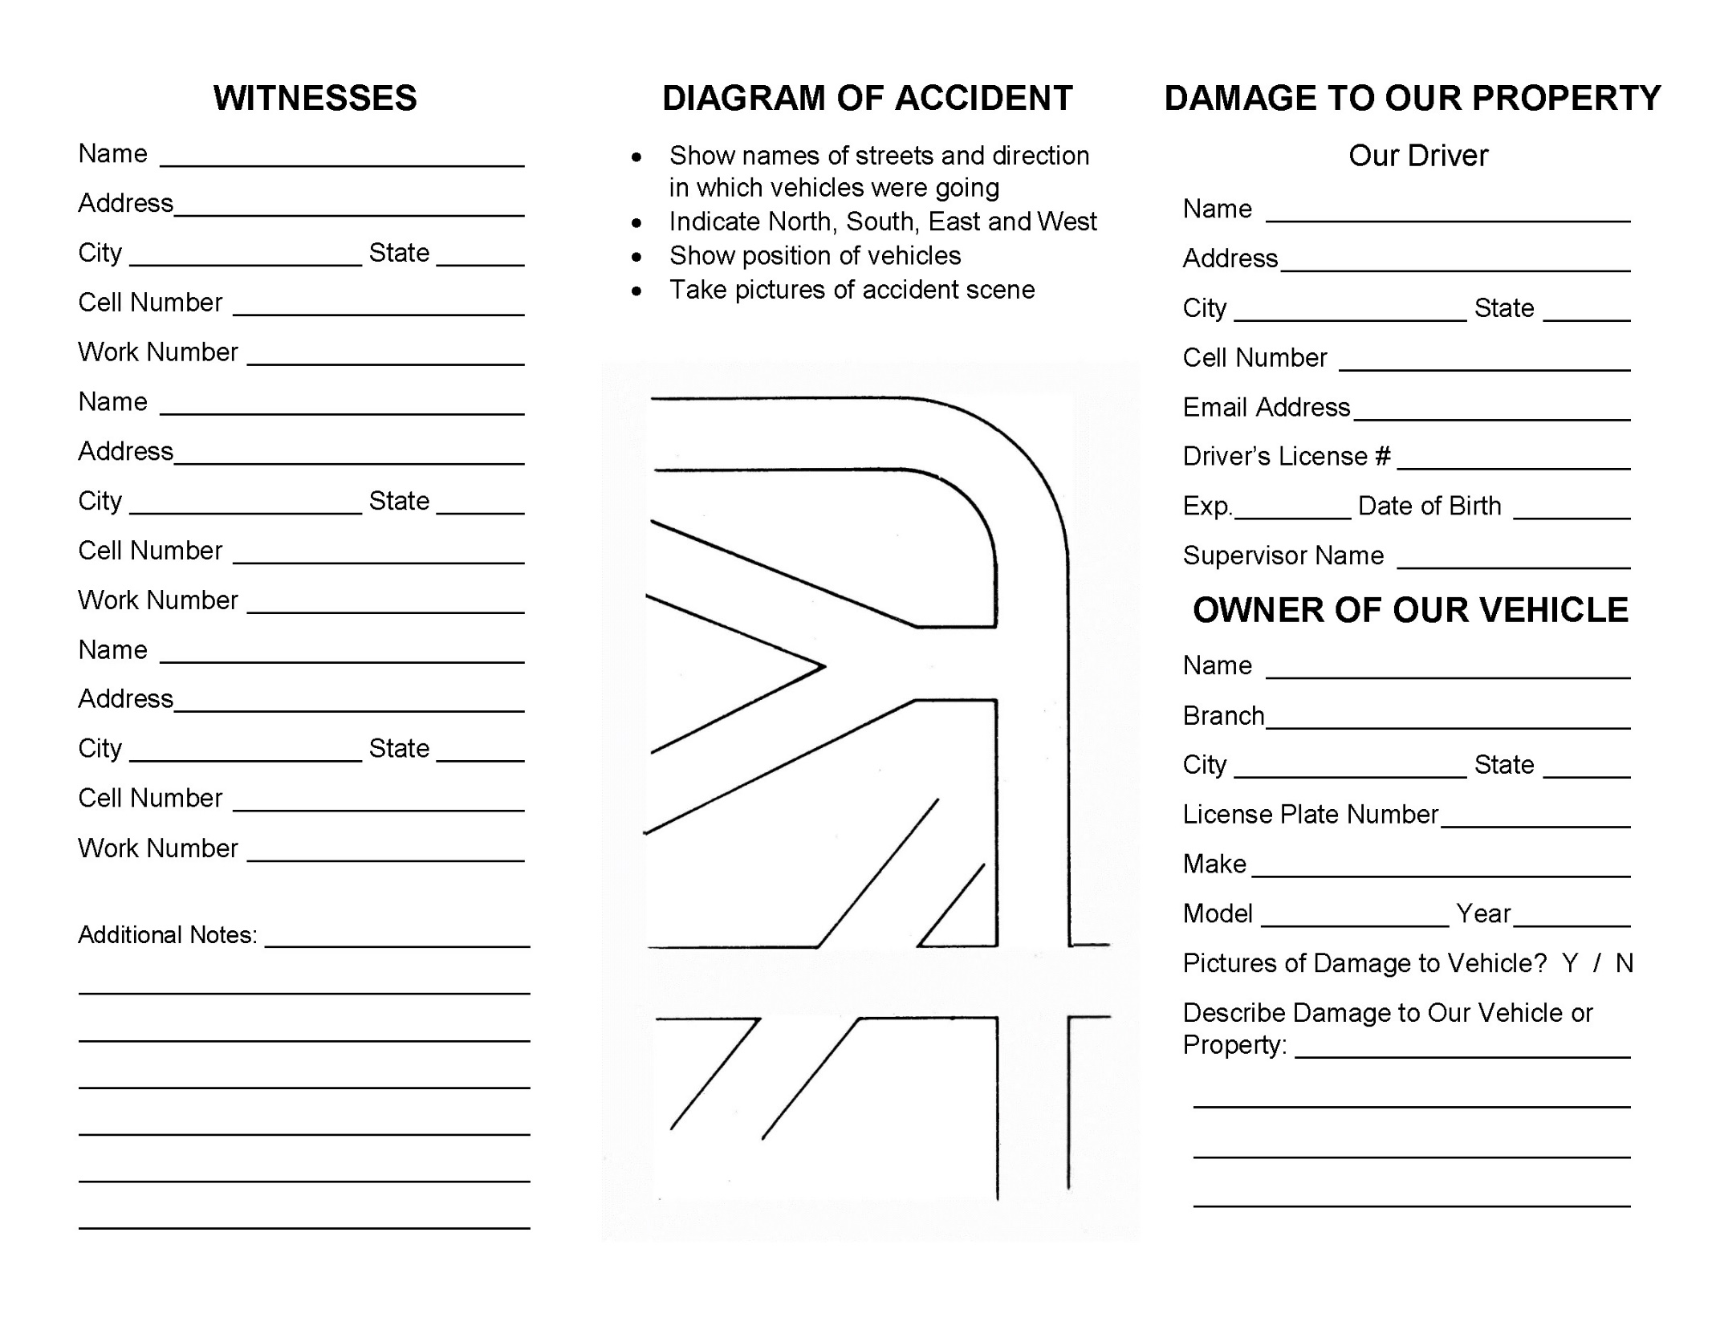

Slide 15
