Slide 1

Basic Ladder Safety
The information in this document was obtained from sources which, to the best of the writer’s knowledge, are authentic and reliable. Arthur J. Gallagher & Co. makes no guarantee of results and assumes no liability in connection with either the information or recommendations obtained in this document. Moreover, it cannot be assumed that every acceptable procedure is included in this document or that abnormal or unusual circumstances may not warrant or require further or additional procedures.
Notes:
Each trainee should have a company ladder inspection form.
Each trainee should have a quiz documentation form.

Slide 2
Objectives:
Create awareness of what actually happens in the field
Show you examples of the crazy things employees will do
Instruct on proper ladder use, inspection, set-up and handling
Discuss ladder use challenges

Slide 3
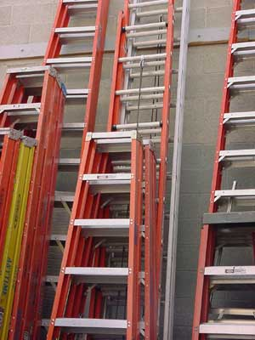
Ladder Requirements
Maximum length
  Single ladders - 30 feet long
  Extension ladders - 60 foot long
  Portable step ladders - 20 feet long
    Shall be equipped with metal spreader or locking device
All ladders should be maintained in good condition at all times
Notes:
Visually inspect ladders before each use
According to the National Safety Council, every year 400 – 600 people are killed and another 30,000 are seriously injured on ladders.
Check for broken, loose or missing steps or rungs
Check rails for structural damage
Make sure rungs are free of grease, oil, water, ice, or other slippery materials
If a ladder is broken or damaged, take it out of service immediately!

Slide 4
Job site assessment
A job site should be assessed prior to ladder use
  Look for power lines
  Uneven or unstable surfaces
  Doors and windows
  Traffic
  Structure stability
  Weather
  Height of area to reach
  Inspect your ladder prior to each use

Slide 5

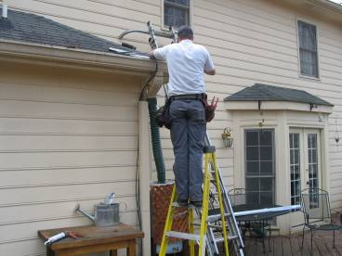
Choose the right ladder
The ladder you choose should be tall enough to allow you to work at the desired height without standing on the top rung or step of the ladder.

Slide 6
Inspect your ladders!
When: Prior to each use
What to look for:
Extension Ladders
  Ropes
    Missing
    Frayed
    Not connected properly
  Structure
    Bent Rails
    Damaged Rungs
    Loose rungs (can be moved by hand)

Slide 7
Inspect Your Ladders!
    Extension ladders cont’d:
    Damaged feet
    Damaged extension locks
      Don’t seat properly
      Missing
      Loose or broken
Step Ladders
  Wobbles from side to side
  Loose or bent hinge spreaders
  Broken stop on hinge spreaders
  Loose Hinges

Slide 8
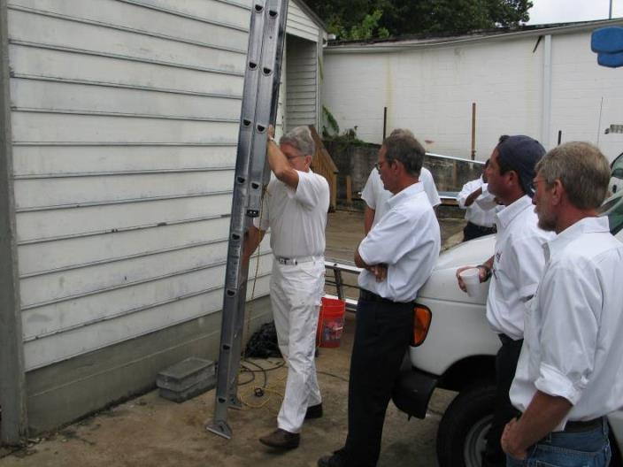
Ropes not connected properly
NO

Slide 9
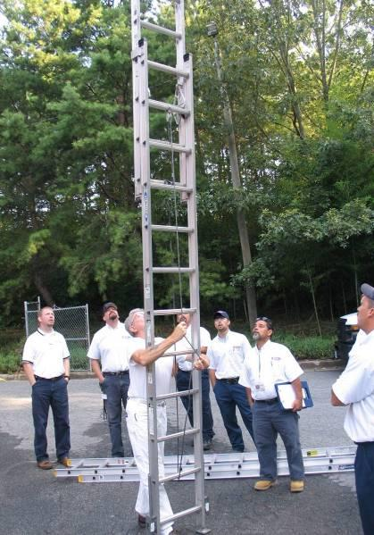
Ropes: connected properly
Yes

Slide 10
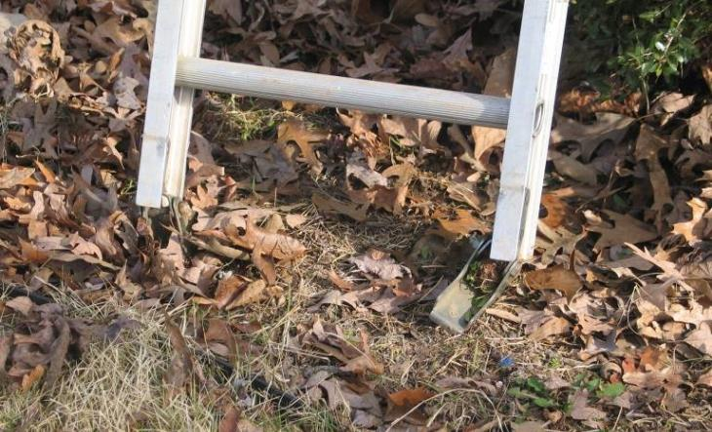
Bent Feet

Slide 11
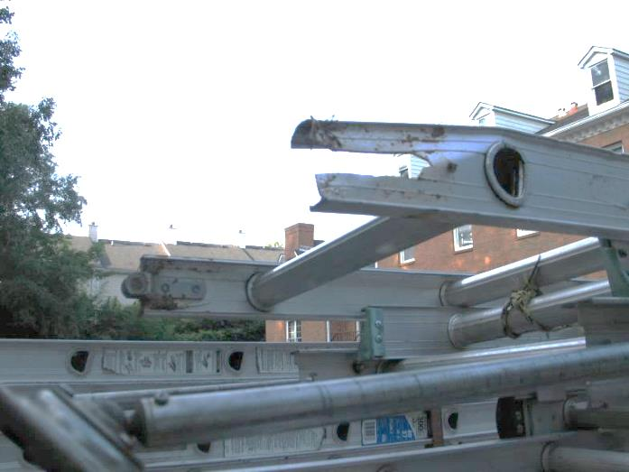
Missing feet

Slide 12
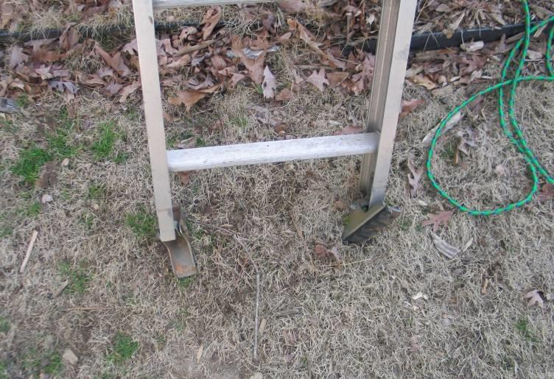
Where was this ladder used?

Slide 13
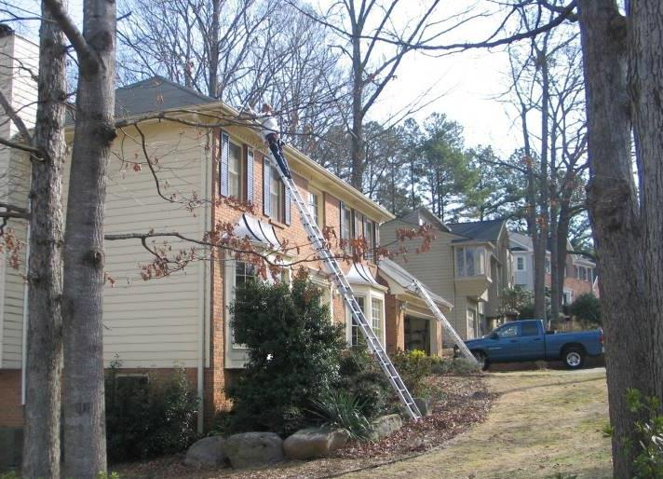
At this home!

Slide 14
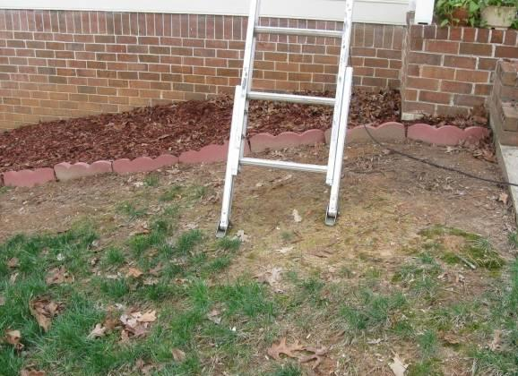
Prevent a Fall
Placed with secure footing, or shall be latched or held in position
YES!

Slide 15
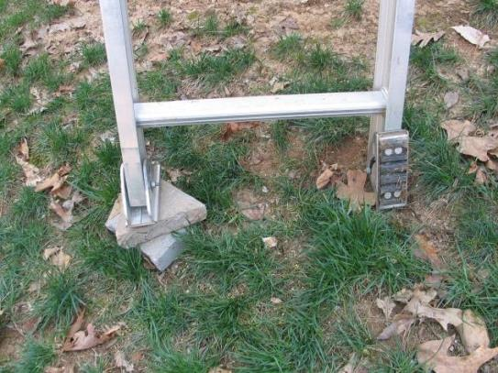
Prevent a Fall
Placed with secure footing, or shall be latched or held in position
NO!

Slide 16
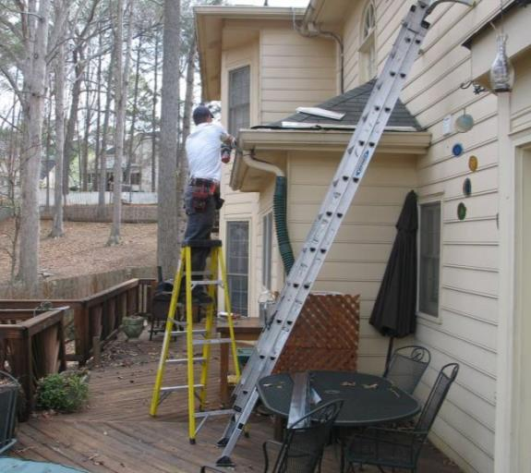
Step Ladders
Never use a stepladder in a closed position as a straight ladder.
Never stand on the top or second step down from the top of a step ladder.
Be sure to check ladder weight rating and remember load weight.

Slide 17
Prevent a Fall
3 Point Contact
  One hand secure and two feet secure
  Two hands secure and one foot secure

Slide 18
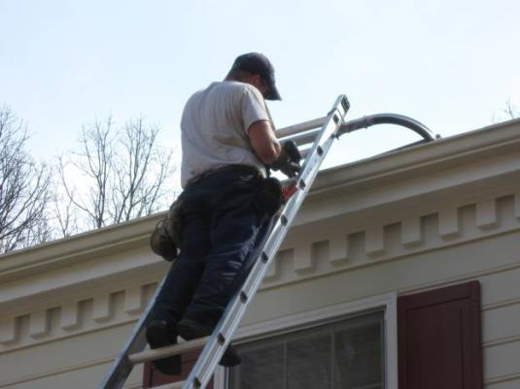
Prevent a Fall
Always face forward and utilize the three point contact rule.
YES!

Slide 19
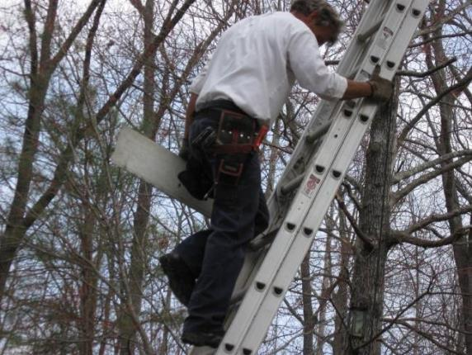
Prevent a Fall
Always face forward and utilize the three point contact rule.
NO!

Slide 20
Prevent a Fall
Maintain four (4) to one (1) ratio when setting up an extension ladder.
Example:
  The gutter is 28 feet from the ground
  28 ÷ 4 = 7
  The bottom of the ladder should be 7 feet out from the point the ladder touches the house

Slide 21
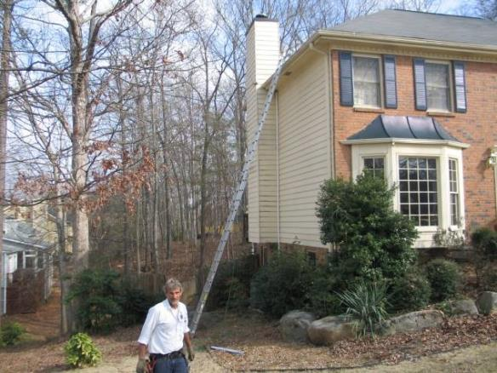
Prevent a Fall
28’
7’

Slide 22
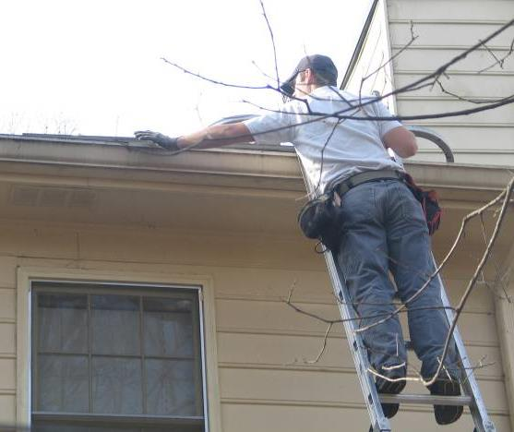
Prevent a Fall
When reaching out from a ladder, keep your belt buckle or the midpoint of your body between the rails to prevent overreaching.
YES!

Slide 23
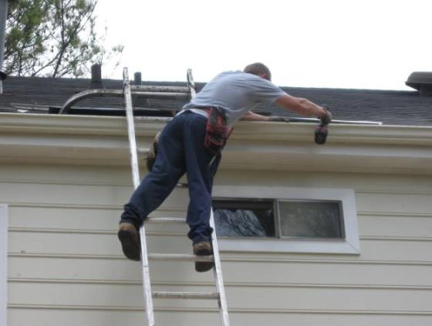
Prevent a Fall
When reaching out from a ladder, keep your belt buckle or the midpoint of your body between the rails to prevent overreaching.
NO!

Slide 24
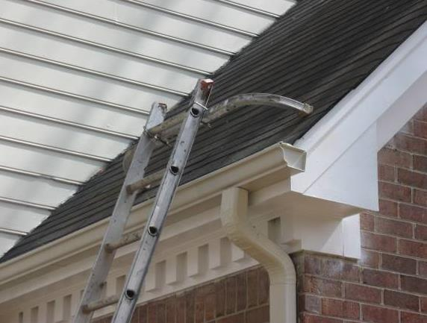
Prevent a Fall
Stabilize the top so that the ladder does not shift from side to side.
Ladder Stabilizer

Slide 25
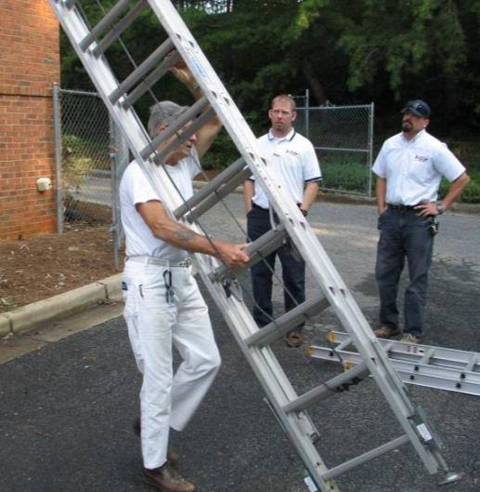
Carrying Ladders
Notes:
Carrying ladders practice using your ladders.

Slide 26
Securing ladders to vehicles
Use heavy duty ratchet straps
Use bicycle cable lock to secure
Bolt the ladder to the ladder rack
Walk around the vehicle and check the ladders prior to departing the location.
Notes:
Also best done with hands on practice using your ladders and your vehicles and your specific ladder racks and securing methods.

Slide 27
Ladder accessories

Slide 28
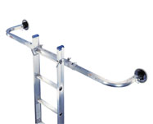
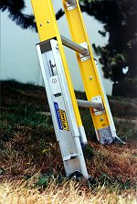
Ladder Stabilizers
Adjustable feet

Slide 29
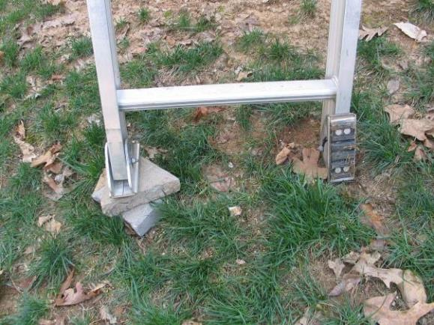
Why spend $139 on adjustable feet?
To prevent this

Slide 30
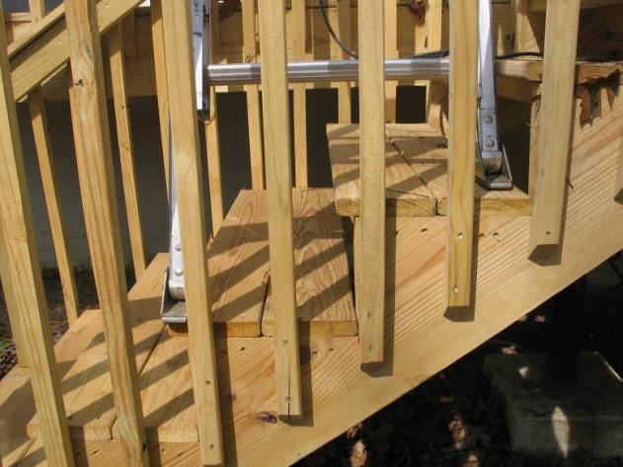
And allow this . . .

Slide 31
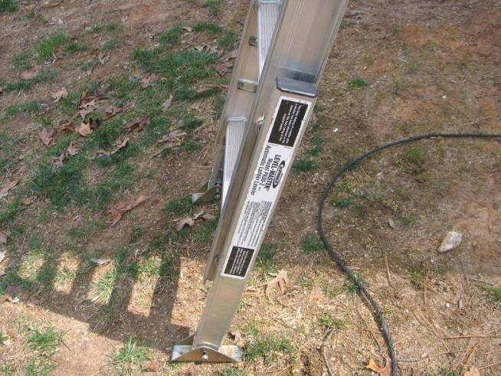
And this . . .

Slide 32
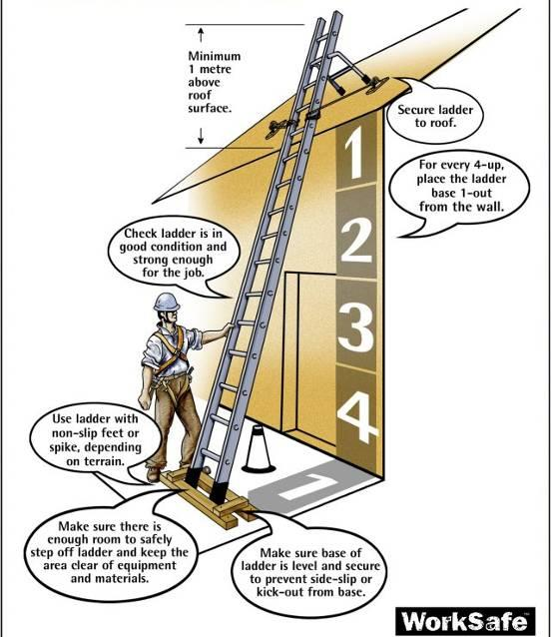
Summary

Slide 33
True or False
If a 4 to 1 ratio is recommended for ladder set-up, a 6 to one ratio should be even better.
An extension ladder can be used as a scaffold platform if you set it up between two stepladders.
A job site should be assessed prior to ladder use.
A ladder should be inspected once per year.
Safe ladder use involves keeping 3 points of contact with the ladder while climbing.
A step-ladder should never be used in the closed position.
In the pre-work job site assessment, it is important to consider surface and height you need to reach.
A ladder should be inspected by the user prior to each use.

Slide 34
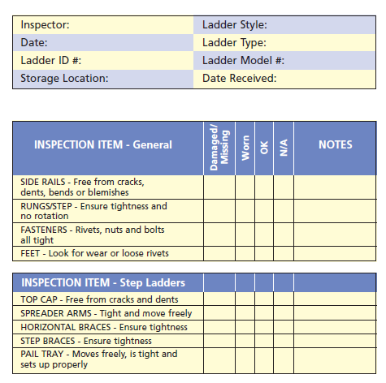

Slide 35
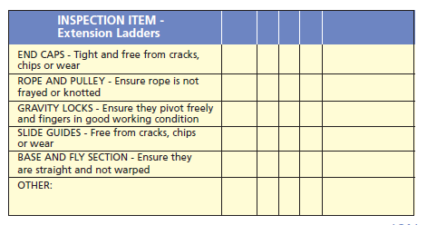
The information in this document was obtained from sources which, to the best of the writer’s knowledge, are authentic and reliable. Arthur J. Gallagher & Co. makes no guarantee of results and assumes no liability in connection with either the information or recommendations obtained in this document. Moreover, it cannot be assumed that every acceptable procedure is included in this document or that abnormal or unusual circumstances may not warrant or require further or additional procedures.

Slide 36
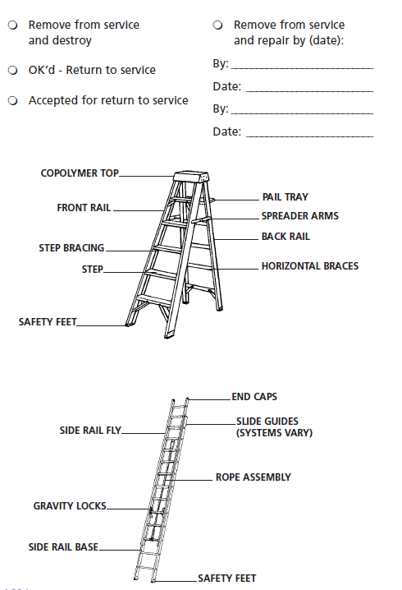

Slide 37
